Slide 1
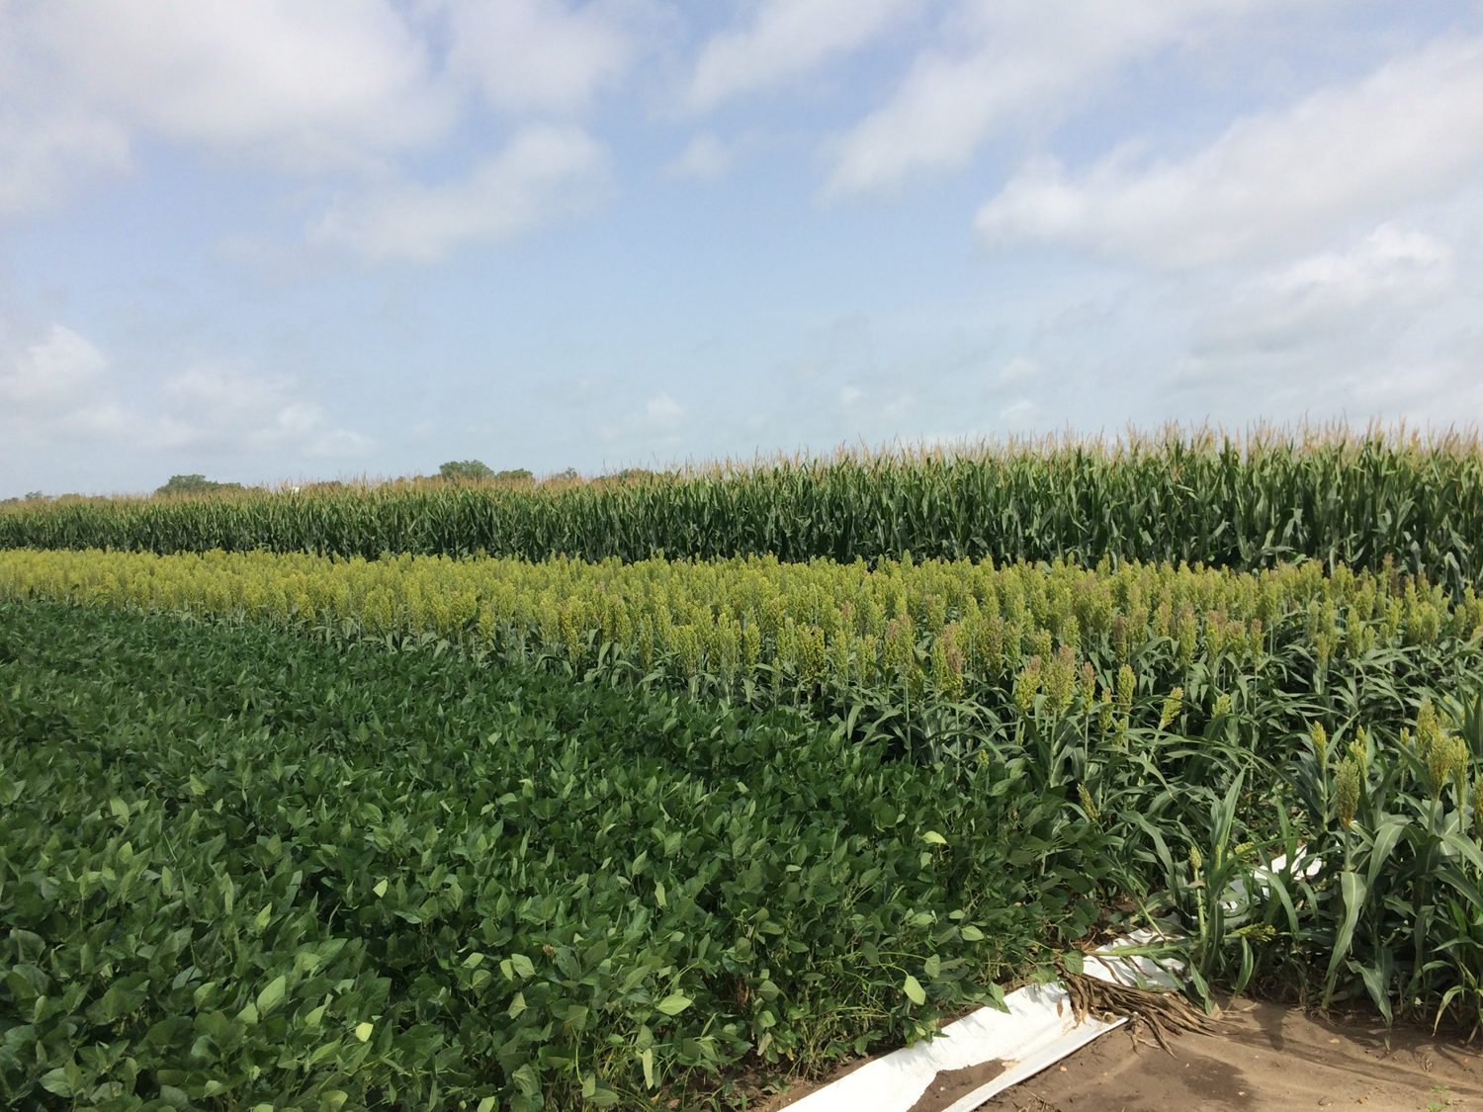
Effects of the Introduction of Feed Grains into Mid-South Soybean Production Systems
Gurpreet Kaur, B.R. Golden, D. Reynolds, J.M. Orlowski, T. Irby, W.J. Ross, G. Stevens, J. Copes, C.B. Neely, and L.L. Falconer

Slide 2
INTRODUCTION
Midwest US:
3-19% yield advantage for corn after soybean.
10% yield advantage for soybean after corn compared to continuous soybean.
What is the advantage for corn/soybean rotation in the Midsouth US?
Objective:
Determine the effect of crop rotations on:
Crop yields (corn, soybean, sorghum, wheat)
Soil properties
Net returns

Slide 3
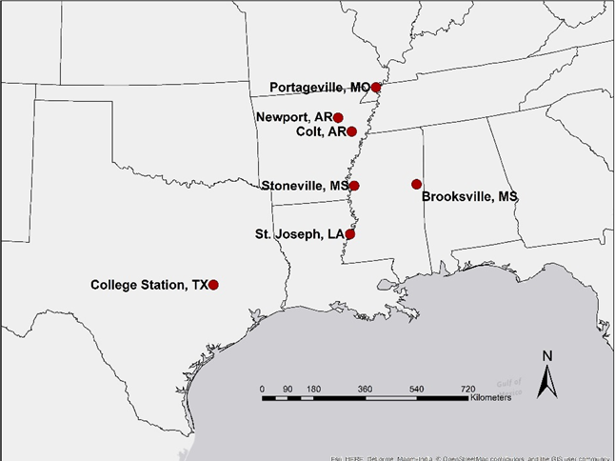
STUDY LOCATIONS

Slide 4
CROP ROTATIONS
Crop Rotations | 2014 |  |  |  |  |  |  | 2015 |  |  |  |  |  |  |  | 2016 |  |  |  |  |  |  | 2017 |  |  |  |  |  |  | 2018 |  |  |  |  |  |  | 2019
1. Continuous Corn |  |  |  | CORN |  |  |  |  |  |  |  | CORN |  |  |  |  |  |  | CORN |  |  |  |  |  |  | CORN |  |  |  |  |  |  | CORN |  |  |  |  |  |  | CORN
2. Continuous Soybean |  |  |  | SOY |  |  |  |  |  |  |  | SOY |  |  |  |  |  |  | SOY |  |  |  |  |  |  | SOY |  |  |  |  |  |  | SOY |  |  |  |  |  |  | SOY
3. 1:1 Soybean/Corn |  |  |  | SOY |  |  |  |  |  |  |  | CORN |  |  |  |  |  |  | SOY |  |  |  |  |  |  | CORN |  |  |  |  |  |  | SOY |  |  |  |  |  |  | CORN
4. 2:1 Soy/Soy/Corn |  |  |  | SOY |  |  |  |  |  |  |  | SOY |  |  |  |  |  |  | CORN |  |  |  |  |  |  | SOY |  |  |  |  |  |  | SOY |  |  |  |  |  |  | CORN
5. 1:2 Soy/Corn/Corn |  |  |  | SOY |  |  |  |  |  |  |  | CORN |  |  |  |  |  |  | CORN |  |  |  |  |  |  | SOY |  |  |  |  |  |  | CORN |  |  |  |  |  |  | CORN
6. Continuous Corn |  |  |  | CORN |  |  |  |  |  |  |  | CORN |  |  |  |  |  |  | CORN |  |  |  |  |  |  | CORN |  |  |  |  |  |  | CORN |  |  |  |  |  |  | CORN
7. Continuous Soybean |  |  |  | SOY |  |  |  |  |  |  |  | SOY |  |  |  |  |  |  | SOY |  |  |  |  |  |  | SOY |  |  |  |  |  |  | SOY |  |  |  |  |  |  | SOY
8. 1:1 Soybean/Corn |  |  |  | SOY |  |  |  |  |  |  |  | CORN |  |  |  |  |  |  | SOY |  |  |  |  |  |  | CORN |  |  |  |  |  |  | SOY |  |  |  |  |  |  | CORN
9. 1:1 Soybean/Sorghum |  |  |  | SOY |  |  |  |  |  |  |  |  | SORG |  |  |  |  |  | SOY |  |  |  |  |  |  |  | SORG |  |  |  |  |  |  | SOY |  |  |  |  |  |  | SORG
10. Continuous Sorghum |  |  |  |  | SORG |  |  |  |  |  |  |  | SORG |  |  |  |  |  |  | SORG |  |  |  |  |  |  | SORG |  |  |  |  |  |  | SORG |  |  |  |  |  |  | SORG
11. Corn/Wheat/DC Soy/Corn |  |  |  | CORN |  | WHEAT |  |  |  |  |  |  | SOY |  |  |  |  |  | CORN |  |  |  |  |  |  | CORN |  | WHEAT |  |  |  |  |  | SOY |  |  |  |  |  | CORN
12. Corn/Soy/Wheat/DC Soy |  |  |  | CORN |  |  |  |  |  |  |  | SOY |  | WHEAT |  |  |  |  |  | SOY |  |  |  |  |  | CORN |  |  |  |  |  |  | SOY |  | WHEAT |  |  |  |  |  | SOY
12 Crop rotations: Irrigated (7) and Dryland (5)
2-yr rotations: 2 rotation cycles completed in 2017
3-yr rotations: 1 rotation cycle completed in 2016

Slide 5
TREATMENTS
Irrigated Cont. Corn No Res Mgmt | Irrigated Cont. Soybean | 1:1 Irrigated Soy/Corn Res Mgmt | 2:1 Irrigated Soy/Corn No Res Mgmt | 1:2 Irrigated Soy/Corn Res Mgmt | Dryland Cont. Corn No Res Mgmt | Dryland Cont. Soybean | 1:1 Dryland Soy/Corn Res Mgmt | 1:1 Dryland Soy/Sorg No Res Mgmt | Dryland Cont. Sorghum Res Mgmt | Irrigated Corn/Wht/Soy No Res Mgmt | Irrigated Corn/Soy /Wht Res Mgmt
Alley
Irrigated Cont. Corn Res Mgmt | Irrigated Cont. Soybean | 1:1 Irrigated Soy/Corn No Res Mgmt | 2:1 Irrigated Soy /Corn Res Mgmt | 1:2 Irrigated Soy/Corn No Res Mgmt | Dryland Cont. Corn Res Mgmt | Dryland Cont. Soybean | 1:1 Dryland Soy/Corn No Res Mgmt | 1:1 Dryland Soy/Sorg Res Mgmt | Dryland Cont. Sorghum No Res Mgmt | Irrigated Corn/Wht/Soy Res Mgmt | Irrigated Corn/Soy /Wht No Res Mgmt
1 | 2 | 3 | 4 | 5 | 6 | 7 | 8 | 9 | 10 | 11 | 12
Irrigated
Dryland
Irrigated
Residue Management: Burn vs No-burn

Slide 6
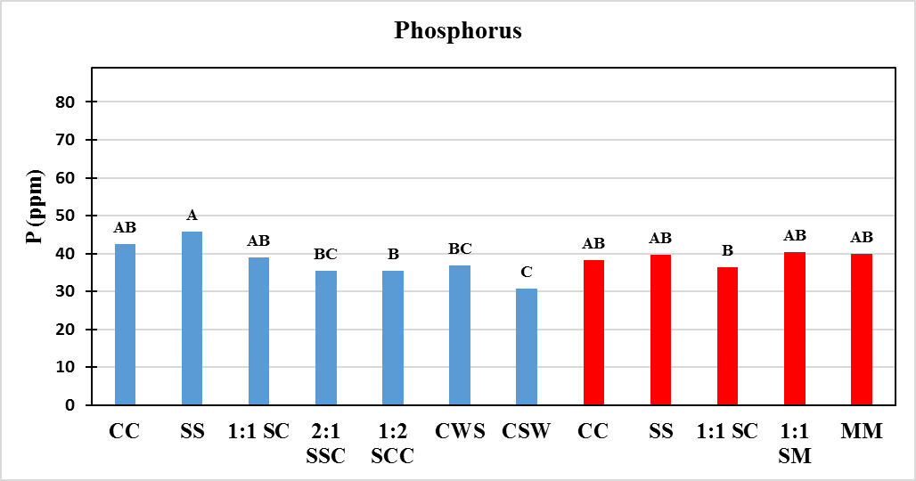
SOIL P CONCENTRATION
Stoneville, MS

Slide 7
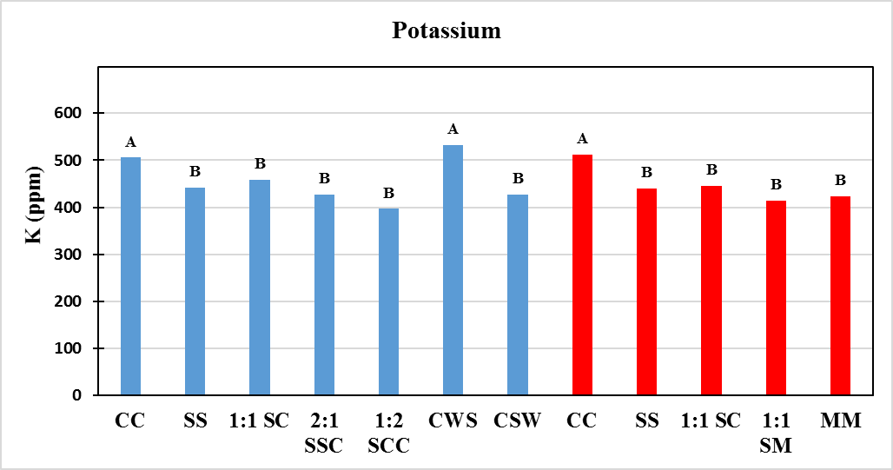
SOIL K CONCENTRATION
Stoneville, MS

Slide 8
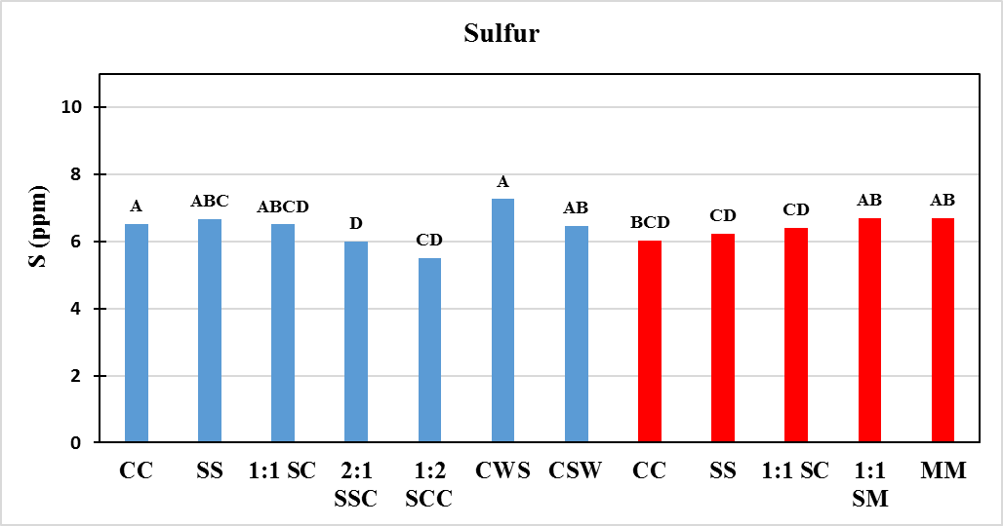
SOIL S CONCENTRATION
Stoneville, MS

Slide 9
SOIL Ca CONCENTRATION
Stoneville, MS

Slide 10
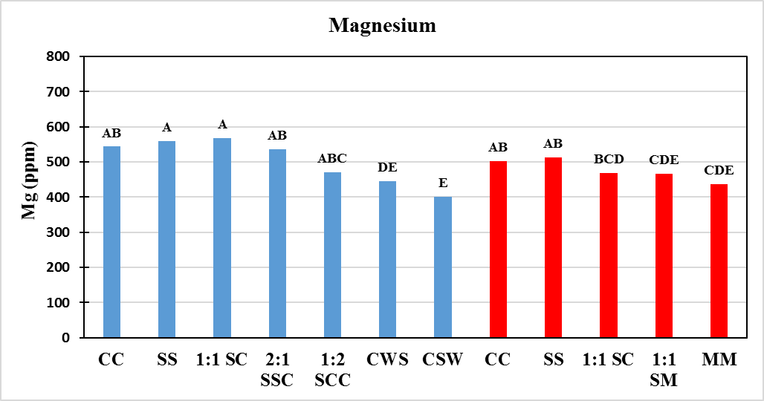
SOIL Mg CONCENTRATION
Stoneville, MS

Slide 11
PROGRESS
2017 post harvest nematode samples and soil nutrient samples were analyzed by this summer.
Publications: Journal articles
Crop rotation influences on corn and soybean yield and economics in the Mid-south US
Grain sorghum yield and net returns as affected by the crop rotation under dryland conditions
Long-term management effects on soil properties in corn-soybean cropping systems in Mid-south

Slide 12
PROGRESS
Nematode samples and soil nutrient samples will be collected after harvesting crops this year.
Planting wheat in rotation number 12.
Poster presentation of soil’s results in ASA-CSSA conference in Baltimore, MD in Nov.
Publications: Extension article or bulletin for each state.

Slide 13
Thank You

Slide 14
Crop | Units | N | P2O5 | K20
Corn (grain) | lb/bu | 0.90 | 0.44 | 0.27
Soybeans | lb/bu | 3.8 | 0.84 | 1.30
Sorghum (grain) | lb/bu | 0.66 | 0.39 | 0.27
Wheat | lb/bu | 1.3 | 0.60 | 0.34
Table 1. Macronutrient removal by selected crops. Data derived from International Plant Nutrition Institute
Nutrient Database, North Carolina State University Extension Service Publication AG-439, Section 4
of the Mississippi NRCS Field Office Technical Guide, and http://plants.usda.gov/.

Slide 15
ACKNOWLEDGEMENT

