Slide 1
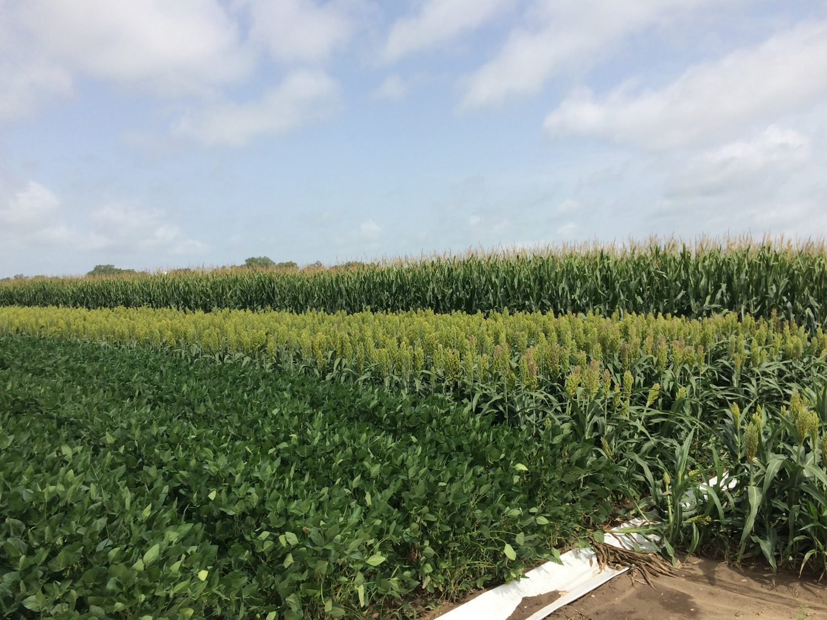
Effects of the Introduction of Feed Grains into Mid-South Soybean Production Systems
Gurpreet Kaur, Dan Reynolds, B.R. Golden, T. Irby, W.J. Ross, G. Stevens, J. Copes, C.B. Neely, and L.L. Falconer

Slide 2
RATIONALE AND JUSTIFICATION
Midwest US:
3-19% yield advantage for corn after soybean.
10% yield advantage for soybean after corn compared to continuous soybean.
What is the advantage for corn/soybean rotation in the Midsouth US?
Objective:
Determine the effect of crop rotations and residue management on crop yields (corn, soybean, sorghum), net returns and soil properties in the Midsouthern US.

Slide 3
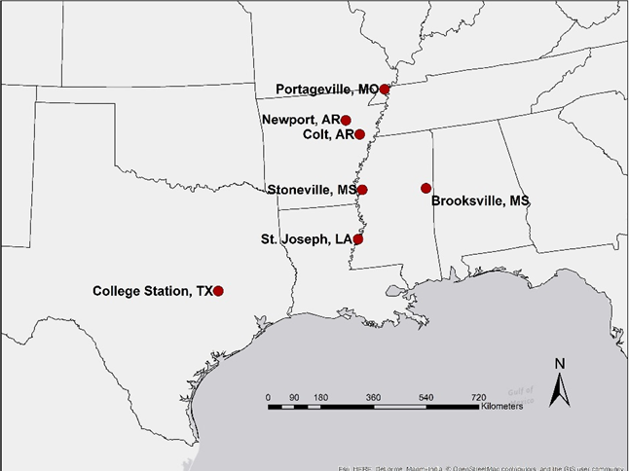
STUDY LOCATIONS

Slide 4
CROP ROTATIONS
Crop Rotations | 2014 |  |  |  |  |  |  | 2015 |  |  |  |  |  |  |  | 2016 |  |  |  |  |  |  | 2017 |  |  |  |  |  |  | 2018 |  |  |  |  |  |  | 2019
1. Continuous Corn |  |  |  | CORN |  |  |  |  |  |  |  | CORN |  |  |  |  |  |  | CORN |  |  |  |  |  |  | CORN |  |  |  |  |  |  | CORN |  |  |  |  |  |  | CORN
2. Continuous Soybean |  |  |  | SOY |  |  |  |  |  |  |  | SOY |  |  |  |  |  |  | SOY |  |  |  |  |  |  | SOY |  |  |  |  |  |  | SOY |  |  |  |  |  |  | SOY
3. 1:1 Soybean/Corn |  |  |  | SOY |  |  |  |  |  |  |  | CORN |  |  |  |  |  |  | SOY |  |  |  |  |  |  | CORN |  |  |  |  |  |  | SOY |  |  |  |  |  |  | CORN
4. 2:1 Soy/Soy/Corn |  |  |  | SOY |  |  |  |  |  |  |  | SOY |  |  |  |  |  |  | CORN |  |  |  |  |  |  | SOY |  |  |  |  |  |  | SOY |  |  |  |  |  |  | CORN
5. 1:2 Soy/Corn/Corn |  |  |  | SOY |  |  |  |  |  |  |  | CORN |  |  |  |  |  |  | CORN |  |  |  |  |  |  | SOY |  |  |  |  |  |  | CORN |  |  |  |  |  |  | CORN
6. Continuous Corn |  |  |  | CORN |  |  |  |  |  |  |  | CORN |  |  |  |  |  |  | CORN |  |  |  |  |  |  | CORN |  |  |  |  |  |  | CORN |  |  |  |  |  |  | CORN
7. Continuous Soybean |  |  |  | SOY |  |  |  |  |  |  |  | SOY |  |  |  |  |  |  | SOY |  |  |  |  |  |  | SOY |  |  |  |  |  |  | SOY |  |  |  |  |  |  | SOY
8. 1:1 Soybean/Corn |  |  |  | SOY |  |  |  |  |  |  |  | CORN |  |  |  |  |  |  | SOY |  |  |  |  |  |  | CORN |  |  |  |  |  |  | SOY |  |  |  |  |  |  | CORN
9. 1:1 Soybean/Sorghum |  |  |  | SOY |  |  |  |  |  |  |  |  | SORG |  |  |  |  |  | SOY |  |  |  |  |  |  |  | SORG |  |  |  |  |  |  | SOY |  |  |  |  |  |  | SORG
10. Continuous Sorghum |  |  |  |  | SORG |  |  |  |  |  |  |  | SORG |  |  |  |  |  |  | SORG |  |  |  |  |  |  | SORG |  |  |  |  |  |  | SORG |  |  |  |  |  |  | SORG
11. Corn/Wheat/DC Soy/Corn |  |  |  | CORN |  | WHEAT |  |  |  |  |  |  | SOY |  |  |  |  |  | CORN |  |  |  |  |  |  | CORN |  | WHEAT |  |  |  |  |  | SOY |  |  |  |  |  | CORN
12. Corn/Soy/Wheat/DC Soy |  |  |  | CORN |  |  |  |  |  |  |  | SOY |  | WHEAT |  |  |  |  |  | SOY |  |  |  |  |  | CORN |  |  |  |  |  |  | SOY |  | WHEAT |  |  |  |  |  | SOY
12 Crop rotations: Irrigated (7) and Dryland (5)
2-yr rotations: 2 rotation cycles completed in 2017
3-yr rotations: 1 rotation cycle completed in 2016

Slide 5
TREATMENTS
Irrigated Cont. Corn No Res Mgmt | Irrigated Cont. Soybean | 1:1 Irrigated Soy/Corn Res Mgmt | 2:1 Irrigated Soy/Corn No Res Mgmt | 1:2 Irrigated Soy/Corn Res Mgmt | Dryland Cont. Corn No Res Mgmt | Dryland Cont. Soybean | 1:1 Dryland Soy/Corn Res Mgmt | 1:1 Dryland Soy/Sorg No Res Mgmt | Dryland Cont. Sorghum Res Mgmt | Irrigated Corn/Wht/Soy No Res Mgmt | Irrigated Corn/Soy /Wht Res Mgmt
Alley
Irrigated Cont. Corn Res Mgmt | Irrigated Cont. Soybean | 1:1 Irrigated Soy/Corn No Res Mgmt | 2:1 Irrigated Soy /Corn Res Mgmt | 1:2 Irrigated Soy/Corn No Res Mgmt | Dryland Cont. Corn Res Mgmt | Dryland Cont. Soybean | 1:1 Dryland Soy/Corn No Res Mgmt | 1:1 Dryland Soy/Sorg Res Mgmt | Dryland Cont. Sorghum No Res Mgmt | Irrigated Corn/Wht/Soy Res Mgmt | Irrigated Corn/Soy /Wht No Res Mgmt
1 | 2 | 3 | 4 | 5 | 6 | 7 | 8 | 9 | 10 | 11 | 12
Irrigated
Dryland
Irrigated
Residue Management: Burn vs No-burn

Slide 6
Stoneville, MS: Corn Yields 2018
Rotation | Residue Management | Crop Yield (Bu/A) | Difference (Bu/A) | Yield (combined)
Continuous Corn | Burn | 192 |  | 189a
 | No Burn | 186 | -6
1:2 Soy/Corn/Corn | Burn | 166 |  | 158b
 | No Burn | 151 | -15
Continuous Corn | Burn | 157 |  | 162b
 | No Burn | 166 | +9
Difference = No burn – Burn
“+” = No-burn > Burn
“-” = Burn > No-burn

Slide 7
Stoneville, MS: Soybean Yields 2018
Rotation | Residue Management | Yield (Bu/A) | Difference | Yield (Combined)
Continuous Soybean | No Burn | 39 |  | 38c
1:1 Soybean/Corn | Burn | 52 |  | 51ab
 | No Burn | 51 | -1
2:1 Soybean/Soybean/Corn | Burn | 42 |  | 42bc
 | No Burn | 41 | -1
Corn/wheat/DC Soybean/corn | Burn | 19 |  | 19d
 | No Burn | 19 | 0
Corn/Soybean/Wheat/DC Soybeans | Burn | 57 |  | 57a
 | No Burn | 56 | -1
Continuous Soybean | No Burn | 26 |  | 26d
1:1 Soybean/corn | Burn | 49 |  | 51ab
 | No Burn | 52 | +3
1:1 Soybean/Sorghum | Burn | 43 |  | 45bc
 | No Burn | 47 | +4
13 bu/A
25 bu/A
19 bu/A

Slide 8
Brooksville, MS: Corn Yields 2018
Rotation | Residue Management | Crop Yield (Bu/A) | Difference (Bu/A)
Continuous Corn | Burn | 66.38
 | No Burn | 52.15 | -14.23
1:2 Soybean/Corn/Corn | Burn | 52.80
 | No Burn | 65.98 | 13.18
Continuous Corn | Burn | 59.83
 | No Burn | 53.20 | -6.63
Difference = No burn – Burn
“+” = No-burn > Burn and “-” = Burn > No-burn
Lodging in corn
No significant differences between rotations and residue management

Slide 9
Brooksville, MS: Soybean Yields 2018
Rotation | Residue Management | Yield (Bu/A) | Difference
Continuous Soybean | No Burn | 49
1:1 Soybean/Corn | Burn | 53
 | No Burn | 51 | -2
2:1 Soybean/Soybean/Corn | Burn | 54
 | No Burn | 49 | -6
Continuous Soybean | No Burn | 53
1:1 Soybean/corn | Burn | 51
 | No Burn | 52 | +1
1:1 Soybean/Sorghum | Burn | 51

Slide 10
Portageville, MO: Corn Yields 2018
Rotation | Residue Management | Crop Yield (Bu/A) | Difference | Yield (combined)
Continuous Corn | Burn | 119 |  | 114b
 | No Burn | 109 | -10
1:1 Soybean/Corn | Burn | 168 |  | 164a
 | No Burn | 161 | -8
1:2 Soy/Corn/Corn | Burn | 161 |  | 161a
 | No Burn | 161 | 0.25
Continuous Corn | Burn | 115 |  | 110b
 | No Burn | 106 | -8
1:1 Soybean/Corn | Burn | 133 |  | 139 ab
 | No Burn | 145 | +12
47-50 bu/acre

Slide 11
Portageville, MO: Soybean Yields 2018
Rotation | Residue Management | Yield (Bu/A) | Difference | Yield (combined)
Continuous Soybean | No Burn | 56 |  | 56ab
2:1 Soybean/Soybean/Corn | No Burn | 49 |  | 49b
Continuous Soybean | No Burn | 53 |  | 53b
Corn/wheat/DC Soybean/corn | Burn | 33 |  | 37c
 | No Burn | 41 | +8
Corn/Soybean/Wheat/DC Soybeans | Burn | 66 |  | 65a
 | No Burn | 63 | -3

Slide 12
St. Joe, LA: Corn Yields 2018
Rotation | Residue Management | Crop Yield (Bu/A) | Difference | Yield (Combined)
Continuous Corn | Burn | 207 |  | 205a
 | No Burn | 202 | -15
1:2 Soy/Corn/Corn | Burn | 227 |  | 217a
 | No Burn | 207 | -20
Continuous Corn | Burn | 177 |  | 182b
 | No Burn | 188 | 11
Difference between irrigation and dryland rotation = 23-35 bu/acre
Difference = No burn – Burn
“+” = No-burn > Burn
“-” = Burn > No-burn

Slide 13
St. Joe, LA: Soybean Yields 2018
Rotation | Residue Management | Yield (Bu/A) | Difference
Continuous Soybean | No Burn | 71
1:1 Soybean/Corn | Burn | 68
 | No Burn | 66 | -2
2:1 Soybean/Soybean/Corn | Burn | 69
 | No Burn | 68 | -1
Corn/wheat/DC Soybean/corn | Burn | 55
 | No Burn | 56 | 1
Corn/Soybean/Wheat/DC Soybeans | Burn | 64
 | No Burn | 64 | 0
Continuous Soybean | No Burn | 76
1:1 Soybean/corn | Burn | 79
 | No Burn | 76 | -3
1:1 Soybean/Sorghum | Burn | 75
 | No Burn | 77 | +2

Slide 14
College Station, TX: Corn Yields 2018
Rotation | Residue Management | Crop Yield (Bu/A) | Difference | Yield (Combined)
Continuous Corn | Burn | 87 |  | 92b
 | No Burn | 97 | 9
1:2 Soybean/Corn/Corn | Burn | 122 |  | 135a
 | No Burn | 147 | 25
Continuous Corn | Burn | 82 |  | 82b
 | No Burn | 82 | 0
43 bu/acre
Residue management | Corn Yield
No Burn | 108a
Burn | 97b
11 bu/acre

Slide 15
College Station, TX: Soybean Yields 2018
Rotation | Residue Management | Yield (Bu/A) | Difference
Continuous Soybean | No Burn | 14
1:1 Soybean/Corn | Burn | 13
 | No Burn | 12 | -1
2:1 Soybean/Soybean/Corn | Burn | 8
 | No Burn | 8 | 0
Corn/wheat/DC Soybean/corn | Burn
 | No Burn | 24 | -
Corn/Soybean/Wheat/DC Soybeans | Burn | 14
 | No Burn | 11 | -3
Continuous Soybean | No Burn | 13
1:1 Soybean/corn | Burn | 10
 | No Burn | 11 | +1
Exceptionally wet conditions at harvest, delayed harvest; very poor quality seed

Slide 16
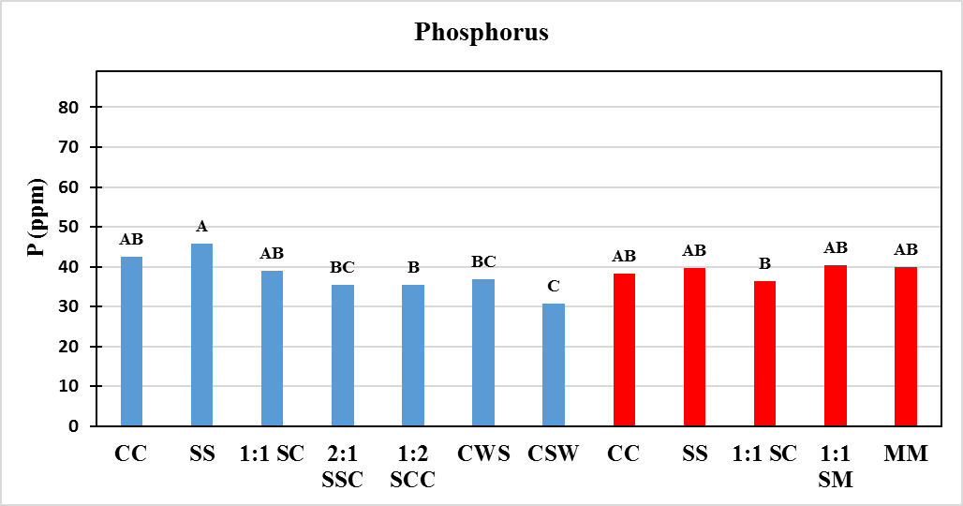
SOIL P CONCENTRATION
Stoneville, MS

Slide 17
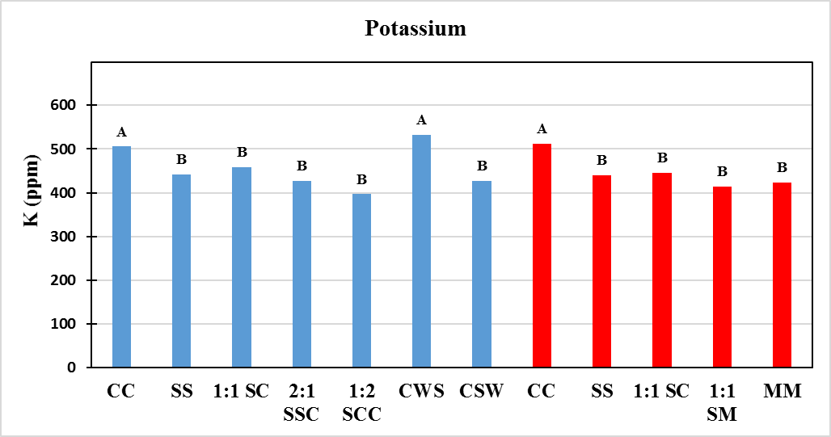
SOIL K CONCENTRATION
Stoneville, MS

Slide 18
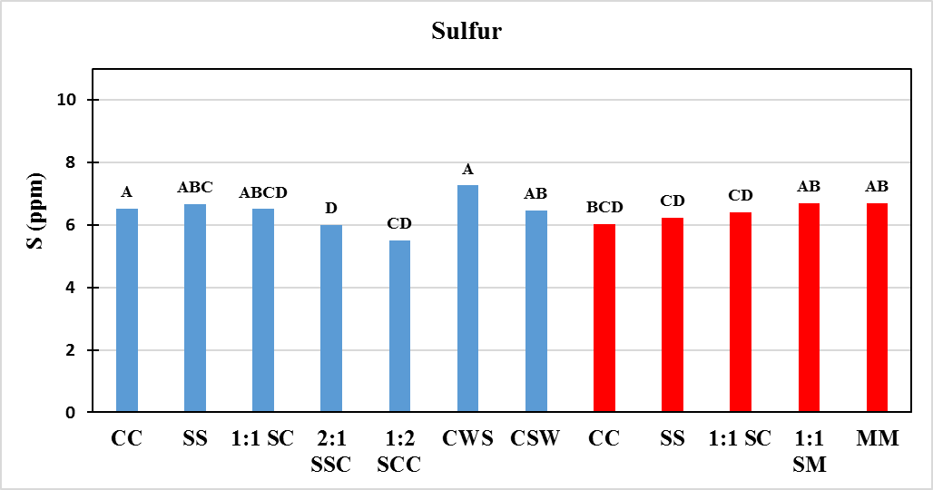
SOIL S CONCENTRATION
Stoneville, MS

Slide 19
SOIL Ca CONCENTRATION
Stoneville, MS

Slide 20
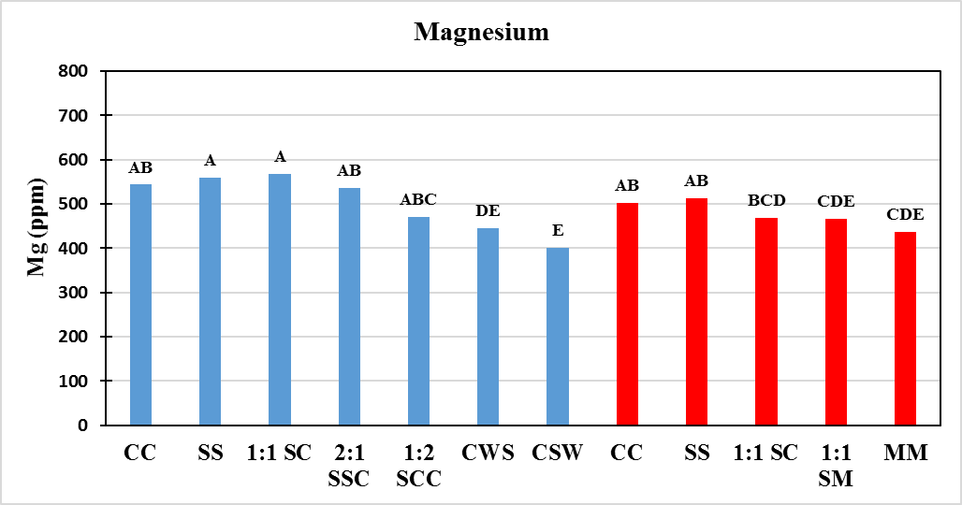
SOIL Mg CONCENTRATION
Stoneville, MS

Slide 21
2018 season
4 years of this study (2014-2018):
2 yr rotations (2 complete cycles by 2017…
3 complete cycles in 2019): We have two years of corn and soybean yield data so far.
Wet season in fall:
Delayed harvesting or did not allow harvesting (Brooksville-sorghum)
Lodging in corn (Brooksville)
Weed pressure (LA: Johnson grass in sorghum)
crop residues burning delayed
Wheat: some locations planted, some did not.

Slide 22
2018 season
Soil samples
Samples received from all locations except one location.
Nematode samples currently being analyzed at MSU.
Soil nutrient samples will be sent LSU soil lab soon, after I get samples from all locations.
Economic analysis: already asked for crop inputs used.
Publications: Working on one journal article.

Slide 23
2019 season…
Seed for all crops already ordered by Dr. Jeremy Ross
Publications:
Research: Yield, economics, soil nutrient concentrations
Extension: Need to ask every state cooperator what they prefer? Bulletin or short report?
PI for this project: Dr. Daniel Reynolds
Budget for 2019?

Slide 24
Thank You

Slide 25
Crop | Units | N | P2O5 | K20
Corn (grain) | lb/bu | 0.90 | 0.44 | 0.27
Soybeans | lb/bu | 3.8 | 0.84 | 1.30
Sorghum (grain) | lb/bu | 0.66 | 0.39 | 0.27
Wheat | lb/bu | 1.3 | 0.60 | 0.34
Table 1. Macronutrient removal by selected crops. Data derived from International Plant Nutrition Institute
Nutrient Database, North Carolina State University Extension Service Publication AG-439, Section 4
of the Mississippi NRCS Field Office Technical Guide, and http://plants.usda.gov/.

Slide 26
Corn Planted P1637 36,000 seed/a
Soybean Planted CZ4853 LL 129,778 seed/a
Grain Sorghum Planted 84P80
Wheat Planted CZ4853 LL 140,000 seed/a

Slide 27
2019 season crops

Slide 28
NET RETURNS
(STONEVILLE, MS)
Crop Rotation | Years of rotation |  |  | Total
 | 1st | 2nd | 3rd | 3 yrs
 | (2014) | (2015) | (2016)
 | -----------------$ Acre⁻¹------------------
Continuous Corn | 516 | 291 | 238 | 1044a
Continuous Soybean | 379 | 70 | 401 | 849ab
2:1 Soybean/Corn | 380 | 65 | 133 | 579c
1:2 Soybean/Corn | 393 | 285 | 155 | 834abc
Continuous Corn | 566 | 222 | 100 | 888ab
Continuous Soybean | 390 | -2 | 322 | 710bc
Irrigated
Dryland

Slide 29
Progress…
Rotation cycles completed by 2016
1:1 Soybean/Corn
1:1 Soybean/Sorghum
2:1 Soybean/Soybean/Corn
1:2 Soybean/Corn/Corn
Corn/wheat/DC Soybean/corn
Corn/Soybean/Wheat/DC Soybeans
Nematode samples and soil samples analyzed from 2016
Soil analysis: Carbon and Nitrogen percent, pH, P, K, Ca, Mg, S, Cu, Na, Zn
Nematode: RKN, Reniform, CL, SCN, Lesion, Dagger, Stunt, Spiral, Tylenchus, Ring, Sting, Awl, Stubby, Ditylenchus, Needle, Aphelenchoides, Aphelenchus
First cycle: 2015
Second Cycle: 2017
Third Cycle: 2019
First cycle: 2016
Second Cycle: 2019

Slide 30
2017
All crops –
Fall prepare beds
Irrigation: 2 events 3 inches/event
Corn-PRE
Lexar -3 qt/acre
Corn-POST
Roundup- 1 qt/acre
Atrazine – 1 qt .acre
Corn-Fertilizer
240 lb N acre Applied injected as UAN
Soybean PRE
Gramoxone 2 qt/acre
Prefix- Full rate
Soybean POST
Liberty (glufosinate) 29 fl/oz acre
Prefix- 2 pints/acre
Milo Fertilizer
60 lb N/acre Applied injected as UAN
Milo PRE
Lexar- 3 qt/acre
Milo Insecticide
1 applications- Karate- full rate (sorghum midge)
2 applications-Sivanto-full rate (sugarcane aphid)

Slide 31
CORN YIELDS
Portageville, MO
Crop Rotation | Years of rotation
 | 1st | 2nd | 3rd | 4th
 | (2014) | (2015) | (2016) | (2017)
 | -------------Mg ha⁻¹---------------
Corn-Corn | 15.0a | 7.6a | 10.0a | 11.2a
Soybean-Corn |  | 9.7a |  | -
Soybean-Soybean-Corn |  |  | 10.1a
Soybean-Corn-Corn |  | 8.8a | 9.0ab
Corn-Corn | 15.0a | 7.1a | 7.8b | 10.7a
Soybean-Corn |  | 8.9a |  | -
Irrigated
Dryland

Slide 32
SOYBEAN YIELDS
Portageville ,MO
Crop Rotation | Years of rotation
 | 1st | 2nd | 3rd |  | 4th
 | (2014) | (2015) | (2016) |  | (2017)
 | -------------Mg ha⁻¹---------------
Soybean-Soybean | 4.6a | 4.6a | 2.9a
Soybean-Corn |  |  | 3.1a
Soybean-Soybean-Corn |  | 4.6a
Soybean-Corn-Corn
Soybean-Soybean | 4.3b | 3.4b | 2.1b
Soybean-Corn |  |  | 3.0a
Soybean-Sorghum |  |  | 3.3a
Irrigated
Dryland

Slide 33
CORN YIELDS
Stoneville, MS
Crop Rotation | Years of rotation
 | 1st | 2nd | 3rd | 4th
 | (2014) | (2015) | (2016) | (2017)
 | -------------Mg ha⁻¹---------------
Corn-Corn | 15.6a | 11.8a | 11.8a | 10.8ab
Soybean-Corn |  | 11.4a |  | 9.4b
Soybean-Soybean-Corn |  |  | 10.1ab
Soybean-Corn-Corn |  | 11.7a | 10.4a
Corn-Corn | 15.6a | 9.3ab | 7.7b | 9.8b
Soybean-Corn |  | 8.5b |  | 12.1a
Irrigated
Dryland

Slide 34
SOYBEAN YIELDS
Stoneville, MS
Crop Rotation | Years of rotation
 | 1st | 2nd | 3rd |  | 4th
 | (2014) | (2015) | (2016) |  | (2017)
 | -------------Mg ha⁻¹---------------
Soybean-Soybean | 4.5a | 2.4a | 4.6a | 3.6a
Soybean-Corn |  |  | 5.1a
Soybean-Soybean-Corn |  | 2.4a |  | 4.0a
Soybean-Corn-Corn |  |  |  | 3.5a
Soybean-Soybean | 3.9b | 1.3b | 3.5b | 1.7b
Soybean-Corn |  |  | 3.9b
Soybean-Sorghum |  |  | 4.0b
Irrigated
Dryland

Slide 35
CORN YIELDS
College Station, TX
Crop Rotation | Years of rotation
 | 1st | 2nd | 3rd | 4th
 | (2014) | (2015) | (2016) | (2017)
 | -------------Mg ha⁻¹---------------
Corn-Corn | 13.3a | 6.3b | 6.2b | 10.4c
Soybean-Corn |  | 8.8a |  | 11.2b
Soybean-Soybean-Corn |  |  | -
Soybean-Corn-Corn |  | 8.3a | 8.2a
Corn-Corn | 13.3a | 5.4b | 7.4ab | 11.1a
Soybean-Corn |  | 6.1b |  | 12.3a
Irrigated
Dryland

Slide 36
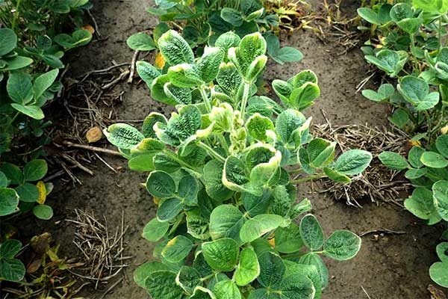
SOYBEAN YIELDS
College Station, TX
Crop Rotation | Years of rotation
 | 1st | 2nd | 3rd |  | 4th
 | (2014) | (2015) | (2016) |  | (2017)
 | -------------Mg ha⁻¹---------------
Soybean-Soybean |  | 2.1a | 0.13 | -
Soybean-Corn |  |  | 0.12 | -
Soybean-Soybean-Corn |  | 2.1a |  | -
Soybean-Corn-Corn |  |  |  | -
Soybean-Soybean |  | 1.4a | 0.13 | -
Soybean-Corn |  |  | 0.10 | -
Soybean-Sorghum |  |  | 0.08
Irrigated
Dryland

Slide 37
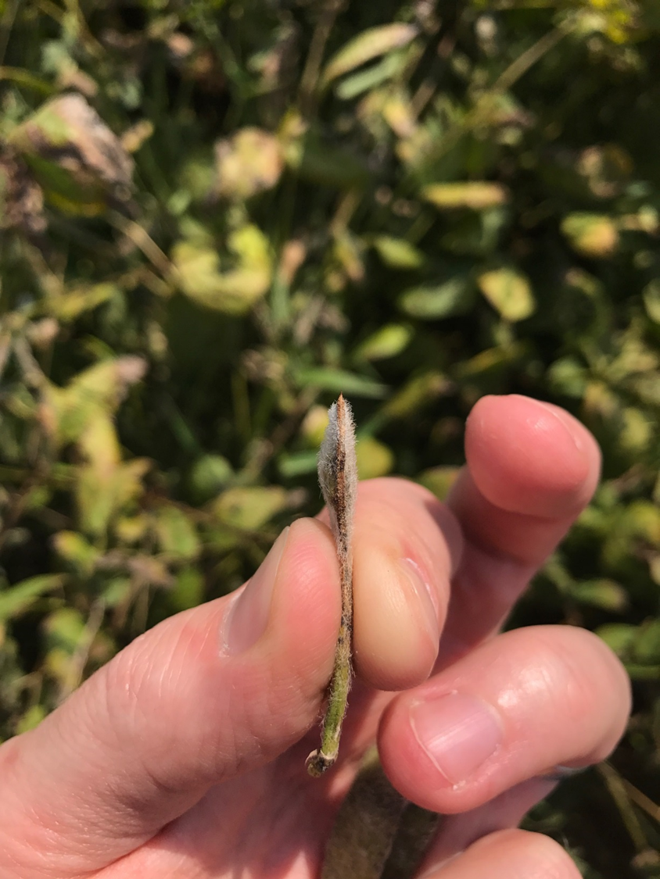
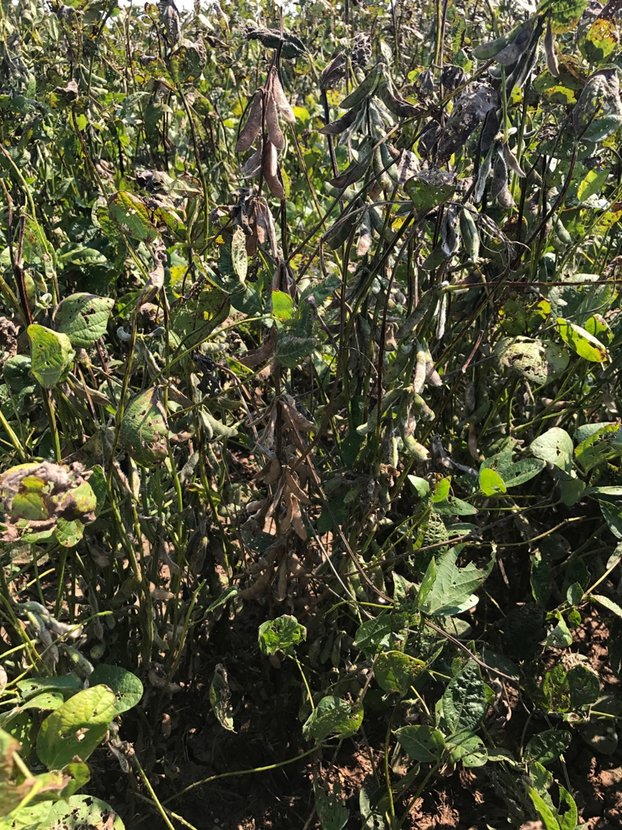
SOYBEAN YIELDS
(PC: Dr. Clark Neely)

Slide 38
CORN YIELDS
St. Joseph, LA
Crop Rotation | Years of rotation
 | 1st | 2nd | 3rd | 4th
 | (2014) | (2015) | (2016) | (2017)
 | -------------Mg ha⁻¹---------------
Corn-Corn | 12.2a | 9.3c | 9.3a | 11.8b
Soybean-Corn |  | 11.3ab |  | 12.5a
Soybean-Soybean-Corn
Soybean-Corn-Corn |  | 10.0bc | 11.3a
Corn-Corn | 12.2a | 12.3a | 10.9a | 11.8b
Soybean-Corn |  |  |  | -
Irrigated
Dryland

Slide 39
SOYBEAN YIELDS
St. Joseph, LA
Crop Rotation | Years of rotation
 | 1st | 2nd | 3rd |  | 4th
 | (2014) | (2015) | (2016) |  | (2017)
 | -------------Mg ha⁻¹---------------
Soybean-Soybean | 4.2a | 3.3a | 1.9a | 3.8b
Soybean-Corn |  |  | 2.0a
Soybean-Soybean-Corn |  | 3.3a |  | -
Soybean-Corn-Corn |  |  |  | 4.2a
Soybean-Soybean | 4.4a | 3.6a | 1.9a | 3.6b
Soybean-Corn |  |  | -
Soybean-Sorghum |  |  | -
Irrigated
Dryland

Slide 40
CORN YIELDS
Colt, AR
Crop Rotation | Years of rotation
 | 1st | 2nd | 3rd | 4th
 | (2014) | (2015) | (2016) | (2017)
 | -------------Mg ha⁻¹---------------
Corn-Corn | 10.5a | 9.0a | 10.1ab
Soybean-Corn |  | 9.4a
Soybean-Soybean-Corn |  |  | 10.4a
Soybean-Corn-Corn |  | 9.7a | 10.2b
Corn-Corn | 10.5a | 7.2b | 1.7c
Soybean-Corn |  | 6.9b
Irrigated
Dryland

Slide 41
SOYBEAN YIELDS
Colt, AR
Crop Rotation | Years of rotation
 | 1st | 2nd | 3rd |  | 4th
 | (2014) | (2015) | (2016) |  | (2017)
 | -------------Mg ha⁻¹---------------
Soybean-Soybean | 4.8a | 3.0a | 3.6a
Soybean-Corn |  |  | 3.6a
Soybean-Soybean-Corn |  | 3.0a
Soybean-Corn-Corn
Soybean-Soybean | 3.6b | 1.4b | 2.4bc
Soybean-Corn |  |  | 2.4b
Soybean-Sorghum |  |  | 1.8c
Irrigated
Dryland

Slide 42
CORN YIELDS
Newport, AR
Crop Rotation | Years of rotation
 | 1st | 2nd | 3rd | 4th
 | (2014) | (2015) | (2016) | (2017)
 | -------------Mg ha⁻¹---------------
Corn-Corn | 6.9a | 9.3ab | 4.1ab
Soybean-Corn |  | 9.9a
Soybean-Soybean-Corn |  |  | 4.8a
Soybean-Corn-Corn |  | 10.0a | 3.8b
Corn-Corn | 6.9a | 8.0b | 0.8c
Soybean-Corn |  | 8.2ab
Irrigated
Dryland

Slide 43
SOYBEAN YIELDS
Newport, AR
Crop Rotation | Years of rotation
 | 1st | 2nd | 3rd |  | 4th
 | (2014) | (2015) | (2016) |  | (2017)
 | -------------Mg ha⁻¹---------------
Soybean-Soybean | 1.9a | 3.9a | 3.5a
Soybean-Corn |  |  | 3.8a
Soybean-Soybean-Corn |  | 3.9a
Soybean-Corn-Corn
Soybean-Soybean | 1.2b | 3.1b | 1.6b
Soybean-Corn |  |  | 1.6b
Soybean-Sorghum |  |  | 1.6b
Irrigated
Dryland

Slide 44
REFERENCES
USDA-NASS 2017.
Erickson, B. 2008. Corn/Soybean literature summary. http://www.agecon.purdue.edu/pdf/Crop_Rotation_Lit_Review.pdf

Slide 45
SUMMARY
Mostly crop yields were higher from irrigated rotations compared to dryland rotations.
Corn yields:
Location | Year | Rotations
Colt and Newport, AR | 2016 | Soy-Soy-Corn > Soy-Corn-Corn
Stoneville, MS | 2017 | Soy-Corn > Corn-Corn (Dryland)
College Station, TX | 2017 | Dryland > Irrigated
St. Joseph, LA | 2017 | Soy-Corn > Corn-Corn (Irrigated)

Slide 46
SUMMARY
Soybean yields:
No effect of residue management on yields…yet.
Location | Year | Rotations
Portageville, MO | 2016 | Soy-Corn or Soy-Sorghum > Soy-Soy (Dryland)
Colt, AR | 2016 | Soy-Corn > Soy-Sorghum (Dryland)
St. Joseph, LA | 2017 | Irrigated = Dryland (Soy-Soy)

Slide 47
CLIMATIC CONDITIONS
ANNUAL PRECIPITATION
YEAR | COLLEGE STATION, TX | PORTAGEVILLE, MO | ST. JOSEPH, LA | STONEVILLE, MS
2014 | 40 | 45 | 64 | 56
2015 | 58 | 51 | 106 | 58
2016 | 47 | 47 | 56 | 61

Slide 48
Year | Month | Total Monthly Precipitation (in inches)
 |  | Brooksville, MS | College Station, TX | Portageville, MO | St. Joseph, LA | Stoneville, MS
2014 | Jan | 2.38 | 1.29 | 1.78 | 4.77 | 1.15
 | Feb | 6.54 | 0.89 | 2.88 | 3.986 | 3.96
 | Mar | 5.12 | 1.61 | 3.8 | 7.87 | 6.36
 | Apr | 11.3 | 1.23 | 8.98 | 6.79 | 9.82
 | May | 2.42 | 9.01 | 3.73 | 7.05 | 6.22
 | Jun | 9.23 | 1.61 | 6.12 | 5.33 | 5.74
 | July | 0.69 | 6.72 | 4.39 | 4.64 | 4.81
 | Aug | 2.07 | 0.41 | 2.48 | 8.63 | 3.03
 | Sep | 2.53 | 6.57 | 1.88 | 2.43 | 1.03
 | Oct | 2.72 | 1.81 | 4.16 | 3.41 | 6.69
 | Nov | 2.94 | 5.89 | 2.09 | 2.92 | 2.9
 | Dec | 5.23 | 2.57 | 2.3 | 6.19 | 4.77
 | Total (Annual) | 53.17 | 39.61 | 44.59 | 64.016 | 56.48

Slide 49
Year | Month | Total Monthly Precipitation (in inches)
 |  | Brooksville, MS | College Station, TX | Portageville, MO | St. Joseph, LA | Stoneville, MS
2015 | Jan | 5.46 | 6.66 | 1.91 | 6.04 | 5.69
 | Feb | 0.13 | 0.75 | 3.32 | 3.4 | 4.72
 | Mar | 0.01 | 5.83 | 6.9 | 53.83 | 7.31
 | Apr | 0 | 4.8 | 5.64 | 4.86 | 6.33
 | May | 0 | 9.73 | 4.88 | 6.56 | 6.96
 | Jun | 0.04 | 5.21 | 2.64 | 3.04 | 2.57
 | July | 0 | 0.31 | 1.93 | 2.26 | 3.17
 | Aug | 0.65 | 1.36 | 2.1 | 1.23 | 0.73
 | Sep | 0.21 | 1.74 | 0.39 | 1.91 | 0.79
 | Oct | 3.38 | 8.81 | 2.94 | 9 | 5.49
 | Nov | 6.13 | 5.03 | 12.45 | 9.94 | 9.59
 | Dec | 5 | 8.08 | 6.15 | 4.22 | 4.75
 | Total (Annual) | 21.01 | 58.31 | 51.25 | 106.29 | 58.1

Slide 50
Year | Month | Total Monthly Precipitation (in inches)
 |  | Brooksville, MS | College Station, TX | Portageville, MO | St. Joseph, LA | Stoneville, MS
2016 | Jan | 3.22 | 1.3 | 2.61 | 3.81 | 3.39
 | Feb | 5.75 | 1.32 | 2.8 | 3.13 | 4.5
 | Mar | 4.05 | 4.43 | 9.66 | 12.62 | 18.47
 | Apr | 3.94 | 5.42 | 3.74 | 4.05 | 4.31
 | May | 2.85 | 12.93 | 4.61 | 2.3 | 3.26
 | Jun | 2.36 | 2.58 | 2.95 | 7.2 | 5.06
 | July | 2.19 | 0.24 | 5.91 | 2.27 | 6.53
 | Aug | 4.42 | 8.92 | 4.35 | 6.28 | 5.48
 | Sep | 1.35 | 2 | 1 | 1.65 | 0.34
 | Oct | 0.79 | 2.15 | 1.04 | 0.27 | 0.2
 | Nov | 4.26 | 2.73 | 3.01 | 5.4 | 5.72
 | Dec | 1.4 | 2.77 | 5.46 | 6.82 | 3.99
 | Total (Annual) | 36.58 | 46.79 | 47.14 | 55.8 | 61.25

Slide 51
Location | Year | Crop variety names
 |  | Corn |  |  | Soybean |  |  | Sorghum |  | Wheat
 |  | Irrigated | Dryland |  | Irrigated | Dryland |  | Dryland |  | Irrigated
Stoneville, MS | 2014 | Pioneer 1637 | Pioneer 1637 |  | Pioneer 48T53 | Pioneer 48T53 |  | Pioneer 83P17
 | 2015 | Pioneer 1637 | Pioneer 1637 |  | Pioneer 47T36 | Pioneer 47T36 |  | Pioneer 83P17
 | 2016 | Pioneer 1637 | Pioneer 1637 |  | Pioneer 47T36 | Pioneer 47T36 |  | Pioneer 83P17
 | 2017 | Pioneer 1637 | Pioneer 1637 |  | Bayer Credenz 4953 | Bayer Credenz 4953 |  | Pioneer 83P17
College Station, TX | 2014 | P1637 VYHR | P1637 VYHR |  | P49T97R | P49T97R |  | Pioneer 84P80 |  | WB Cedar HRWW
 | 2015 | P1602AM | P1602AM |  | Bayer CZ 4959 | Bayer CZ 4960 |  | DKS 53-67 |  | WB Cedar HRWW
 | 2016 | DKS 76-14 | DKS 76-14 |  | HBK RY 5221 | HBK RY 5222 |  | DKW 53-53 |  | None
 | 2017 | P1637 VYHR | P1637 VYHR |  | Bayer Credenz 4953 | Bayer Credenz 4953 |  | SP7715 |  | Gallagher HRWW

Slide 52
Location | Year | Planting dates
 |  | Corn |  | Soybean |  |  | Sorghum | Wheat
 |  | Irrigated | Dryland | Irrigated | Dryland | DC soy | Dryland | Irrigated
Portageville, MO | 2014 | 7-May |  | 12-May |  |  | 12-May | 1-Dec
 | 2015 | 7-May |  | 7-May |  | 15-Jun | 7-May | 5-Nov
 | 2016 | 26-Apr |  | 2-Jun |  | 23-Jun | 18-May
 | 2017 | 11-Apr |  | 24-Apr |  |  | 9-May
Newport, AR | 2014 | 7-May |  | 7-May |  |  | 7-May | -
 | 2015 | 5-May |  | 5-May |  |  | 5-May
 | 2016 | 6-Apr |  | 25-Apr |  |  | 25-Apr
 | 2017 | 13-Apr |  | 17-May |  |  | 13-Apr
Pinetree, AR | 2014 | 11-Apr |  | 24-May |  |  | 24-May | 3-Nov
 | 2015 | 9-Apr |  | 6-May |  |  | 6-May
 | 2016 | 8-Apr |  | 25-Apr |  |  | 9-May
 | 2017 | 18-Apr |  | 15-May |  |  | 18-Apr
Stoneville, MS | 2014 | 26-Mar |  | 19-Apr |  |  | 1-May | 23-Oct
 | 2015 | 7-Apr |  | 16-Apr |  |  | 12-May | -
 | 2016 | 29-Mar |  | 25-Apr |  |  | 25-Apr
 | 2017 | 21-Mar |  | 6-Apr |  |  | 6-Apr
Brooksville, MS | 2014 | 13-May |  | 13-May |  |  | 13-May | 6-Nov
 | 2015 | 21-May |  | 21-May |  |  | 21-May | 17-Nov
 | 2016 | 5-Apr |  | 19-Apr |  |  | 16-May
College Station, TX | 2014 | 7-Mar | 7-Mar | 27-Mar | 27-Mar | None | 27-Mar | 2-Dec
 | 2015 | 17-Mar | 17-Mar | 9-Apr | 9-Apr | 16-Jun | 9-Apr | 7-Dec
 | 2016 | 5-Mar | 5-Mar | 28-Mar | 28-Mar | None | 28-Mar | None
 | 2017 | 3-Mar | 3-Mar | 27-Mar | 27-Mar | None | 27-Mar | TBD
St. Joe, LA | 2014 | 24-Apr |  | 24-Apr |  |  | 24-Apr
 | 2015 | 1-Apr |  | 1-Apr |  | 15-Jun | 1-May | 8-Dec
 | 2016 | 23-Mar |  | 11-Apr |  |  | 11-Apr
 | 2017 | 20-Mar |  | 17-Apr |  |  | 17-Apr

Slide 53
Location | Soil pH | P, ppm | K, ppm | Ca | Mg | Na | S | Cu | Zn | TC, % | TN, %
Portageville, MO
Newport, AR | 6.58 | 14.06 | 76.23 | 1397.27 | 322.25 | 19.62 | 7.22 | 1.96 | 1.19 | 0.873 | 0.112
Pinetree, AR
Stoneville, MS | 6.75 | 78.825 | 441 | 2712.75 | 575.475 | 29.85 |  |  | 5.1975
Brooksville, MS
College Station, TX | 8.27 | 55.87 | 304.55 | 5012.75 | 377.73 | 24.56 | 12.84 | 2.3 | 1.11 | 1.528 | 0.107
St. Joe, LA1 | 5.95 | 44.12 | 284.8 | 2103.69 | 474.62 | 13.44 | 9.21 | 3.46 | 2.51 | 1.01 | 0.123
St. Joe, LA2 | 5.55 | 24.35 | 137.18 | 913.12 | 181.51 | 9.43 | 4.73 | 1.43 | 1.32 | 0.598 | 0.077

Slide 54
INTRODUCTION
Literature summary
28 publications
(1988-2008)
Studies from 1979 to 2006
States:
MN, IN, TN, NY, WI,
KY, IA, NE, SD, AL, NJ, IL
Corn yield increase: 3-19%
(Corn-Soybean rotation vs Continuous Corn)
(Erickson, 2008)

