Slide 1
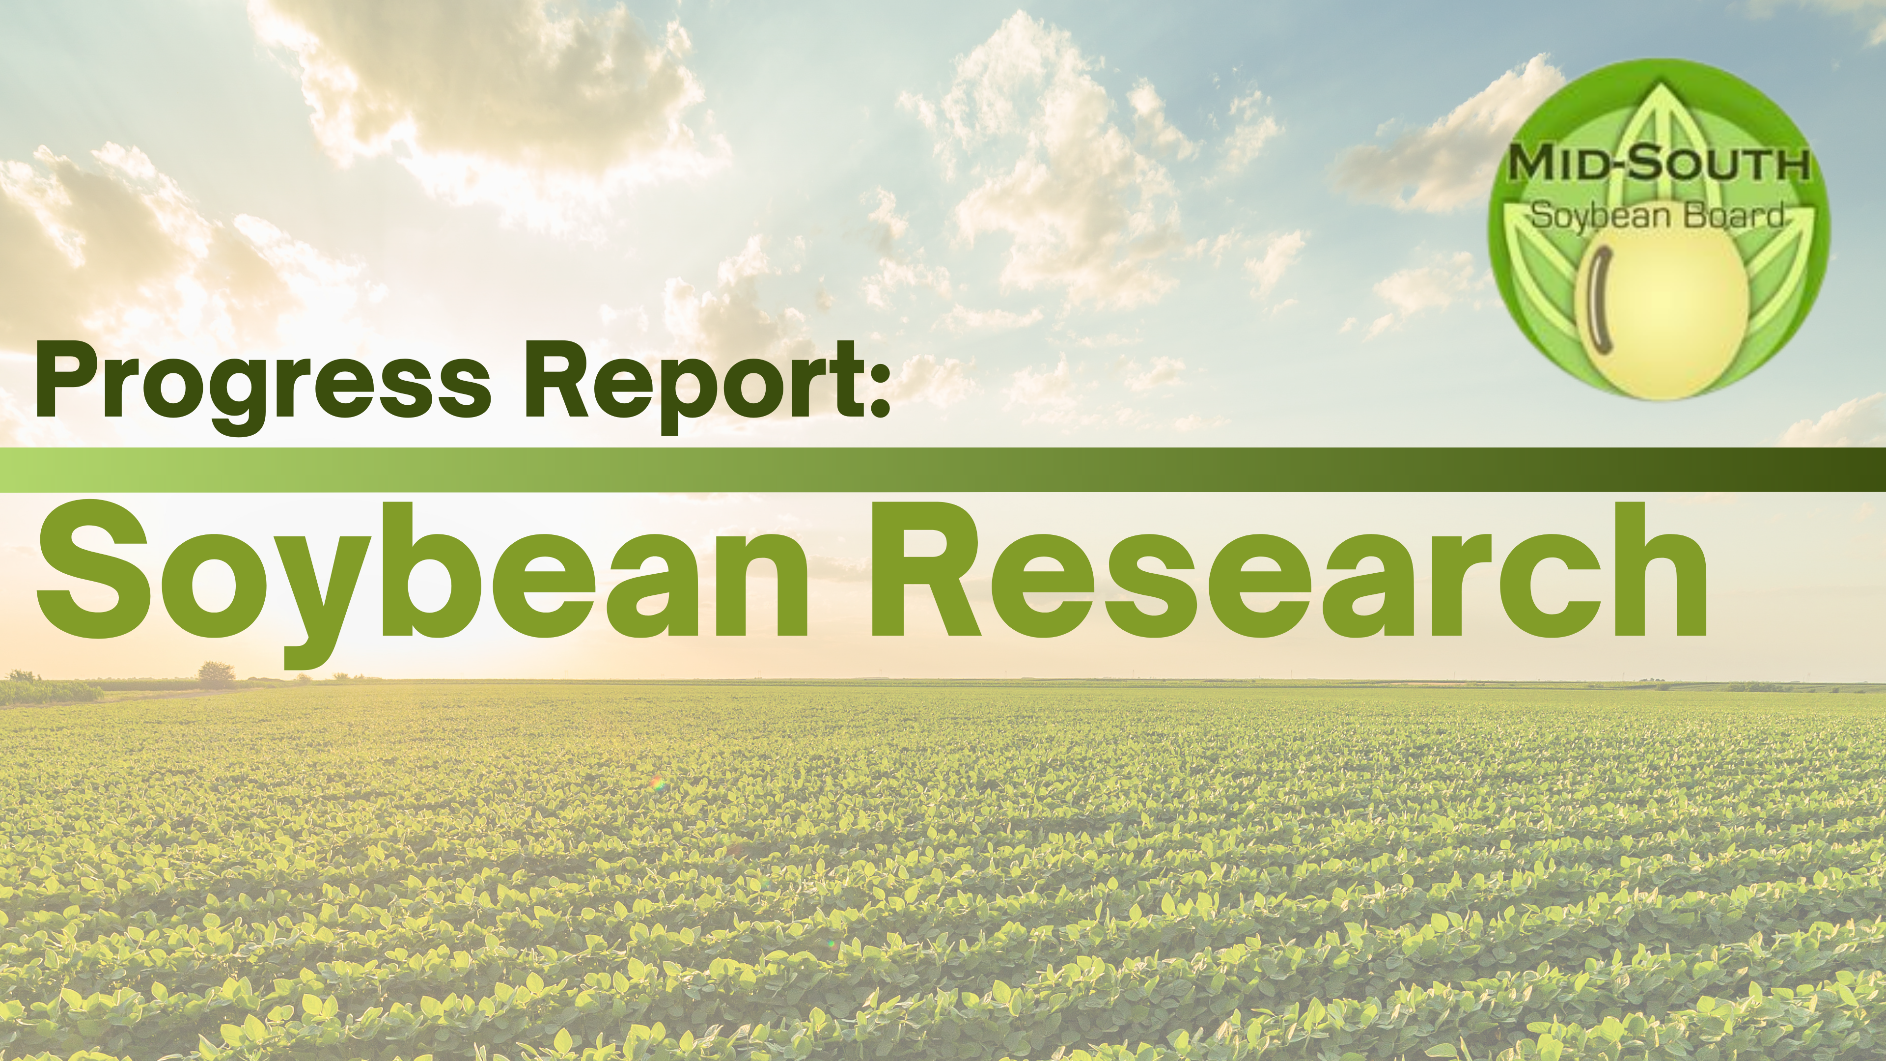

Slide 2
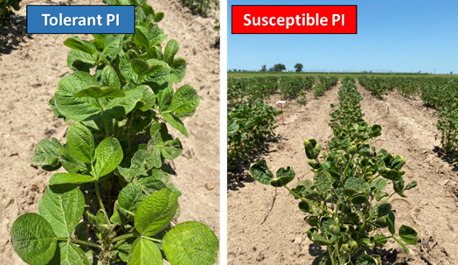
Screening and Selecting Non-Xtend Soybeans for Dicamba Tolerance (2020)
2019 and 2020 off target drift negatively affected yields – 4841 plots
2020- 1500 genotypes/7500 plots tested – elite lines, exotic, RILs (time studies)
  Damage scores and yield, drone phenotyping
  2021 Soy6K SNP chip
2021- entering the top lines in the USDA uniform trial
set of 70 commercial varieties

Slide 3
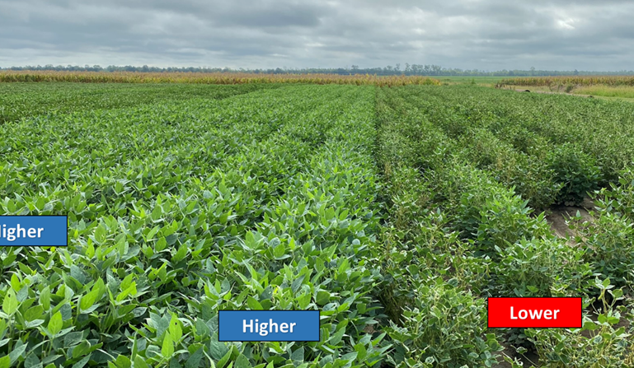

Dicamba
Greenhouse study Univ. of Ill with 5 rates-V2 or V5 spraying
Being analyzed
Heavier doses didn’t separate the tolerant from susceptible, but 1/10,000th dose
Drone to study canopy damage -7400 plots
Assay with SNP chip
Genetics hi x low cross

Slide 4
Dicamba
Over 7,400 plots screened visually and by drone equipped with multispectral camera for natural tolerance;
  • Strong and consistent negative correlation between Dicamba damage and yield was confirmed;
  • Many non-Xtend soybean lines with superior tolerance to off-target Dicamba damage were identified;
Identification of high levels of tolerance in exotic germplasms (PIs);
• Developed two genetic mapping populations using tolerant PIs – want to find where the genes are for tolerance
• New crosses made and populations being advanced to develop high-yielding tolerant lines;
• Presentations at multiple venues highlighting the findings of this project;
• Article at Farm Progress highlighting this project – “Soybeans show natural resistance to dicamba”

Slide 5
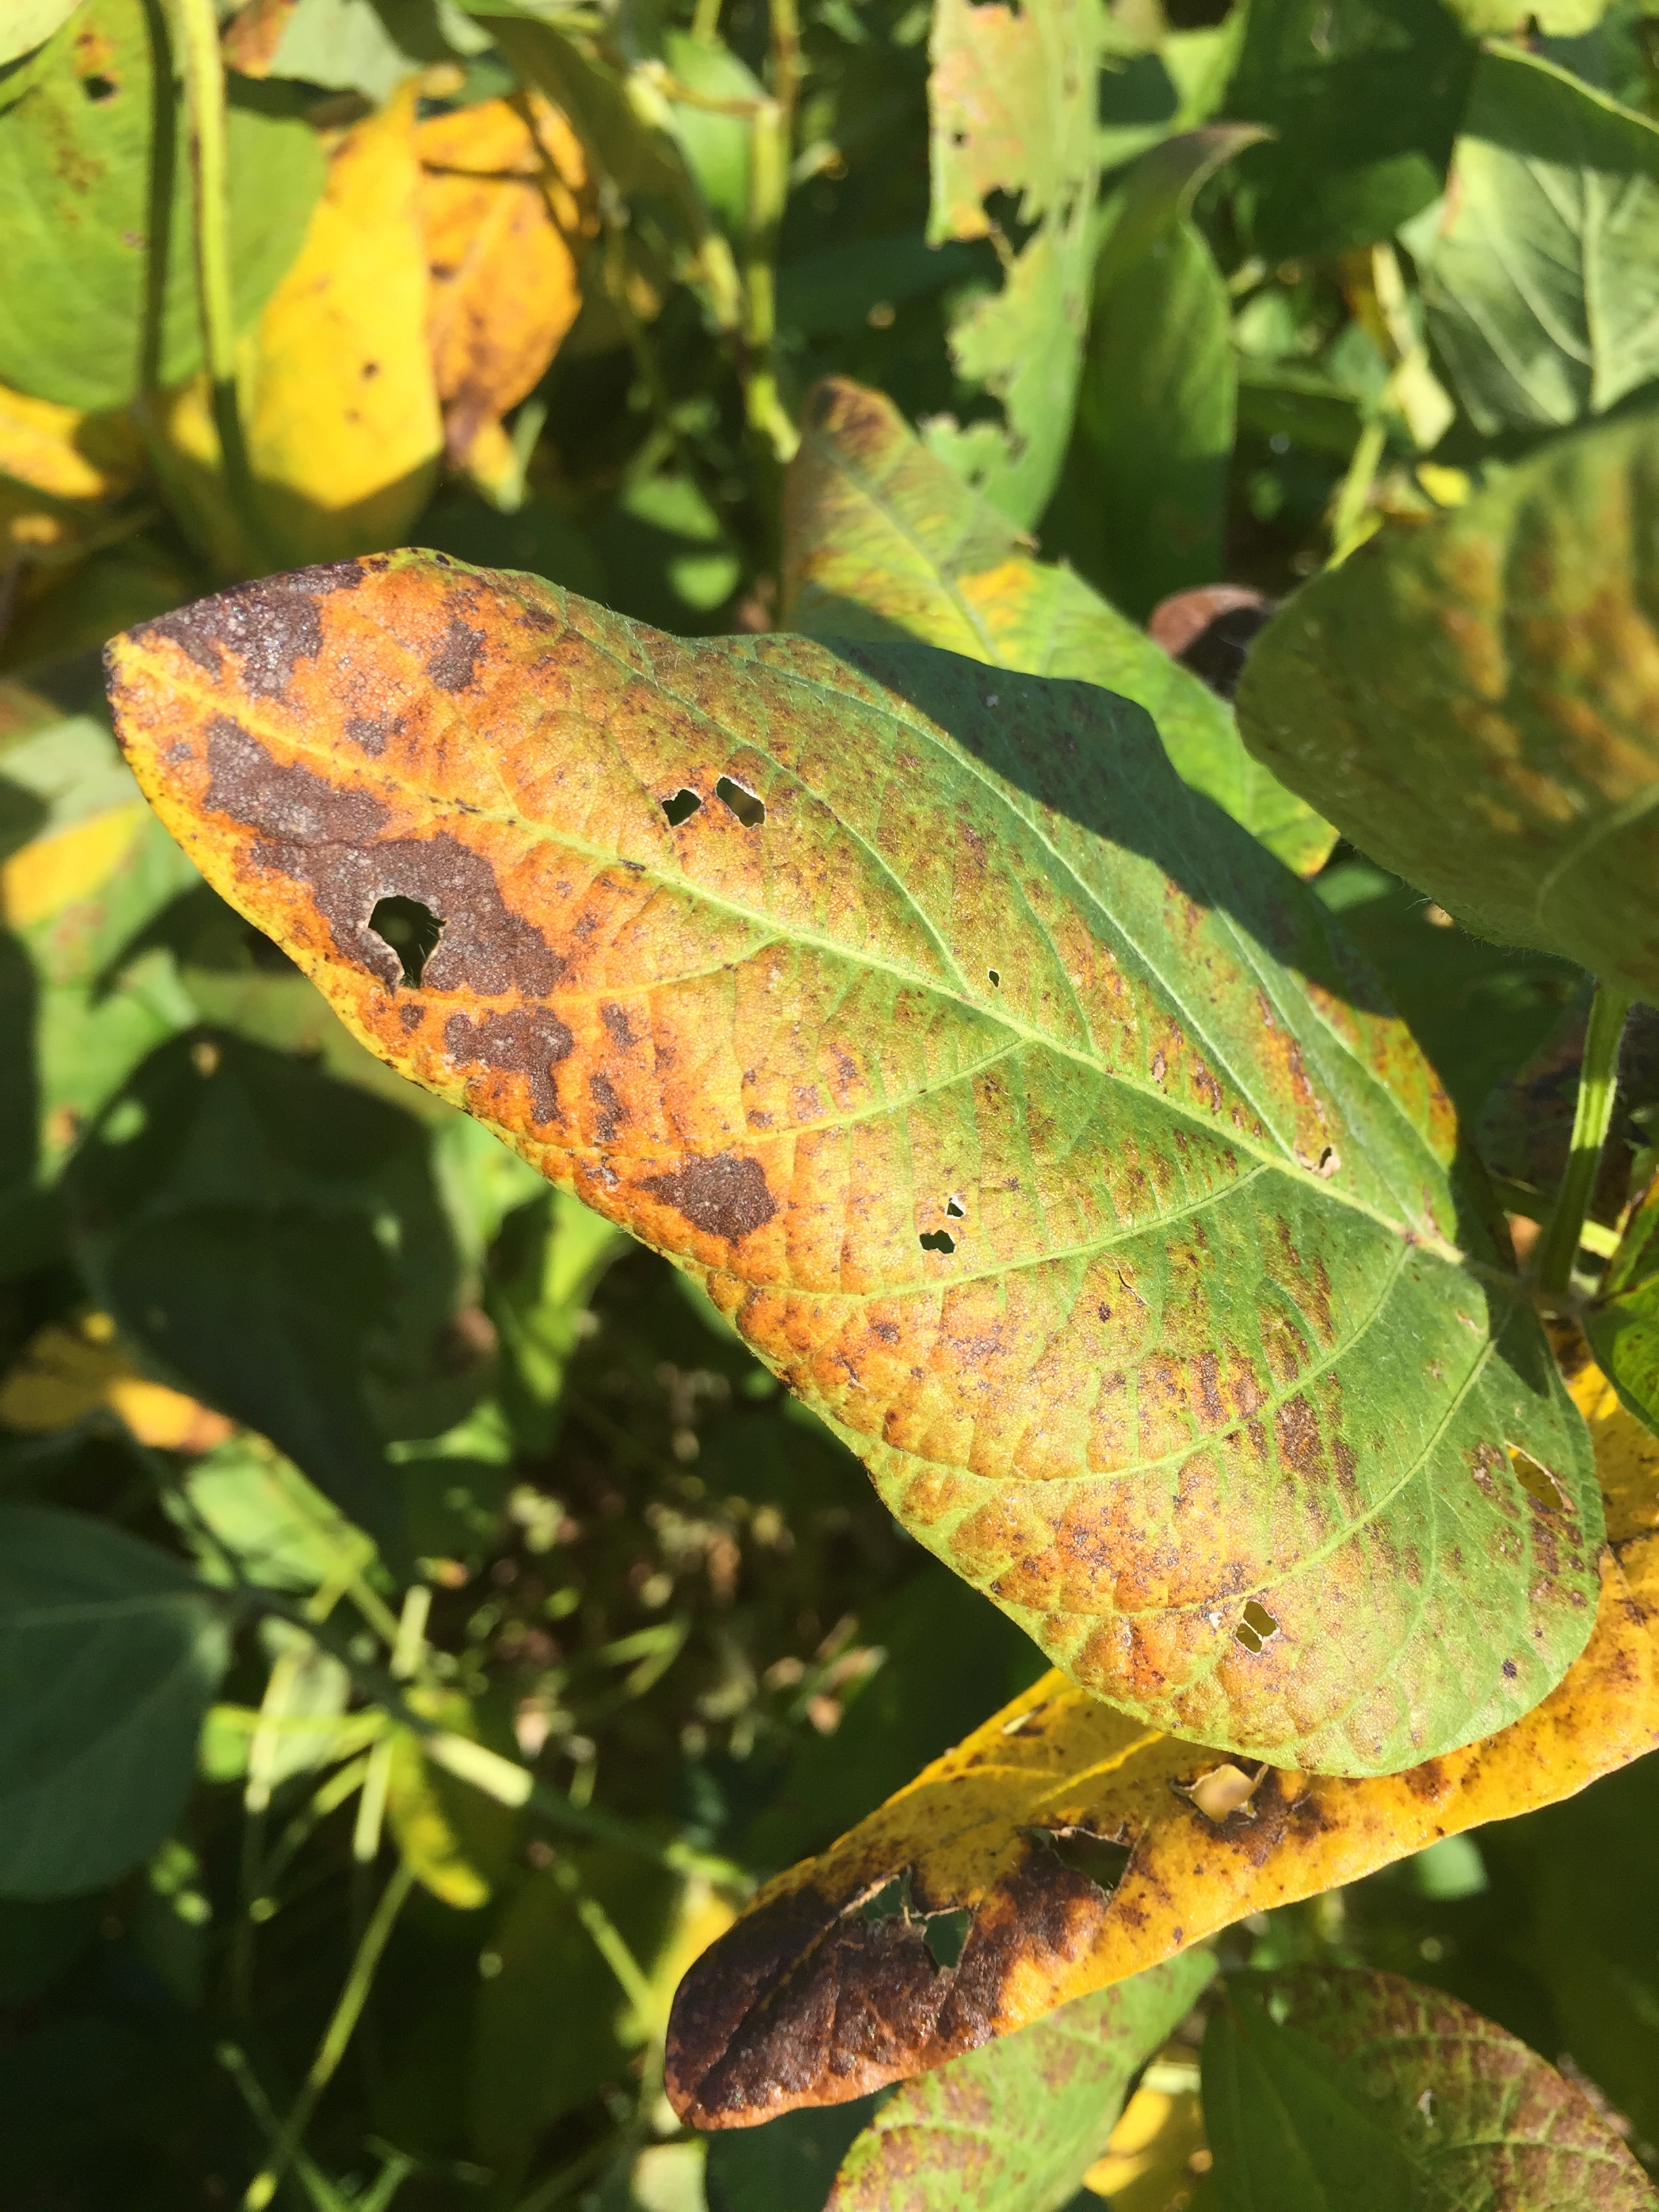
Enhanced Pest Control Systems for Mid-South Soybean Production
(2016)

Slide 6
Enhanced Pest Control Systems for Mid-South Soybean Production
CLB:
2020- 5th season AR 3, AL1, LA4, MO1, MS2, TX1
-only able to do the Public Variety trial
50 PIs with improved resistance out of 580, increased PIs last year so they could trial this year – able to screen for resistance to Qol fungicides.
-susceptible PIs were being increased at MU
-publicly available genetics
-Improved rating scale
100s of strains of CLB; this is making the QTL search harder (QTL 2022) 50KSNP
--19 successful crosses in 2019 with the following -CLB resistant lines: S14-9017R, S15-3772RY, S11-20242. S11-16653, S13-10592C, and S14-15138R

Slide 7
Enhanced Pest Control Systems for Mid-South Soybean Production
STINKBUG:
-5 populations of stink bug resistance – 150 plants – 2020 enough seed to test 6 lines
S13-3851C x TX12-1033
S15-16886C x TX12-1061
S14-9051R x TX12-1039
TX12-1034 x S11-20337GT
S15-5904RY x TX12-1035
Stinkbug x CLB genetics crosses:
Stink Bug Resistant parents:
S11-20242, S11-16653, and S13-10592
CLB Resistant parents:
S14-9017R, S15-3772RY, S11-20242. S11-16653, S13-10592C, and S14-15138R
-82 lines tested in 5 MO locations, 3 reps each
-606 in prelim test with these genetics
-56 populations, 5000 progeny rows

Slide 8
Pest Control Study:
Expected Outputs/
Deliverables
Commercial variety resistance information
Disease resistance data for PIs and selections
ID CLB resistance (use as sources for future)
ID QTL/markers for CLB (Shrestha, Koebernick, Richards)
Confirm QTL/markers for CLB and regional evaluation of breeding lines for resistance
ID stinkbug resistance (tolerance)
Cross stinkbug resistant lines with current cultivars
Use MAS to pyramid genes into adapted cultivars

Slide 9
Bonus Accomplishments (Pathology Angle…)
ID fungicide resistance
Determine Cercospora species at each location
Determine ratio of pathogens at a given location
ID correlations between pathogen ratio and disease severity
Confirm cercosporin screening assay
Further define host/pathogen relationship

Slide 10

Screening Soybean Germplasm and Breeding Soybeans for Flood Tolerance (2019)
-MG 4 &5; Found lines that yield 10-20% more under flooding conditions (R1), don’t yield as much as checks in non-flooded conditions (92%) (2020) rained 4 days before the trial
Preliminary recommendation to plant tolerant lines in lowlands prone to flooding and commercial susceptible lines on well drained soils.
-21 progeny lines (10% made it); various platforms and G.soja; V2 R13-9687 & R13-13997
-13 of these crosses will be evaluated summer 2021; AR releasing soon R16-45
- Commercial checks with good flood tolerance: 46-E50, 49CK6 (Blue River Organic Seed), DG45E28 (Delta Grow), DG51E60 (Delta Grow), 39E00 (FS HiSOY) and ZS5098E3 (Local Seed) exhibited flooding stress tolerance with injury scores from 1.3 to 2.0
 |  | Flooded Yield (b/a) |  |  |  | Non-flooded Yield (b/a) |  |  |  | Flood Tolerance Score
Line | Pedigree | 2016 | 2019 | 2020 | Mean | 2016 | 2019 | 2020 | Mean | 2016 | 2019 | 2020 | Mean
S12-1362 | S05-114482 x RIL 159 | 18 | 25 | 18 | 21 | 52 | 61 | 61 | 58 | 2.7 | 1.3 | 2.0 | 2.0
AG 5335 (Ck) |  | 7.5 | 21 | 3 | 11 | 54 | 60 | 68 | 61 | 4.0 | 3.3 | 5.0 | 4.1
Note: Flood injury scores were rated on a 1-5 scale, where 1 = no visual plant injury while 5 = almost all plants dead.
S12-1362 carries two QTL/genes for flood tolerance

Slide 11
Evaluation of a novel drought-tolerant inoculant on soybean yield in the Mid-South
Final Yield (Bushels/acre) | Yoakum, TX* |  | Jackson, TN |  | Portageville, MO
 | TN16 | CZ5515LL | TN16 | USG-7496 | TN-16 | S14 | S11
Cell-Tech | 14.0 | 7.6 | 51.7 | 43.4 | 55.5 | 64.7 | 62.7
TXVA | 19.4 | 12.4 | 53.3 | 51.9 | 61.4 | 67.4 | 64.4
Final Yield (Bushels/acre) | Stuttgart, AR |  | Stoneville, MS |  | Winnsboro, LA
 | TN16 | S14 | TN16 | S14 | TN16 | CZ5515LL | USG-7496
Cell-Tech | 26.5 | 21.6 | 53.2 | 49.4 | 33.4 | 15.1 | 22.3
TXVA | 27.5 | 24.4 | 46.8 | 58.0 | 33.5 | 16.1 | 24.4
➢ Experimental conditions: Non-irrigated. Two drought-sensitive cultivars (USG-7496 and S14-9017R), one drought-tolerant cultivar (S11-20242C), and the previous year’s cultivar (TN16-520R1) were inoculated with either TXVA strain (drought-tolerant inoculant) or Cell-Tech (commercial inoculant).
Conclusions:
For the TN16 cultivar, we have similar results as those in the previous year (2019). There is a general uptrend by the drought-tolerant inoculant TXVA in all research sites, except Stoneville, MS.
For both drought-sensitive and tolerant cultivars, TXVA provides more benefits compared to the commercial inoculant Cell-Tech, specifically to the drought sensitive cultivars (highlight with yellow).
An invention disclosure is underway to develop this novel drought-tolerant inoculant.
Cultivar information: TN16, TN16-520R1 (MG 4L), the same cultivar used in the previous year (2019); CZ5515LL (tall, bushy MG 5); USG-7496 (drought-sensitive MG 4L); S14, S14-9017R (drought-sensitive MG 5); S11, S11-20242C (drought-tolerant MG 5).
* In the field at Yoakum, TX, it was too hot and dry in August, 2020.

Slide 12
Yield Gap Survey - Jeremy Ross - University of Arkansas (2018)
“Due to the extremely wet year, historical flooding, poor seed quality, and other factors it was decided not to release the survey to capture the 2019 producer data. The survey to capture the 2020 data should be sent to producers by mid March.
No additional funds are requested.”

Slide 13
Evaluation of Residual Weed Control with Common Soil Applied
Herbicides (2021)
-Jason Bond
NEW PROJECT #1
Objectives:
1) Correlate weed control with rainfall across multiple planting dates (ESPS, FS, DC)
  Determine efficacy of nine common soybean herbicides
  Multiple MOA
2) Evaluate residual control after a known quantity of simulated rainfall
  Greenhouse study and multiple site study
  Measure impact of water volume on herbicidal activity
  Justification- help producers know how long they can expect certain herbicides to be effective.

Slide 14
Soybean yield components and seed nutrient concentration responses among nodes to phosphorus fertility
-2021
NEW PROJECT #2
2 sites (high and low P) in AR
  Evaluate leaflet P concentration across time and soybean seed yield, seed weight, pod and seed number per plant, seed abortion and seed nutrient concentrations among nodes at maturity grown under different fertilizer P-rates.
  Soybean removes 0.8 lb P2O5 per bushel which sums to 40 and 60 lb P2O5 per acre for yields of 60 and 75 bushels per acre
  New regulations may reduce P inputs, how low can we go?

Slide 15
Novel New Functional Edible Protein Films using 3D Printing Technology
-2021
NEW PROJECT #3
Justification:
EDIBLE PACKAGING MARKET IS EXPECTED TO BE $1.1 Billion by 2023 and 1.5 Billion by 2028 (Allied Market Research, 2019)
  Adds value to the price of soybean and consumes. We want soybean in on the $320.94 B packaging industry
  Able to put antioxidants into the film and use Arkansas soybean.
  Film fights pathogens
  All-natural material
  Encapsulating supplements
  Helps protect the environment

Slide 16
Effects of the Introduction of Feed Grains into Mid-South Soybean Production Systems- Gurpreet Kaur – MS State
Determine the effect of crop rotations and residue management on crop yields (corn, soybean, sorghum), and soil properties in the Mid-southern US.
Treatments: 12 rotations (corn and soybean based) and residue management (burn vs no-burn)
Locations: 7 locations (2014-2019)
Results:
Crop rotations work…..but not every year at very location. Depends upon other factors.
Not much differences in Burn and no-burn treatments
Update: Rotation project will be continued at Stoneville, MS location and Journal articles will be published in 2021

Slide 17

Analyzing soil samples
  nutrient concentrations (P, K, Ca, Mg, S, Zn, Cu, Na)
  pH
  organic matter (OM; from last 2-3 yrs)
  total C and N.
  Samples from 0-6" depth after crop harvest.
    Did not see differences in total C.
    OM analyses if there are any difference between the treatments. For the soil nutrient concentrations, they vary among rotations depending upon the crop

