Slide 1
Development of Functional Ultra-High Stearic Acid Soybean Germplasm
Grover Shannon, Pengyin Chen, Caio Canella, and Dongho Lee
MSSB Project Meeting
August 2022
University of Missouri Delta Center Soybean Breeding

Slide 2
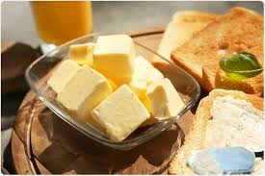
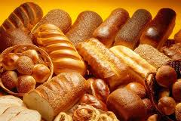
Soybean Breeding
Summary of the previous
Delta Center
Stearic acid
- Bakery products, shortenings, spreads, and margarines
- Oxidative stability for industrial applications
- Important parameter for oil quality
High stearic soybean lines
Challenges in breeding high stearic soybeans
A6
- Low germination and negative agronomic traits
- Sodium azide
- 6Mbp deletion
- SA: ~28%
SACPD-B
Known mutant alleles in SACPDs
FAM94-41
TCJWB03-806-7-19
- Natural
- 1bp substitution
- SA: ~9%
- SACPD-B (Chromosome 2)
- SACPD-C (Chromosome 14)
- Gamma ray
- 1bp deletion
- SA: ~7%
SACPD-C
30-1947-1
- Fast Neutron
- 2Mbp deletion
- SA: ~9%
Chr.2
Chr.14

Slide 3
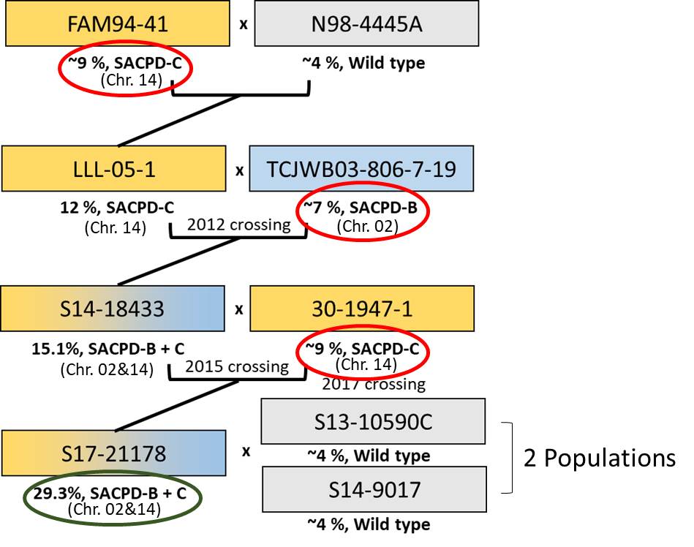
Soybean Breeding
Summary of the previous
Delta Center
Two mapping populations
Out of 250 RILs, 60 lines entered preliminary yield test in 2020 and three lines were selected for advanced yield test in 2021.
ª the percentage of yield performance of lines compared to Xtend checks. Prolonged off-target dicamba exposure significantly affected the yield performance of non-Xtend soybean lines.
^{b} the percentage of yield performance of lines compared to Round-up Ready checks.
Advanced yield test in 2021
Line | Maturity | Yield (bu/ac) | XTª | RR^{b} | Stearic acid (%)
S19-19183 | 4.8 | 50.8 | 74.6 | 77.7 | 16.0
S19-19186 | 4.3 | 47.9 | 70.3 | 73.2 | 18.5
S19-19190 | 4.9 | 47.8 | 60.0 | - | 17.0
Promising lines for germplasm release!

Slide 4
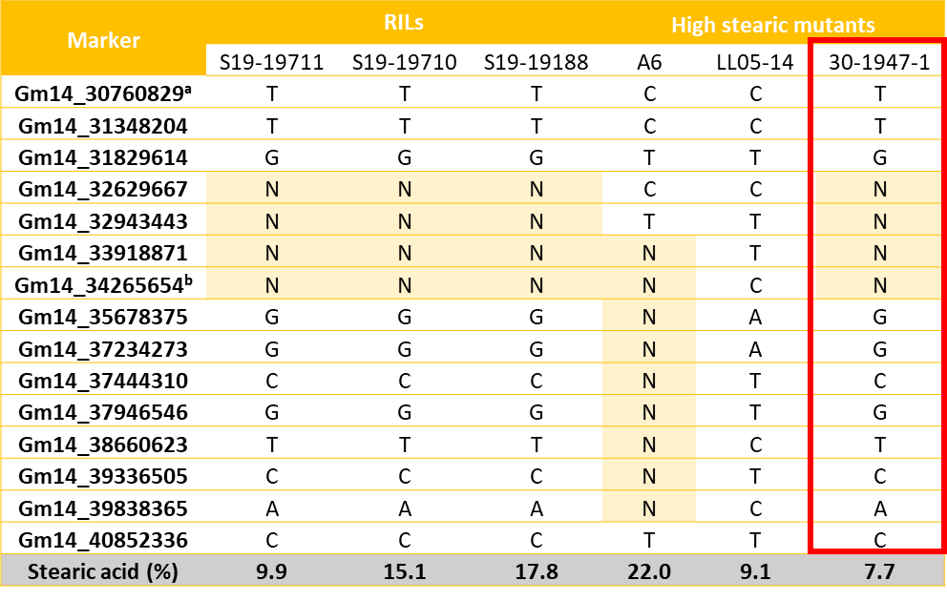
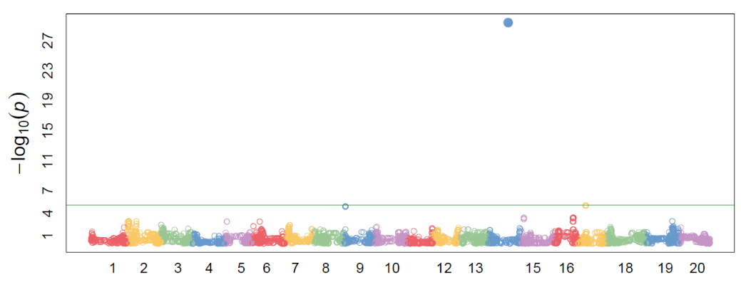
Soybean Breeding
Summary of the previous
Delta Center
6K SNP data
GWAS result
Smaller deletion size than A6 on SACPD-C regions on chromosome 14
Phenotypic variations showing that some lines have much higher stearic acid than 30-1947-1
Multiple mutant alleles or structural variations in deletion region?
Markers around the significant marker (a) resulted from GWAS and SACPD-C (b) region and the SNP information and stearic acid (%) of selected RILs and high stearic mutants.
Genome sequencing!!

Slide 5
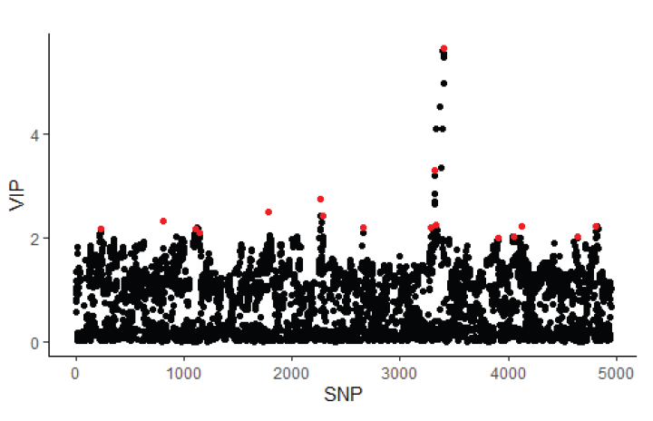
Soybean Breeding
Progress in 2022
Delta Center
Machine-learning GWAS
Enhanced statistical power to identify QTL with minor effect
A total of nine SNP markers involved in fatty acid biosynthetic process were found on chromosome 1, 3, 5, 13, 14, 16, and 18.

Slide 6
Soybean Breeding
Progress in 2022
Delta Center
Sequencing strategy & field experiment
17 lines
Sample # | Group | Line | Stearic acid | 2Mbp Deletion
1 | High Steric | S19-19188 | 21.1 | YES
2 | High Steric | S19-19187 | 20.5 | YES
3 | High Steric | S19-19715 | 19.2 | YES
4 | High Steric | S19-19185 | 14.2 | YES
5 | High Steric | S19-19181 | 16.6 | YES
6 | High Steric | S19-19712 | 16.5 | YES
7 | Low Stearic | S19-18842 | 3.5 | NO
8 | Low Stearic | S19-18829 | 3.4 | NO
9 | Low Stearic | S19-20072 | 3.3 | NO
10 | Low Stearic | S19-20086 | 3.2 | NO
11 | Low Stearic | S19-20088 | 3.1 | NO
12 | Low Stearic | S19-20018 | 3.1 | NO
13 | Pedigree | LLL-05-1 | 9.1 | NO
14 | Pedigree | 30-1947-1 | 7.7 | YES
15 | Historical line | A6 | 22.0 | 6Mbp deletion
16 | WT parents | S13-10590C | 3.0 | NO
17 | WT parents | S14-9017R | 3.0 | NO
Whole genome sequencing
Whole genome sequencing has been conducted for dissecting structural variation in the deletion
Analyzing structural variations is on processing
(Time due is in November)
Targeted sequencing
Targeted sequencing will be conducted for confirming the presence of known mutant alleles
Agronomic traits
2m-long single rows (100 seeds per row) were used for agronomic trait measurements (plant height, number of pods/nodes, 100-seed weight)

Slide 7
Soybean Breeding
New populations in 2022 progeny
Delta Center
Traits | Population | Pedigree | # lines | Stearic acid (%) |  | Oleic acid (%) (average)
 |  |  |  | Range | Average
UHS | CR20-132 | S19-19710 x S16-11644C | 2 | 20.2 - 20.9 | 20.6 | 23.8
UHS | CR20-133 | S19-19712 x S16-7922C | 7 | 21.0 - 34.3 | 27.1 | 12.1
UHS | PR20-038 | S19-19710 x S17CR-172 | 2 | 20.0 - 23.6 | 21.8 | 23.3
UHS | PR20-039 | S19-19181 x S16-5540R | 4 | 20.8 - 25.1 | 22.3 | 22.5
UHS | PR20-040 | S19-19181 x S17CR-189 | 18 | 20.1 - 33.4 | 22.1 | 21.2
UHS | PR20-042 | S19-19196 x S17CR-172 | 2 | 21.7 - 21.8 | 21.8 | 23.9
UHS | PR20-043 | S19-19188 x S11-20337 | 6 | 20.0 - 27.4 | 22.5 | 20.4
UHS | PR20-044 | S19-19188 x S17PR-482R | 2 | 21.3 | 21.3 | 34.9
HSHO | CR20-131 | S19-19715 x S17PR-481 | 11 | 6.3 - 14.9 | 9.9 | 75.1
HSHO | PR20-042 | S19-19196 x S17CR-172 | 7 | 7.0 - 17.2 | 11.2 | 72.1
HSHO | PR20-044 | S19-19188 x S17PR-482R | 4 | 8.8 - 18.4 | 12.9 | 70.9
HSHOLL | PR20-038 | S19-19710 x S17CR-172 | 1 | 11.7 | - | 74.0 / 3.2 (18:3)
HSHOLL | PR20-042 | S19-19196 x S17CR-172 | 1 | 7.4 | - | 79.2 / 3.1 (18:3)
HSHOLL | PR20-043 | S19-19188 x S11-20337 | 1 | 8.4 | - | 81.5 / 3.0 (18:3)

Slide 8
Soybean Breeding
What is next?
Delta Center
Progeny Selection
Agronomic traits
Genome sequencing
Germplasm
Select the promising progeny lines for further multi-environmental yield tests
Measure agronomic traits
Dissect structural variations in deletion and confirm the presence of known mutant alleles
Germplasm release for research community and soybean producers

Slide 9
Soybean Breeding
Delta Center
Thank you!
Questions?

