Slide 1


Varietal Resistance to Cercospora Leaf Blight
Brian Ward, PhD
Department of Plant Pathology and Crop Physiology
Louisiana State University Agricultural Center

Slide 2
Locations
Alexandria / Bossier City / St. Joe, LA
Stoneville / Verona, MS
Cotton Grove, TN
Beaumont, TX
Portageville, MO
Fairhope, AL
Kibler / Marianna / Rohwer / Stuttgart, AR
2016, 2017

Slide 3
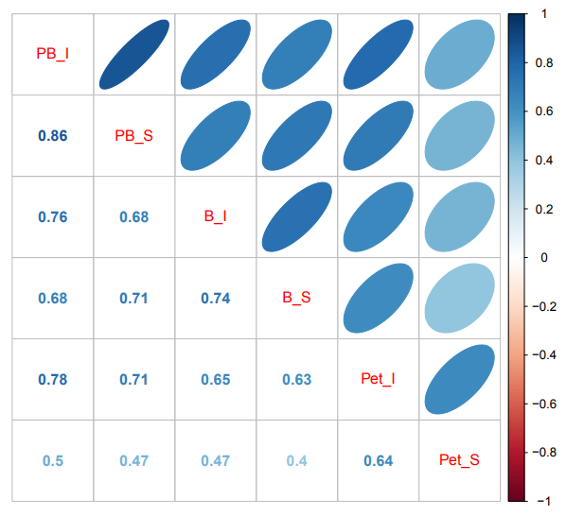
Refine Rating System

Slide 4
Resistant Breeding Lines
2/520 resistant at all analyzed locations
  PI 548548
  PI 592756
  2016
  PI 398982 PI 548477 PI 548514 PI 548518 PI 548548 PI 548986 PI 561702 PI 592756 PI593653 PI 595765 PI 601982
  2017
  PI398359 PI398386 PI398809 PI399003 PI399022 PI407835 PI408191A PI417107 PI417202 PI438295 PI458097 PI506653 PI506866 PI507093 PI507459 PI518673 PI540555 PI548548 PI548653 PI559931 PI592756 PI595081 PI614155 PI615582

Slide 5
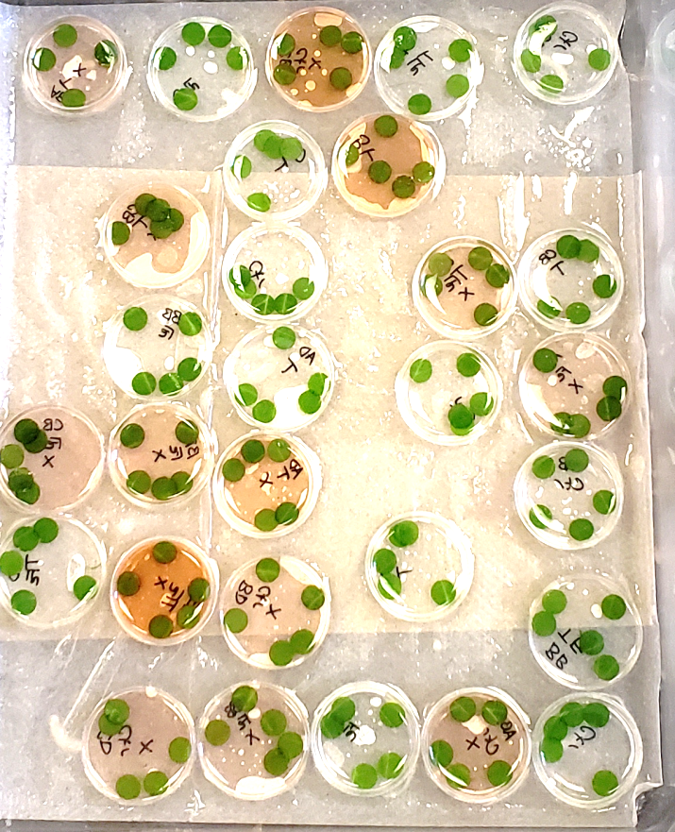
Resistance Screening
Assay utilizing cercosporin (toxin) applied to leaf disks.
3-6 days, minimal material cost.
Resistant Susceptible

Slide 6
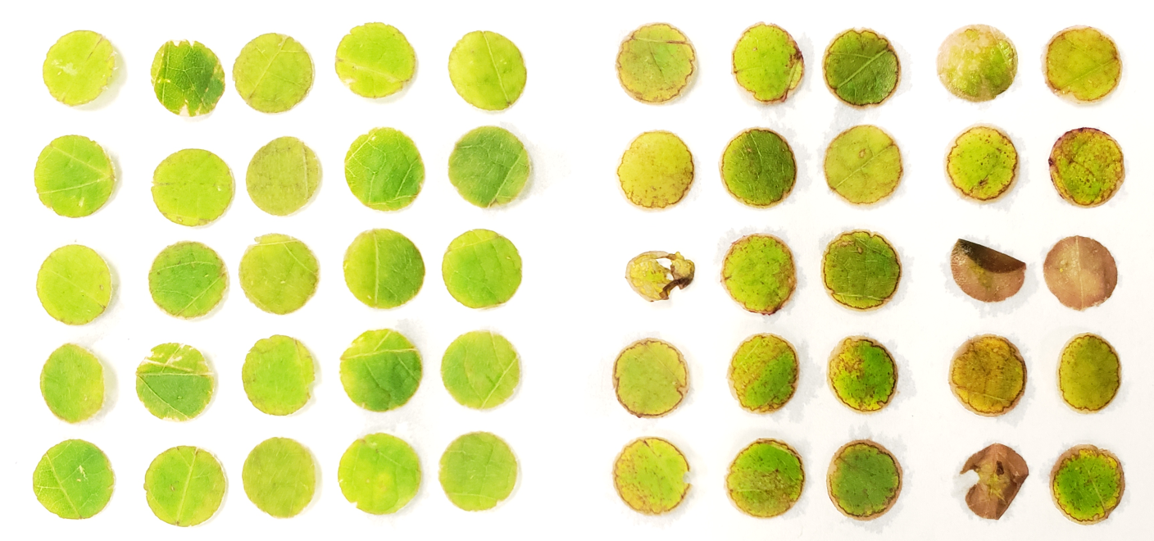
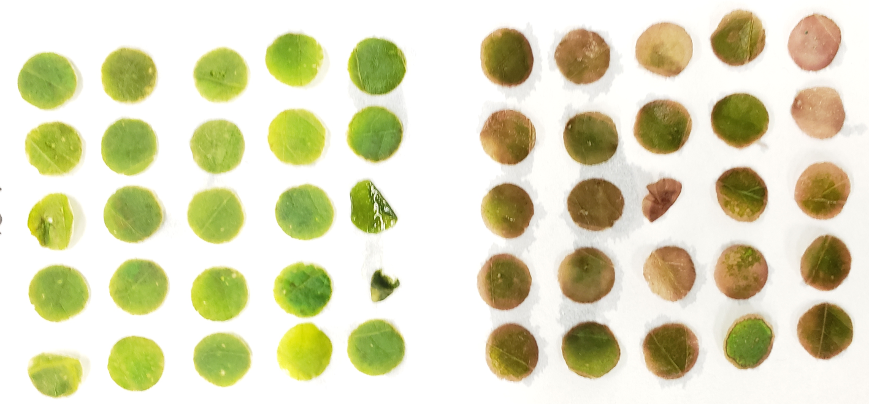
Resistance Screening
Variety 7
Variety 24

Slide 7
Soil Type And Resistance
7%
20%

Slide 8
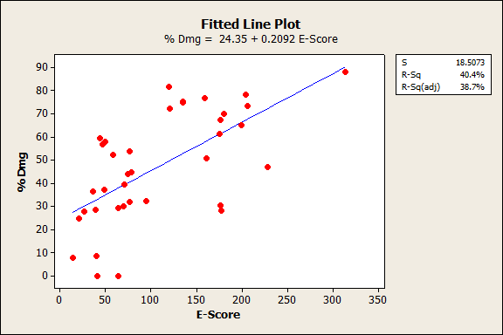
Nutrition and Resistance
Pearson correlation = 0.635 (Strong)
P-Value = 0.000 (Significant)

Slide 9
Soil and Resistance

Slide 10
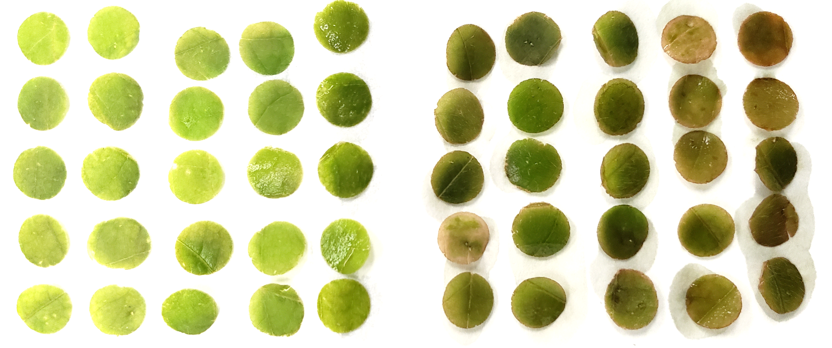
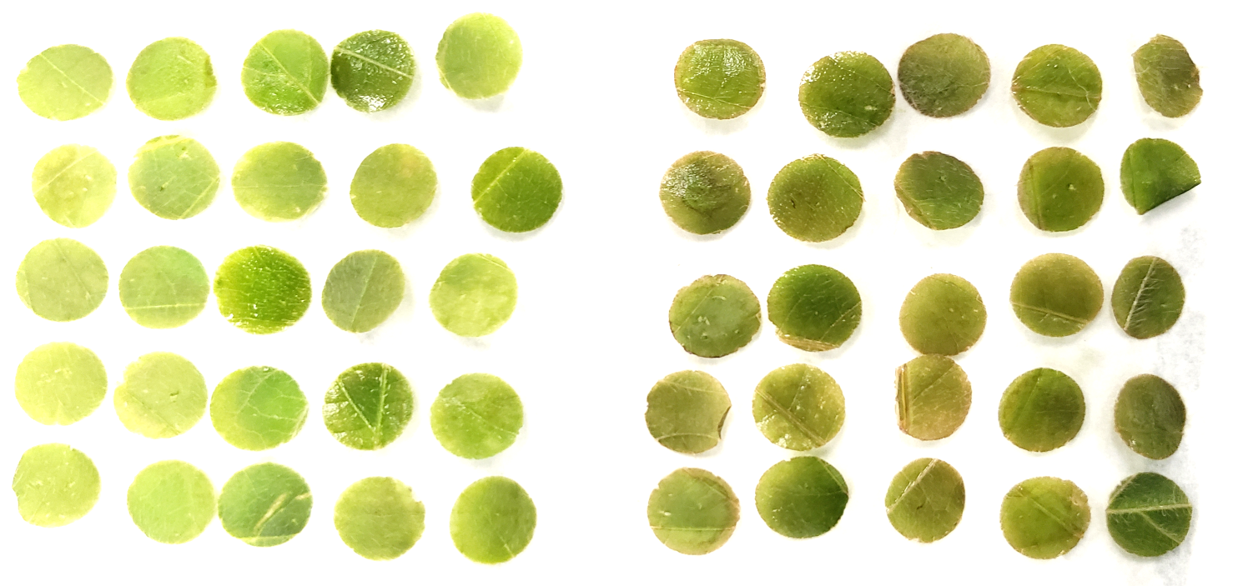
Soil and Resistance
CTR
Iron

Slide 11


Collaborators
Dr. Trey Price
Dr. Thanos Gentimis
Dr. Blair Buckley
Dr. Tom Allen
Dr. John Rupe
Dr. Travis Faske
Dr. Xin-Gen Zhou
Dr. Pengyin Chen
Dr. Terry Spurlock
Dr. Ed Sikora
Dr. Heather Kelly
Dr. Leandro Mozzoni
Bob Holland
Dr. Liliana Florez
Dr. Moldir Orazaly
David Moseley
Dr. Sara Thomas
Clark Robertson
Marija Zivanovic
Emily Pace
Ethan Hunt

