Slide 1

Southern Root-Knot Nematode in MG4 Soybean: Characterization of Resistance Mechanisms and Breeding for Resistance
Travis Faske – Univ. Arkansas Sys., Lonoke
Tristan Watson – LSU AgCenter, Baton Rouge
Henry Nguyen – Univ. Missouri, Columbia
Andrea Acuna-Gilando – Univ. Arkansas Sys., Fayetteville
Pengyin Chen – Univ. Missouri, Portageville
MSSB Proposal Meeting
Aug 25-26, 2022
Notes:
Thanks for allowing to present by zoom
Personnel Changes

Slide 2
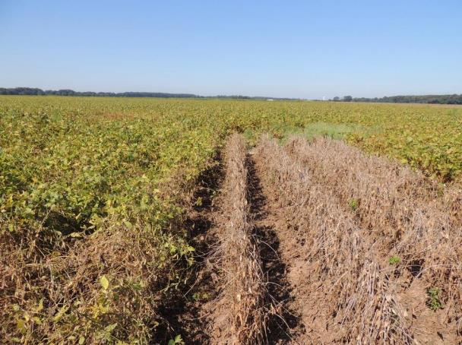
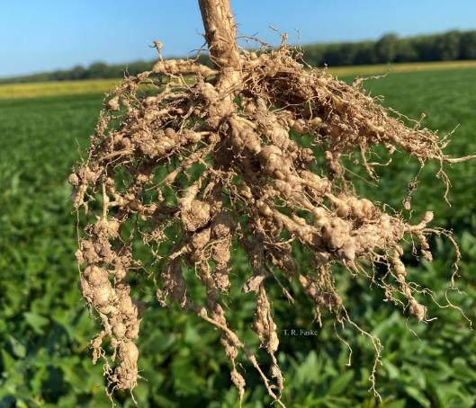
Meloidogyne incognita
Notes:
75% yield loss with susceptible variety in research plots. 70% in field near Kerr.
Nematicides: 1 yr, low protection
Resistance: Limited MGIV and 2021 and Progeny, Armor, and Delta Grow all same genetics

Slide 3
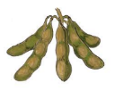
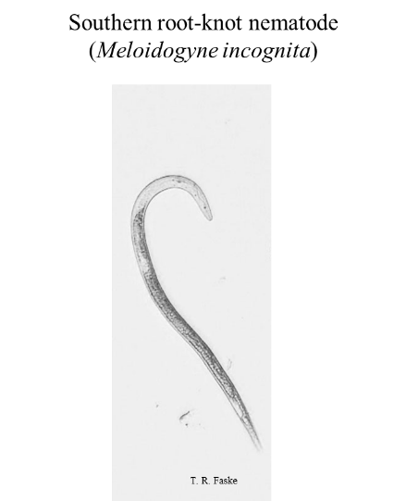
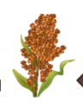




Hosts
Nonhost
Notes:
Not going away and probably get worse in the future

Slide 4
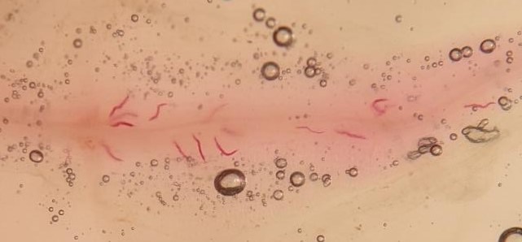
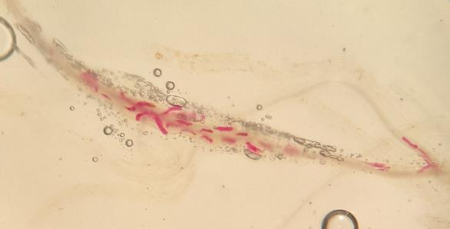
SRKN in MG4 Soybean
Year 1 (3/1/22 to 2/28/23) – All rec. funding in July
Objectives:
  Char. the mechanism of resistance to SRKN in MG4 soybean. (Faske and Watson)
    Optimize techniques and select controls for assays.
Notes:
PI 567516C, PI 438489B

Slide 5
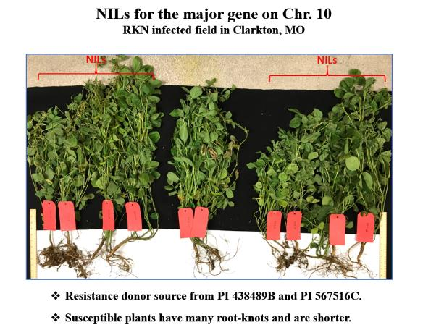
SRKN in MG4 Soybean
Objectives:
  Characterize and develop new markers for new sources of SRKN resistance (Nguyen et al.)
    Seed increase of resistant doner lines: Forrest, PI 567516C, and PI 438489B, and near-isogenic lines (NIL, Magellan x PI 438489B) is underway.
    Currently developing DNA marker assay for the QTL on chromosome 13.
Notes:
Evaluate germplasm that has confirmed

Slide 6
SRKN in MG4 Soybean
Objectives:
  Develop MG4 varieties with resistance to the SRKN (Acuna, Canella, et al.)
    Arkansas:
      10 lines (SRKN tolerant x high-yielding soybean varieties) were developed.
      20 early generation lines were increased in Puerto Rico and Fayetteville.
    Missouri:
      19 breeding lines were entered into USDA Southern Trials.
      260 advanced lines, many with SRKN-resistant pedigree, are being tested across 8 states.
Notes:
QTL 10 markers used on many of these entries.

Slide 7
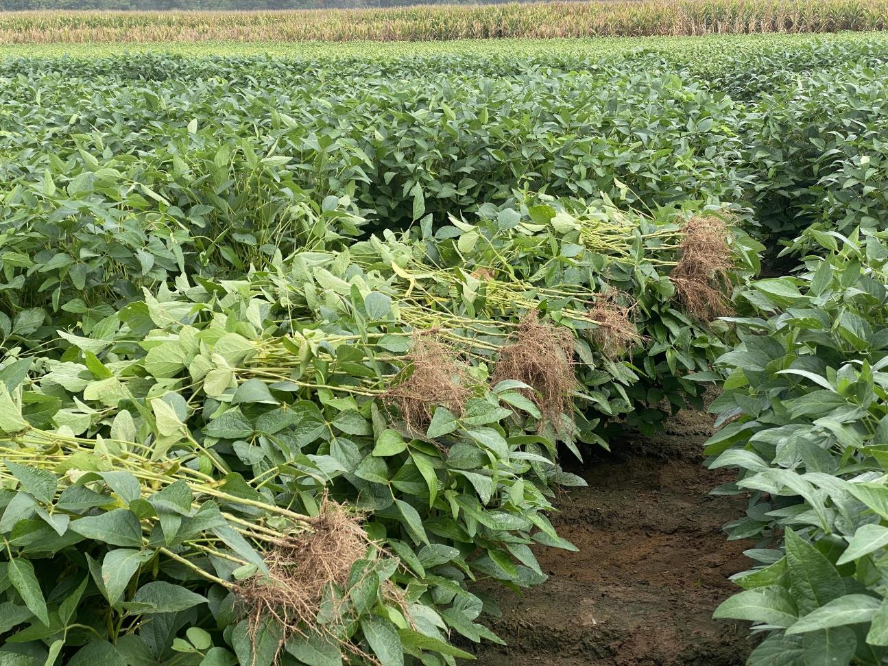
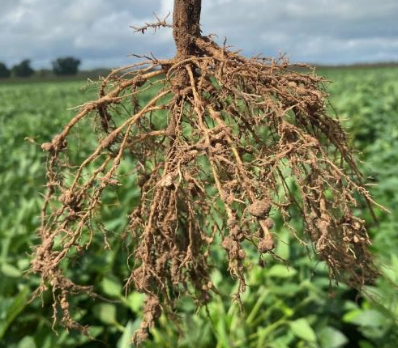
Aug 23, 2022, Field Screen – Kerr, AR
44 AR lines
7 MO lines
Notes:
Assume MG 4. 255 plots

Slide 8
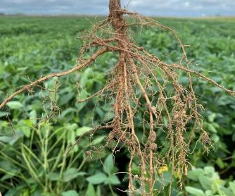
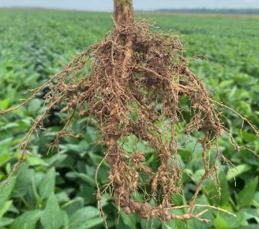
SRKN in MG4 Soybean: Char. the MOR and Breeding for Resistance
Lead Investigator: Travis Faske, Univ. of Ark. Sys., Div. of Ag
Year: Yr. 2 (2023 to 2024)
Amount: $75,000 ($15,000/PI)
Objectives:
Char. the mechanism of resistance to SRKN in MG4 soy germplasm
Char. and develop new markers for new sources of SRKN resistance
Develop MG4 varieties/genotypes with resistance to the SRKN
Output:
Peer-reviewed publications
SRKN-R MG4 Varieties
Notes:
Pubs on MOR, genetic char of soy resistance, and stacking platforms using MAS

Slide 9
Thank you
2023-2024 Funding Cycle
Travis Faske
Extension Plant Pathologist
Lonoke AR
tfaske@uada.edu

