Slide 1
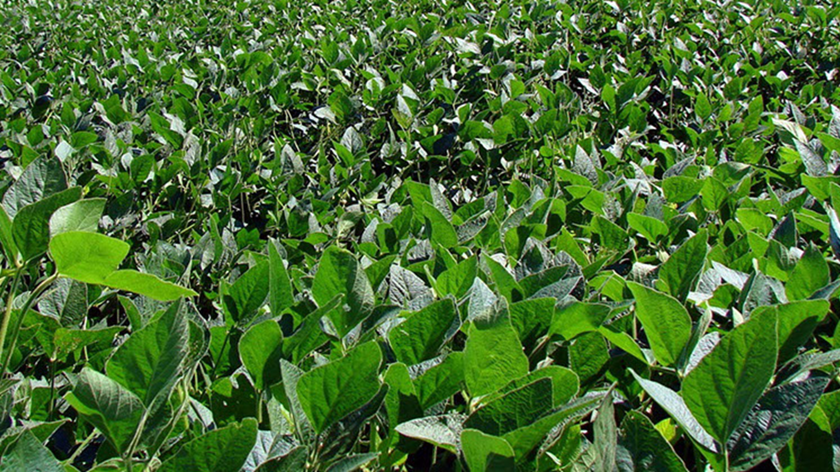
Enhancing Stink Bug Resistance in Midsouth Soybean
Dr. Jeff Davis
Department of Entomology
LSU AgCenter

Slide 2
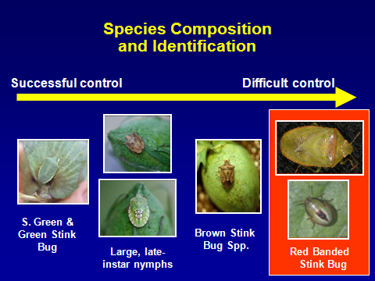
Controlling Stink Bugs in Soybean
Stink bugs can be difficult to control
  Multiple insecticide applications
  Few products available
  Concerns about resistance management
Insecticide applications can flare other pests by reducing predator numbers

Slide 3
Host Plant Resistance (HPR)
“the heritable ability of plants to escape attacking enemies, partially or fully, thus minimizing the amount of damage experienced by the plant”
Why use HPR?
Specific
Persistent
Compatible with other IPM tools and tactics

Slide 4
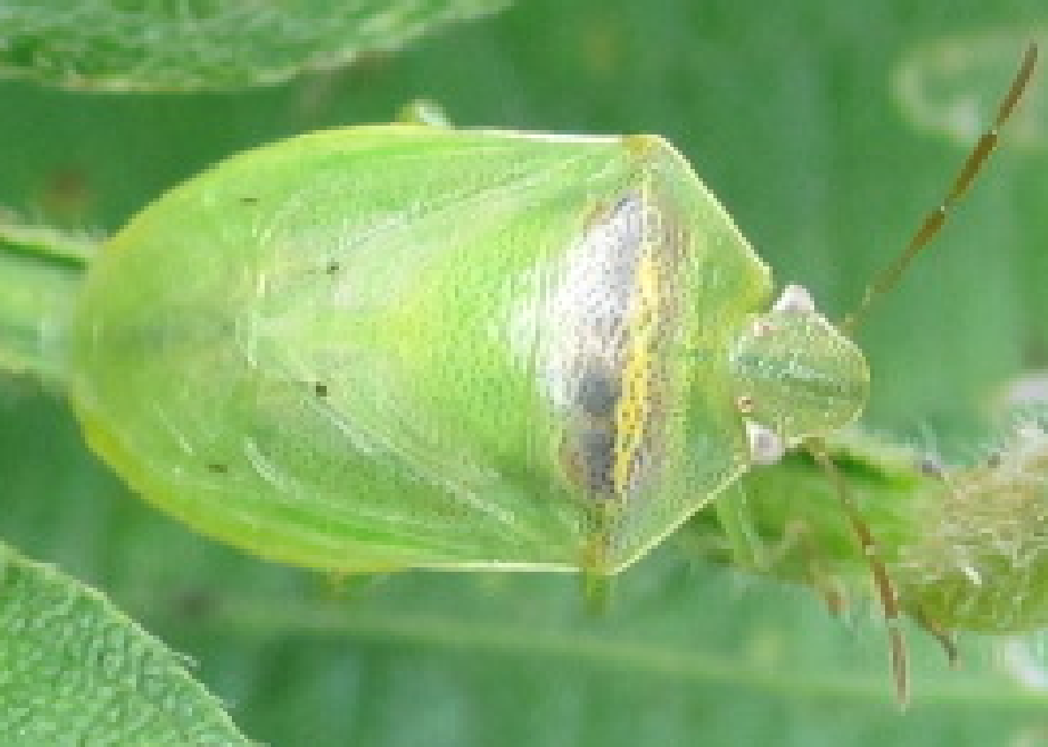



Enhancing Stink Bug Resistance:
Update August 2022 (Year 1 of 3)
Previous funded projects to LA and TX supported redbanded stink bug sampling, seasonal movement, control tactics, and screening of soybean plant introductions for resistance
Part of this work resulted in the creation of 6 stink bug breeding lines:
TX12-1033
TX12-1034
TX12-1035
TX12-1039
TX12-1041
TX12-1061

Slide 5
Enhancing Stink Bug Resistance:
Update August 2022 (Year 1 of 3)
Dr. Chen has done further crossing resulting in new soybean populations we are screening in the lab and field

Slide 6
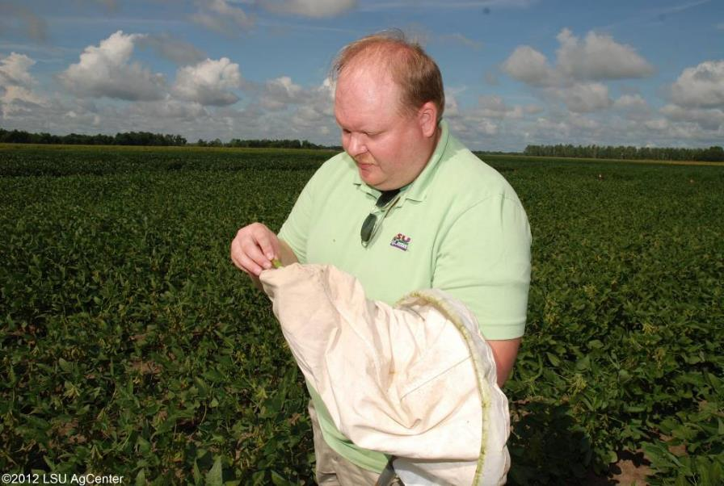
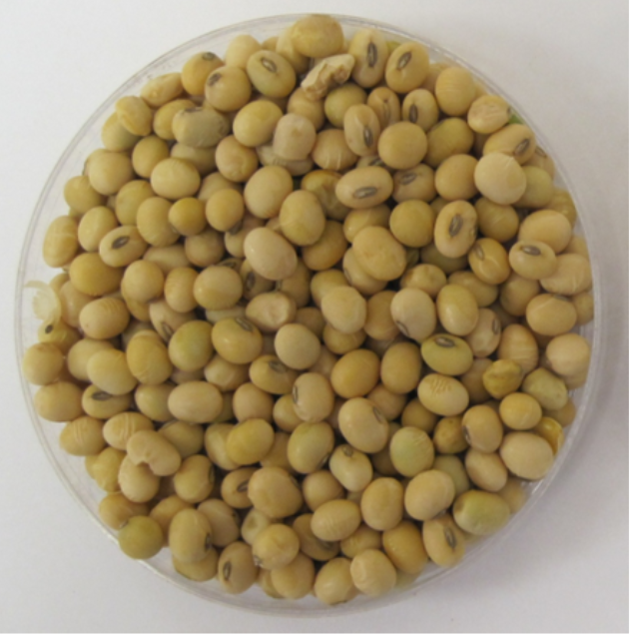
Obj. Screen soybean for resistance to stink bugs and identify specific resistance mechanisms
Notes:
6

Slide 7
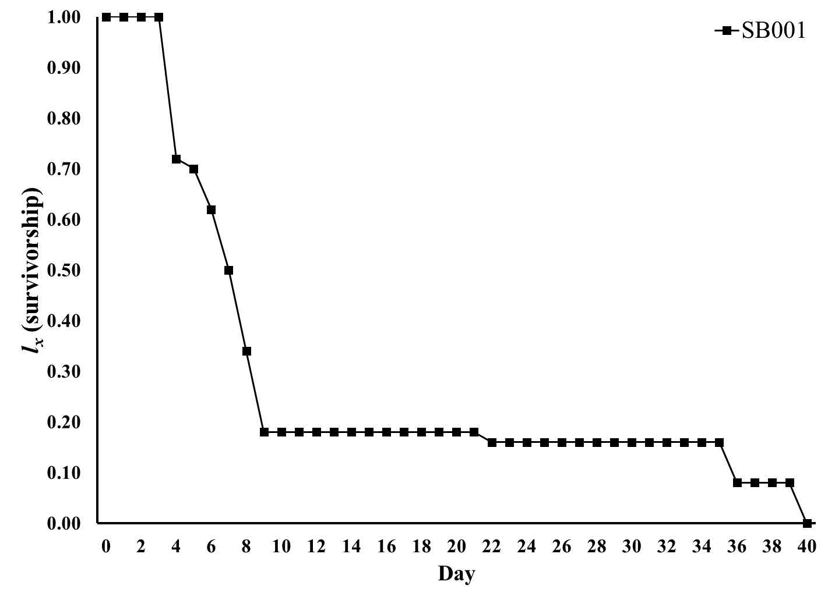

Slide 8
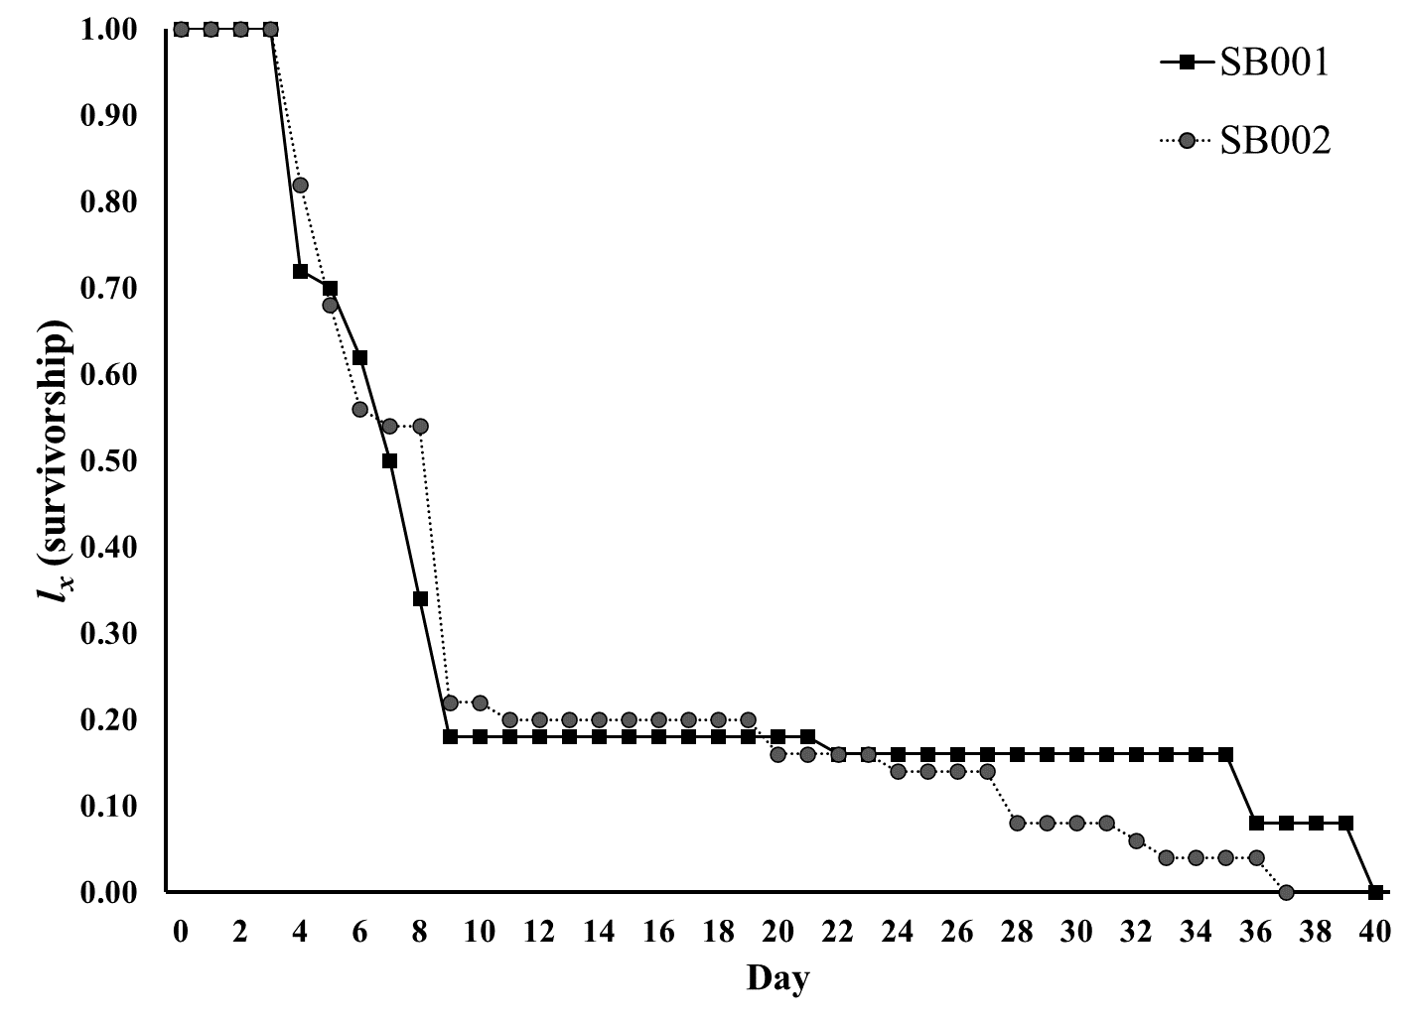

Slide 9
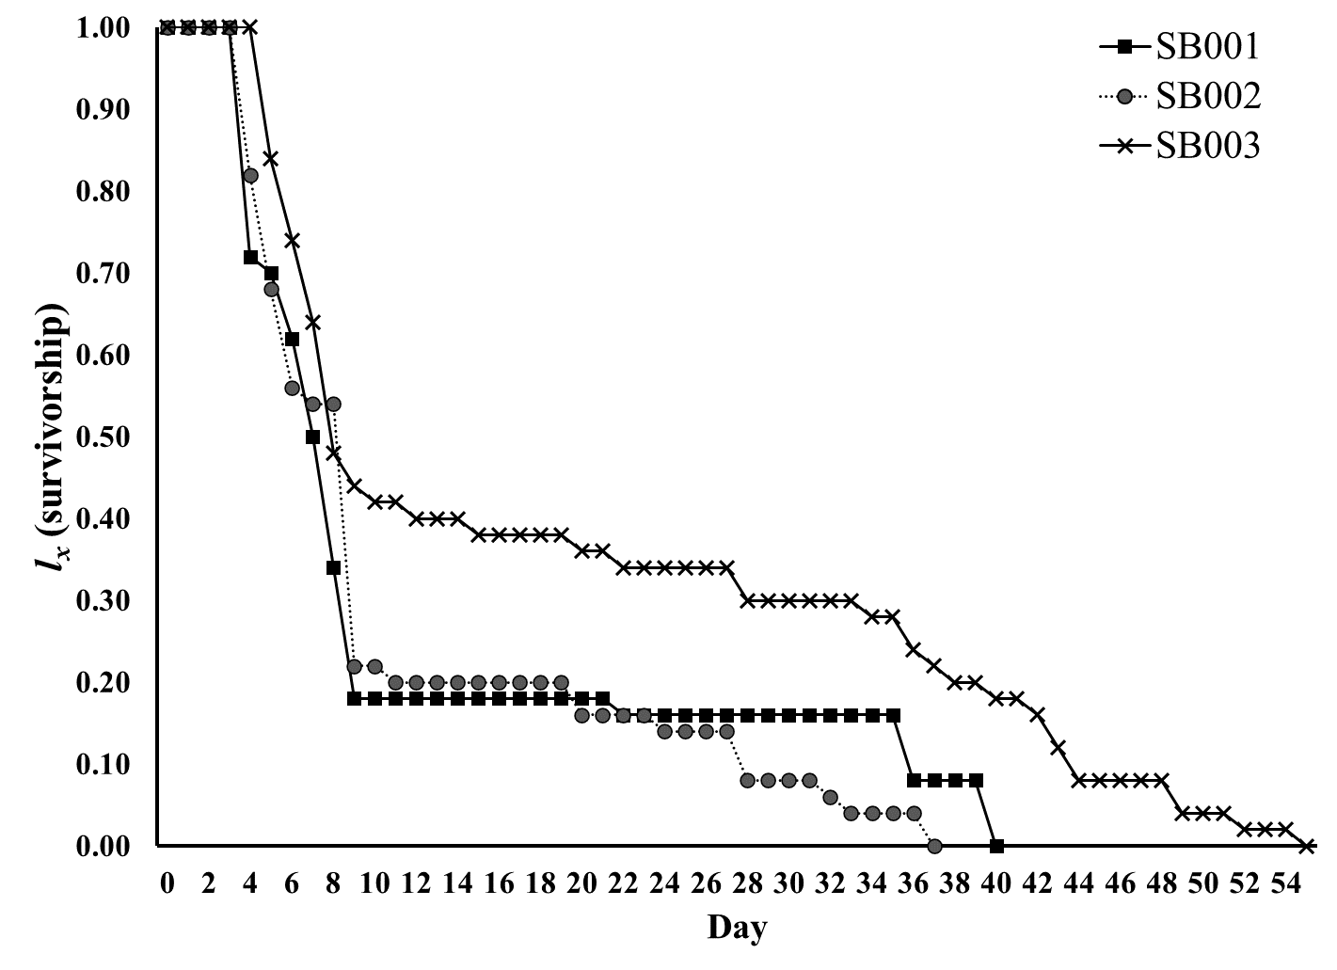

Slide 10
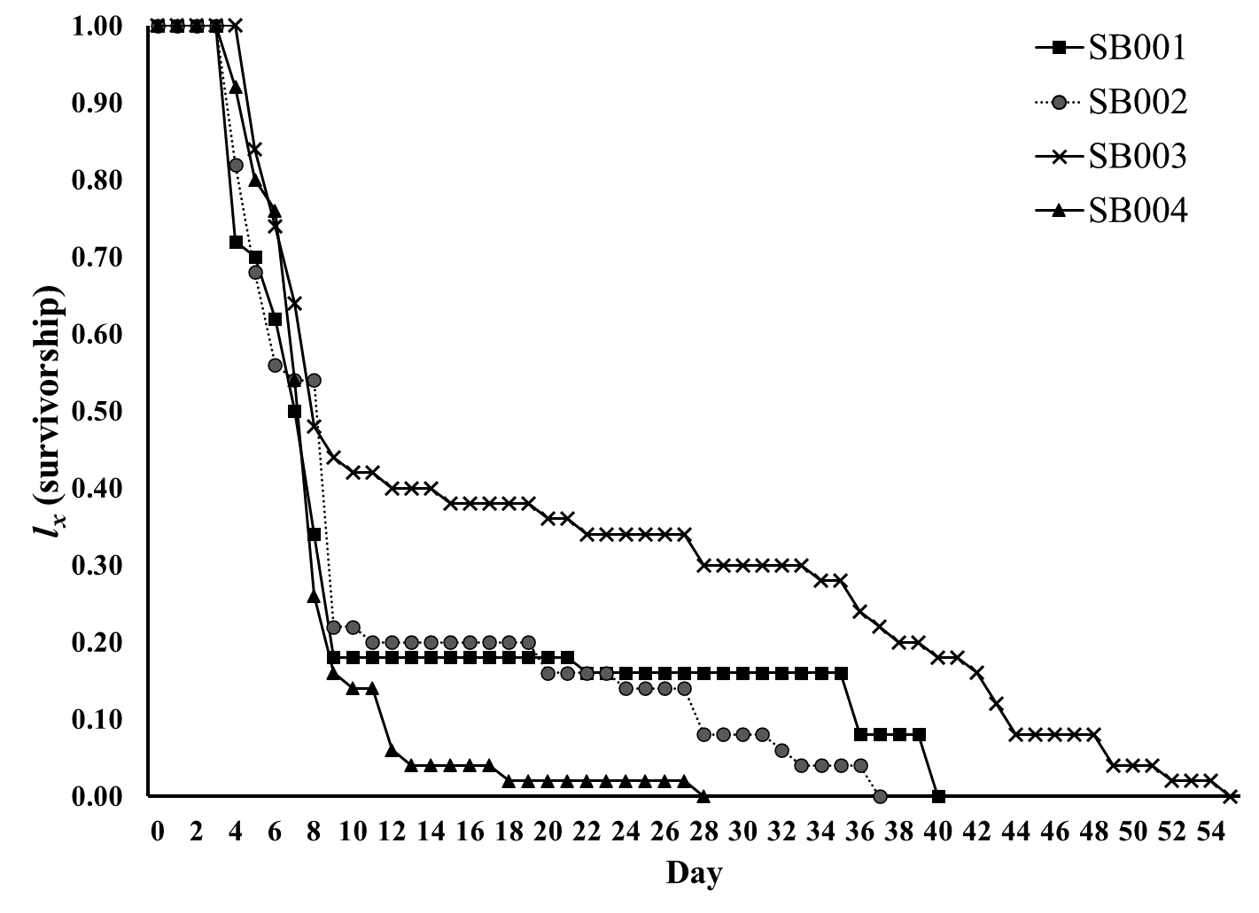

Slide 11
Enhancing Stink Bug Resistance:
Update August 2022 (Year 1 of 3)
r_{m}, intrinsic rate of increase; R_{o}, net reproductive rate; T, mean generation time
* SB004 had no nymphs reach adult

Slide 12
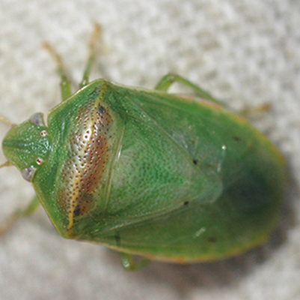
End Goal:
Identify specific mechanisms of resistance
Develop quantitative trait loci for marker assisted selection to speed breeding

Slide 13
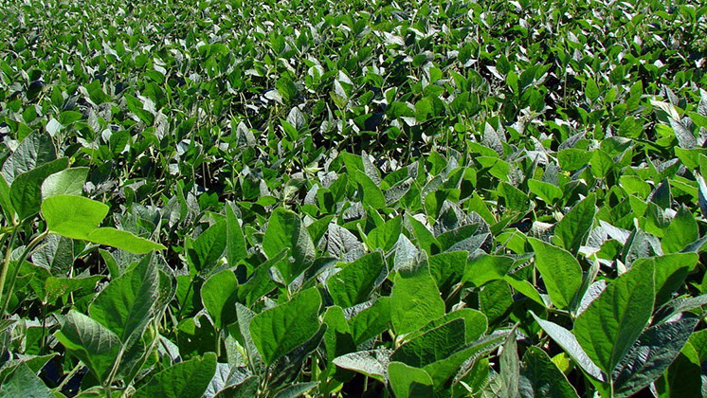
Thank you for continued funding
Questions?

