Slide 1
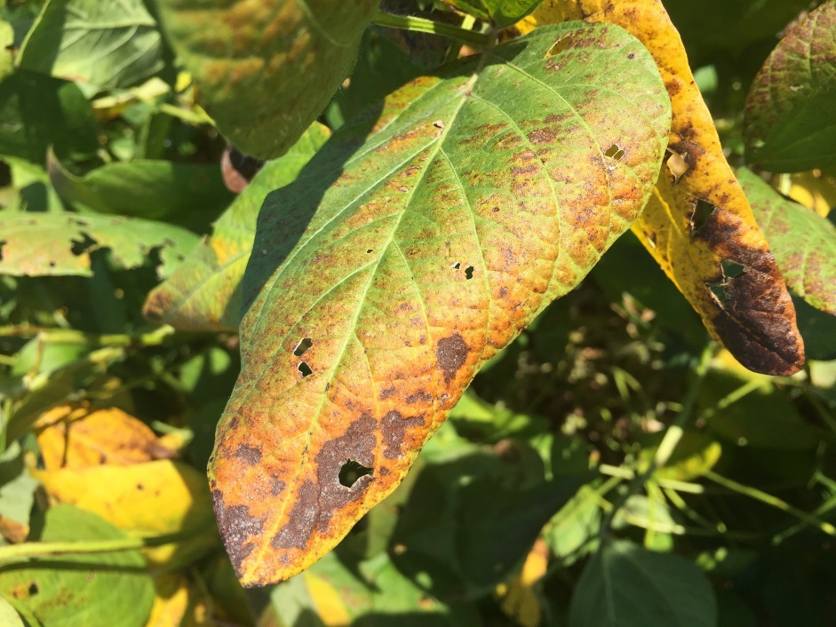
Enhanced Pest Control Systems for Mid-South Soybean Production
Tom Allen, Mississippi State
Blair Buckley, LSU AgCenter
Pengyin Chen, University of Arkansas
Jeff Davis, LSU AgCenter
Travis Faske, University of Arkansas
Clayton Hollier, LSU AgCenter
Heather Kelly, University of Tennessee
Trey Price, LSU AgCenter
John Rupe, University of Arkansas
Grover Shannon, University of Missouri
Ed Sikora, Auburn
Terry Spurlock, University of Arkansas
Shane Zhou, Texas A&M
MSSB Meeting
Baton Rouge, LA
January 30, 2017

Slide 2
2016 MSSB Project Locations
Cooperator | Location # | Location (s) | Status | Disease (s)
Allen | 2 | Stoneville, MS Verona, MS | Completed Completed | CLB, FLS, SBS, TS Need data
Buckley | 1 | Bossier City, LA | Completed | CLB
Faske | 1 | Newport, AR | Completed | CLB, FLS, TS
Hollier | 2 | Baton Rouge, LA Crowley, LA | Flooded Flooded | - -
Kelly | 1 | TN | Completed | CLB, SBS
Price | 2 | Alexandria, LA St. Joseph, LA | Completed Completed | FLS, CLB, TS, RKN, FeX, TRD, AB, & SBR
Rupe | 1 | Marianna, AR | Completed | CLB, TS
Shannon | 1 | Portageville, MO | Completed | No Disease
Sikora | 1 | Shorter, AL | Completed | CLB
Spurlock | 1 | Rohwer, AR | Completed | CLB
Zhou | 1 | Beaumont, TX | Flooded | -

Slide 3
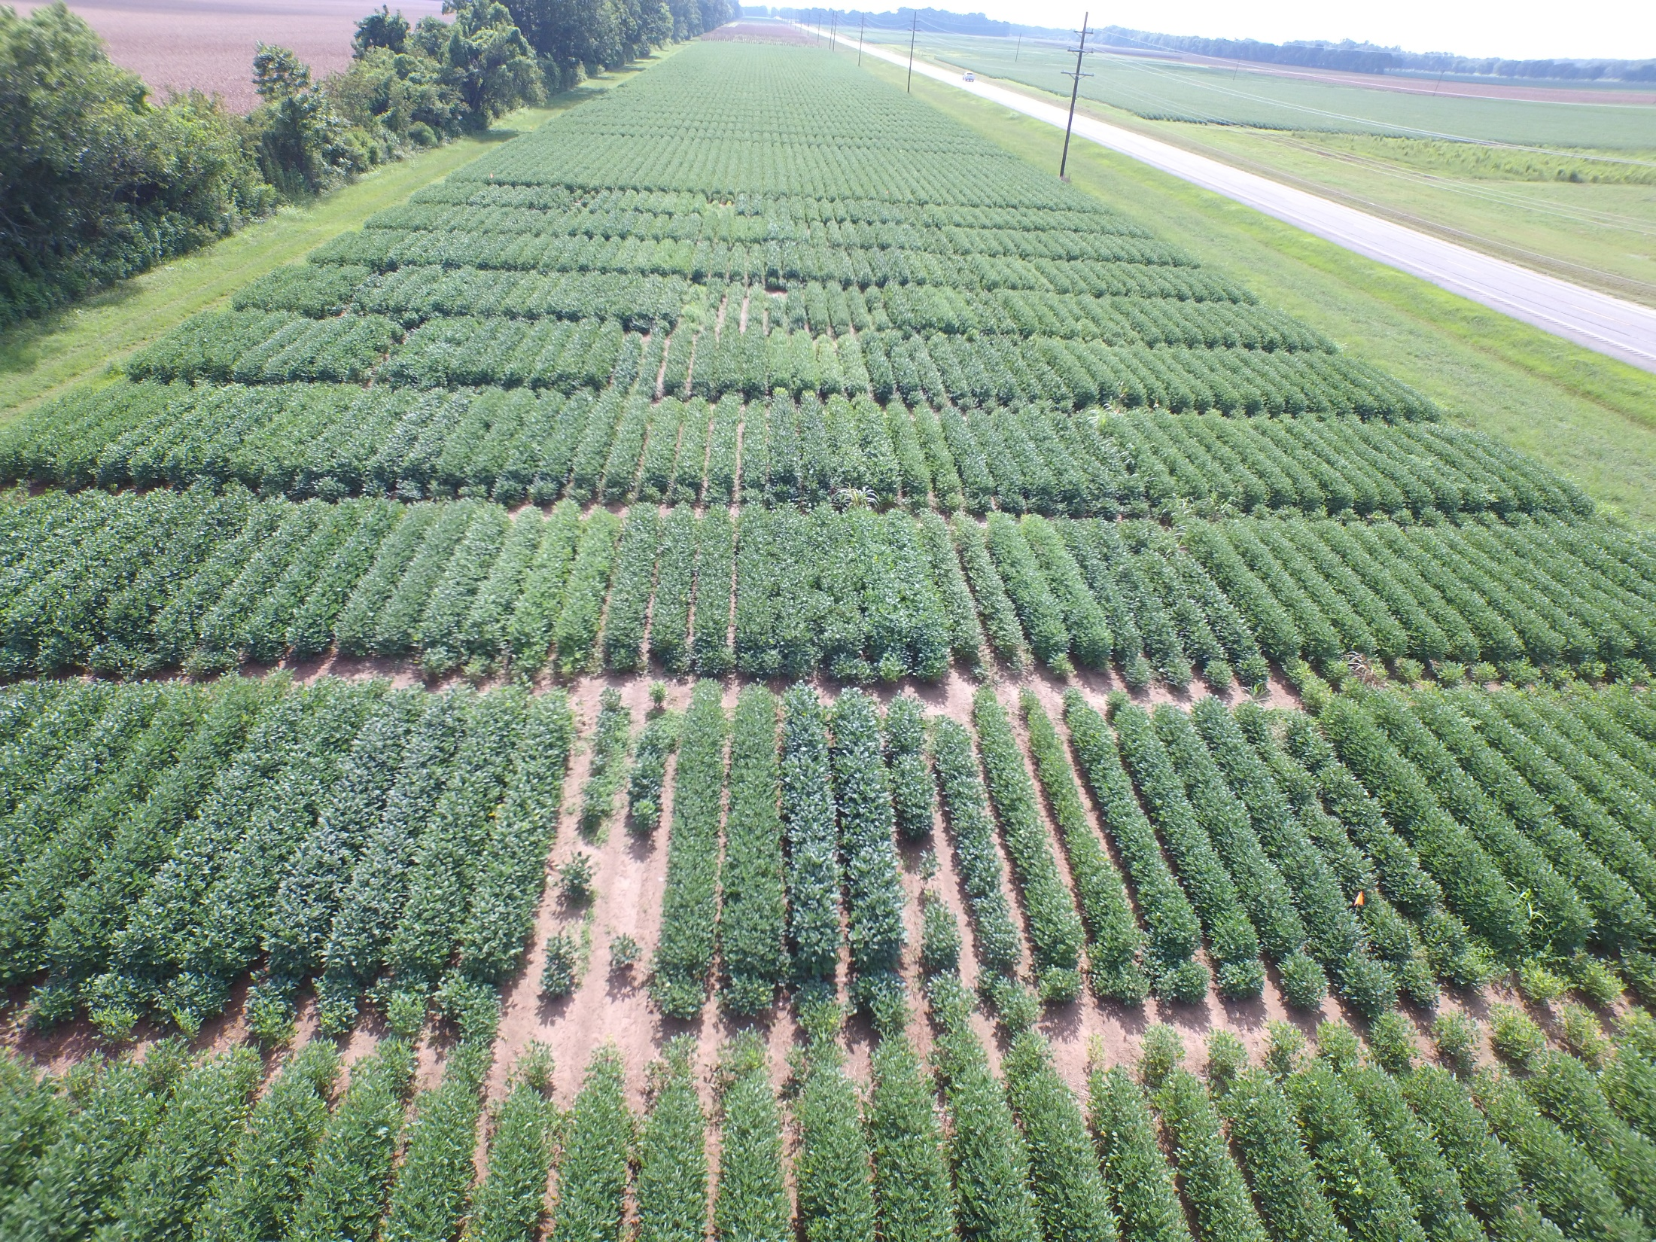
Alexandria, LA Location

Slide 4
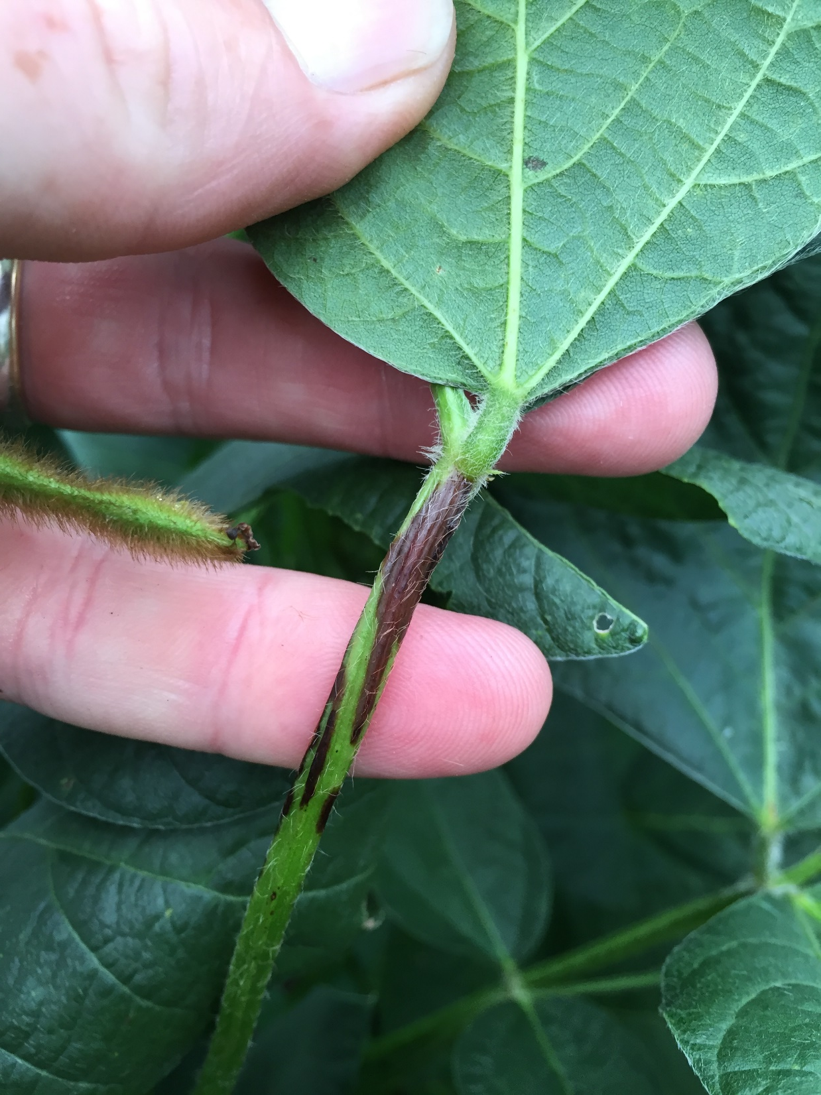

Slide 5
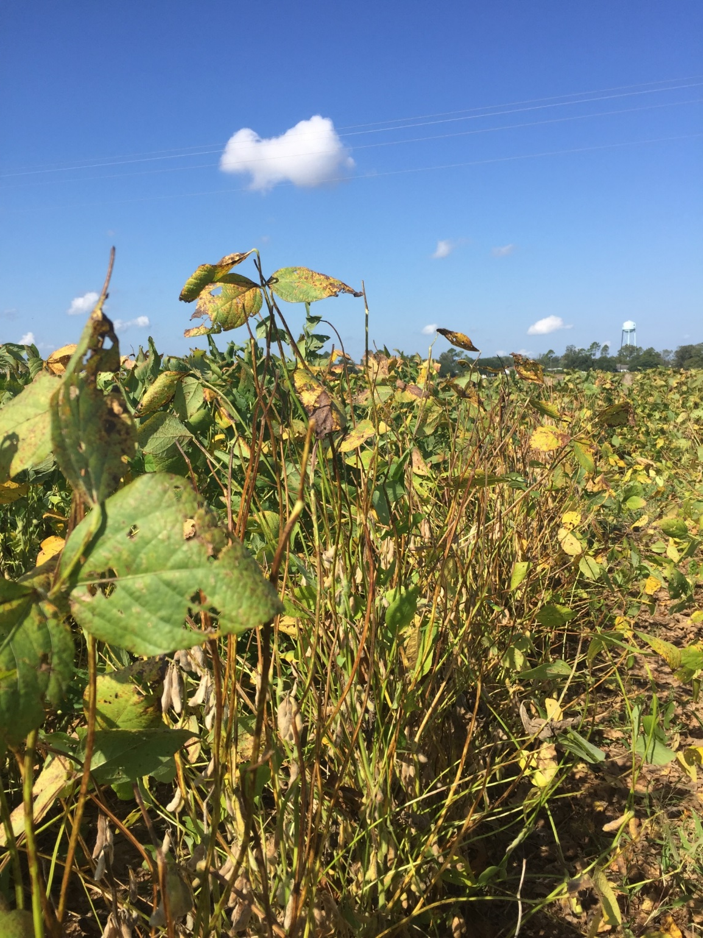
Petiole Rating
0-10 Scale or 0-100
Estimate % of affected petioles in the plot.
1 = 10
2 = 20
3 = 30…etc.

Slide 6
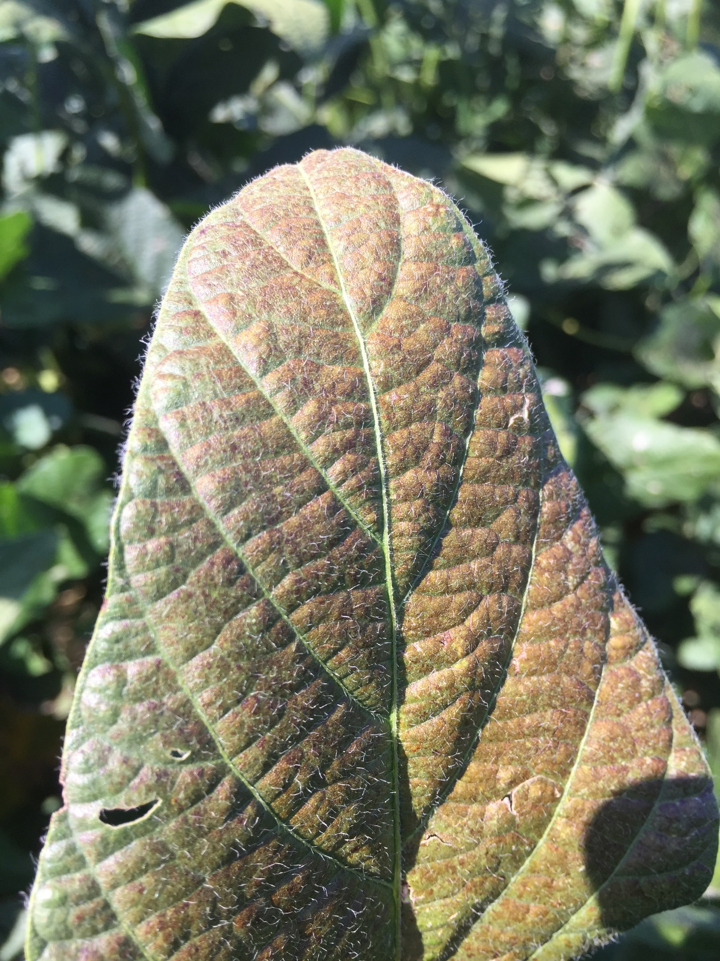

Slide 7
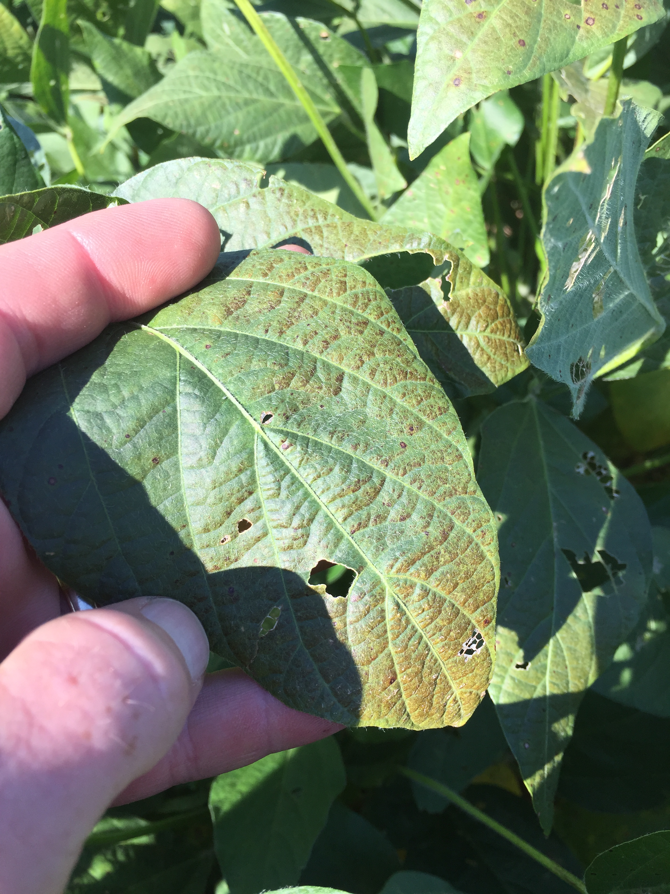
Purple/Bronze Rating
0-10 Scale or 0-100
Estimate % of bronzed/purpled/
leathery leaf area in the plot
1 = 10
2 = 20
3 = 30…etc.

Slide 8
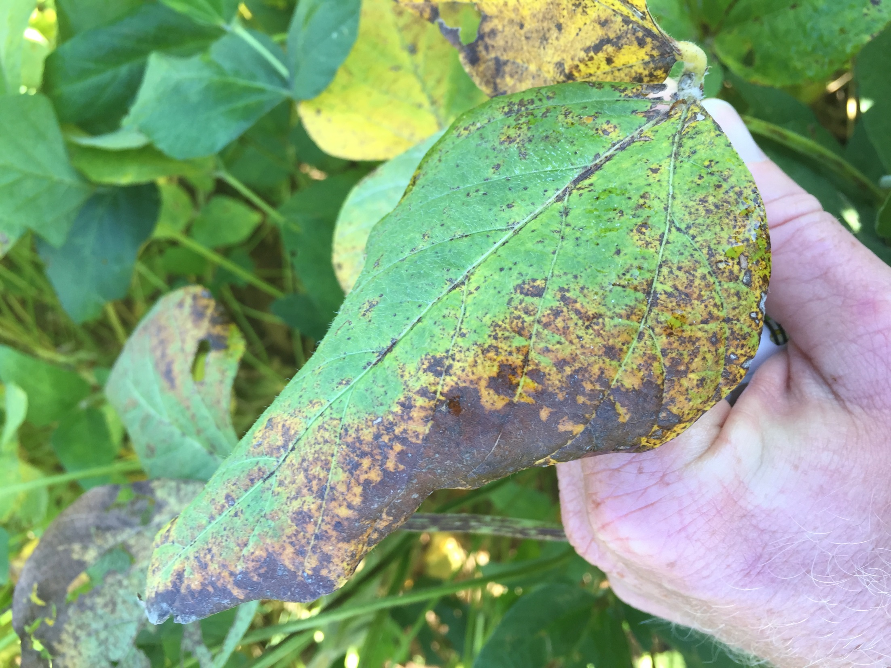

Slide 9


Slide 10
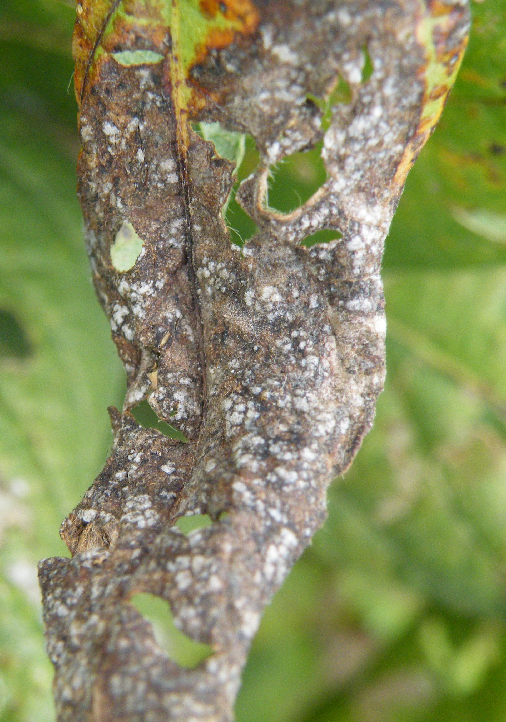
Blight Rating
0-10 Scale or 0-100
Estimate % of blighted leaf area in the plot.
1 = 10
2 = 20
3 = 30…etc.

Slide 11
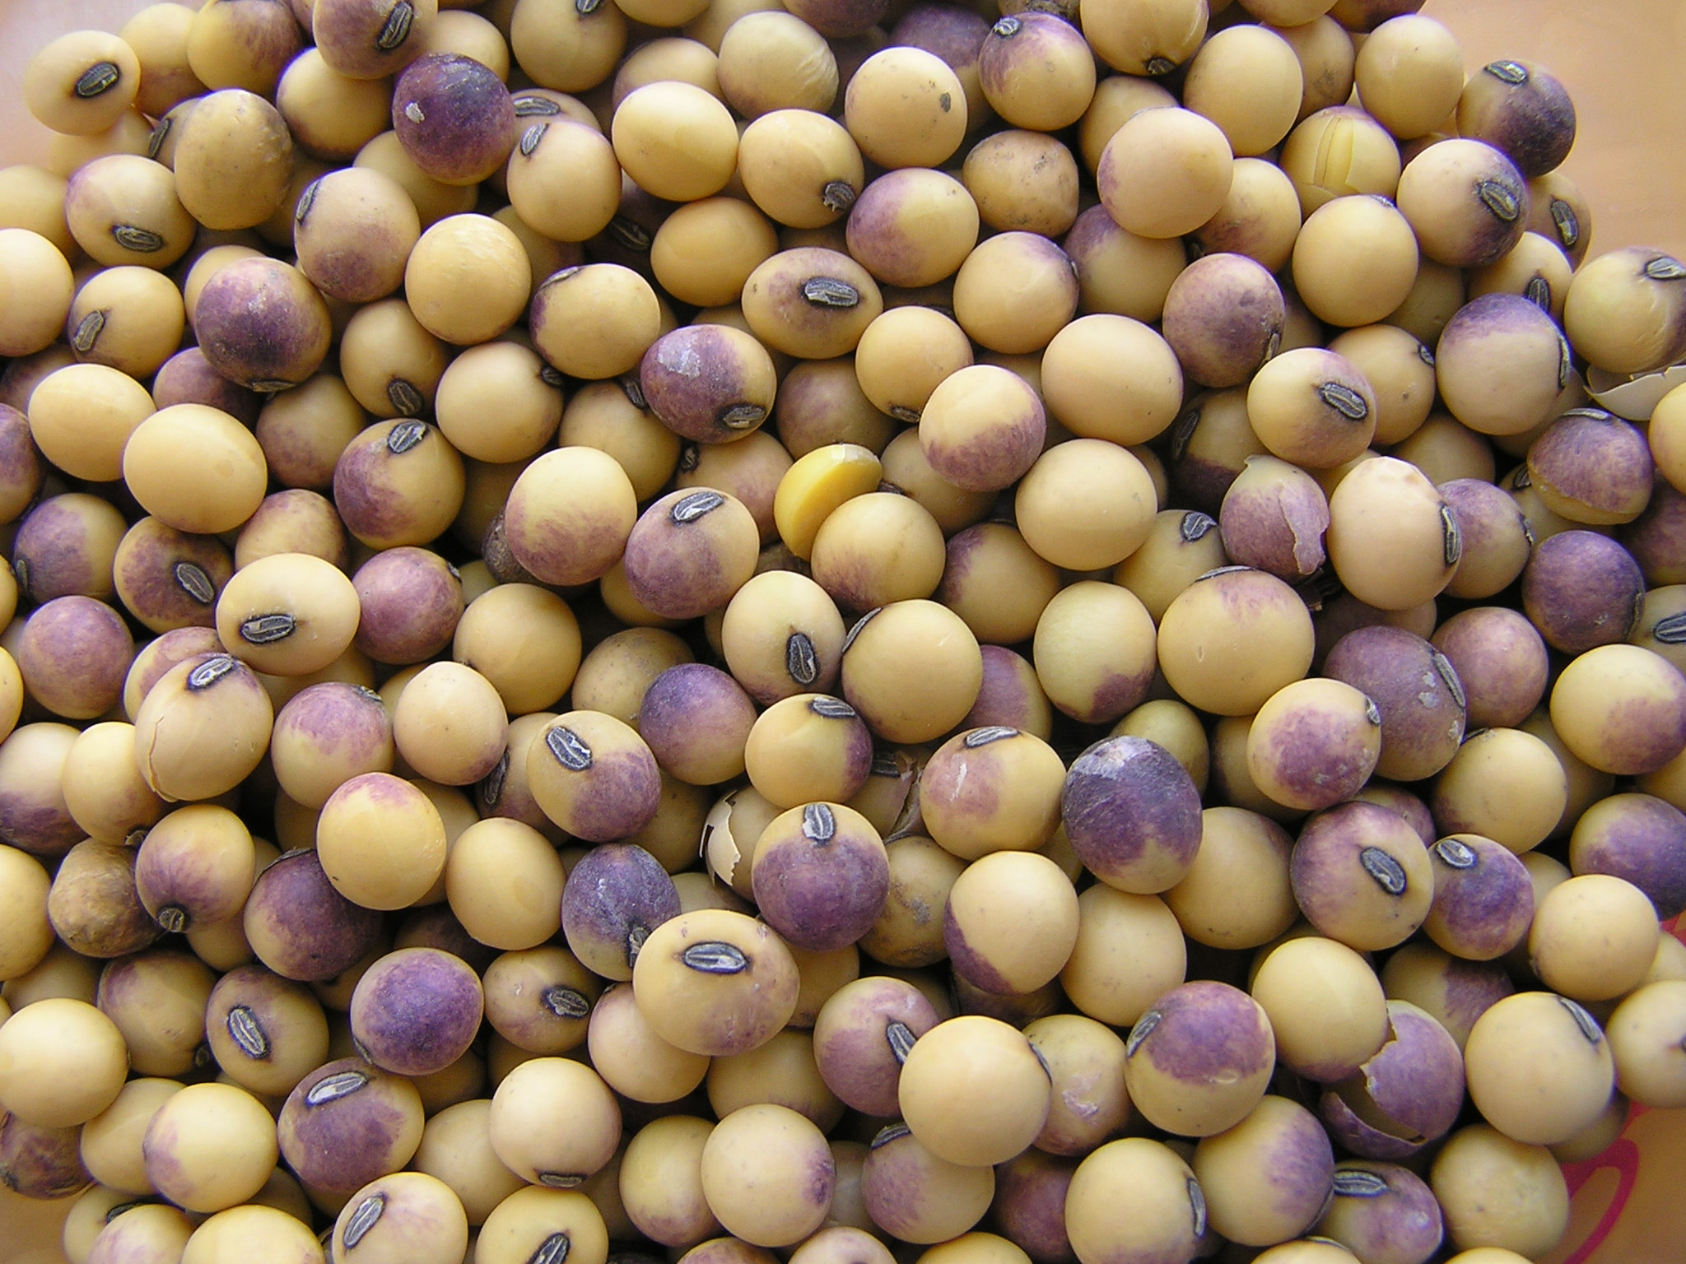

Slide 12
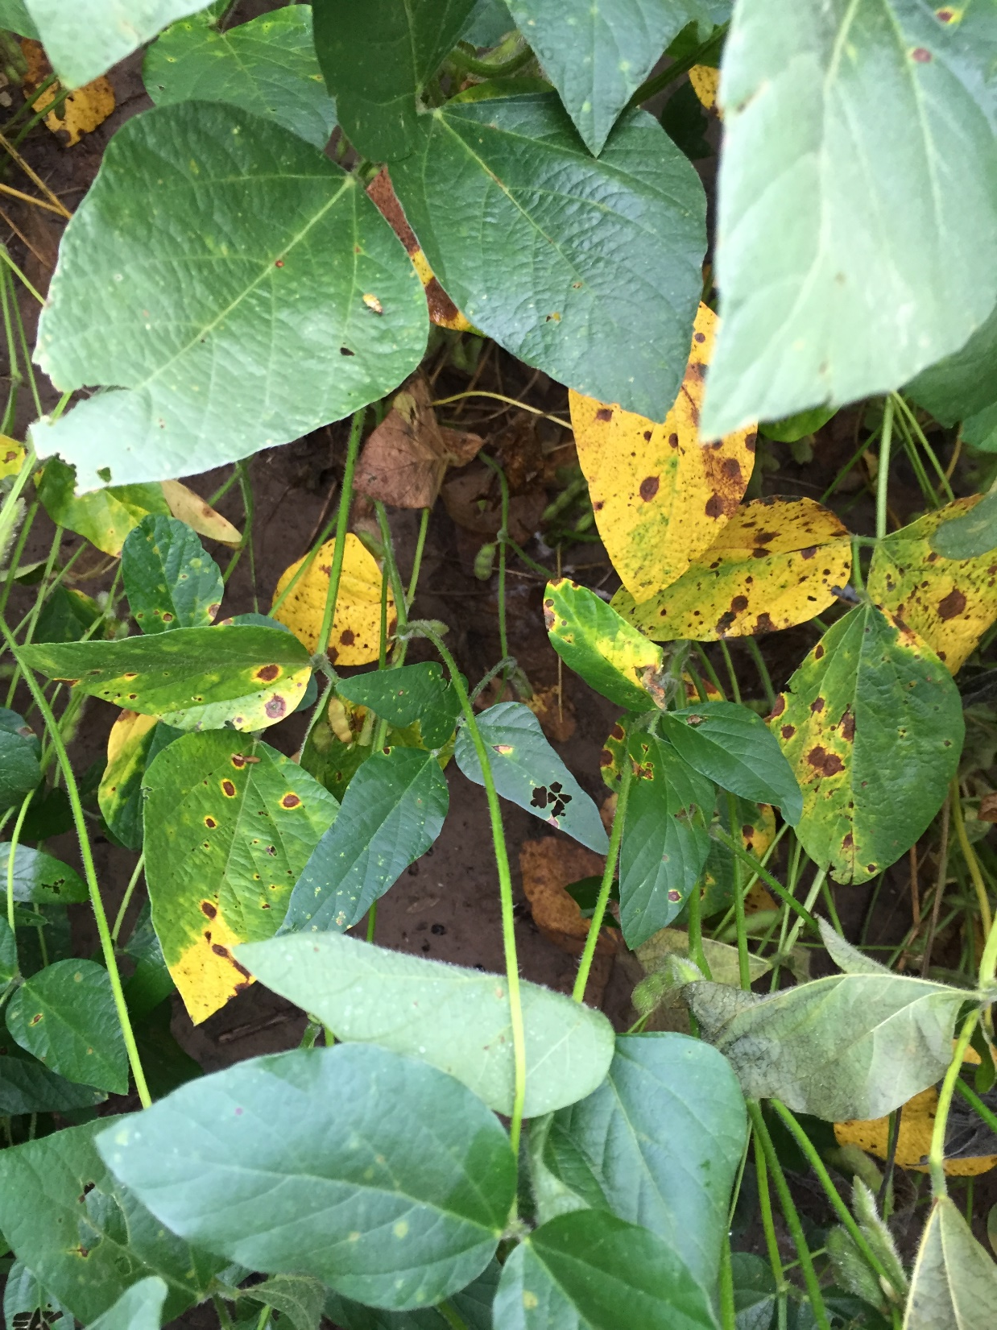

Slide 13
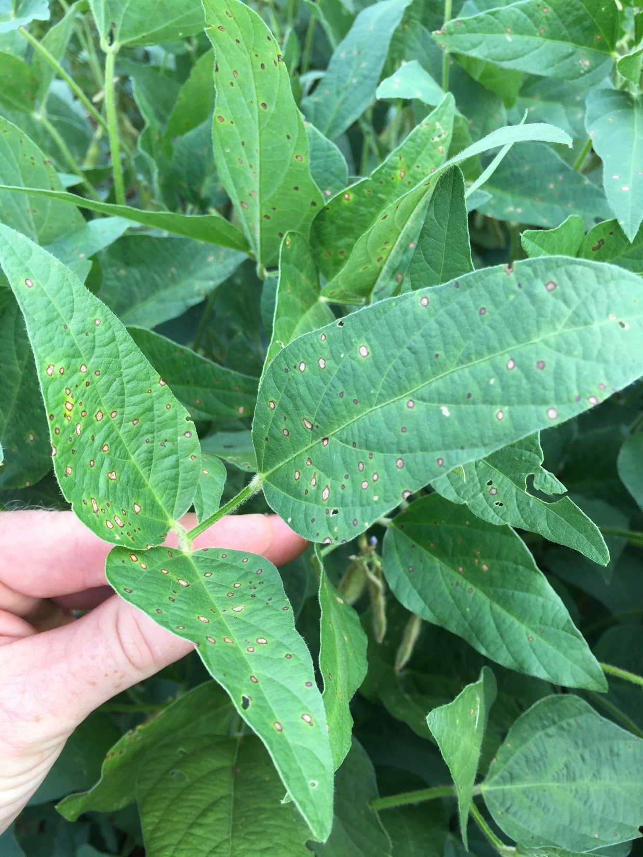

Slide 14
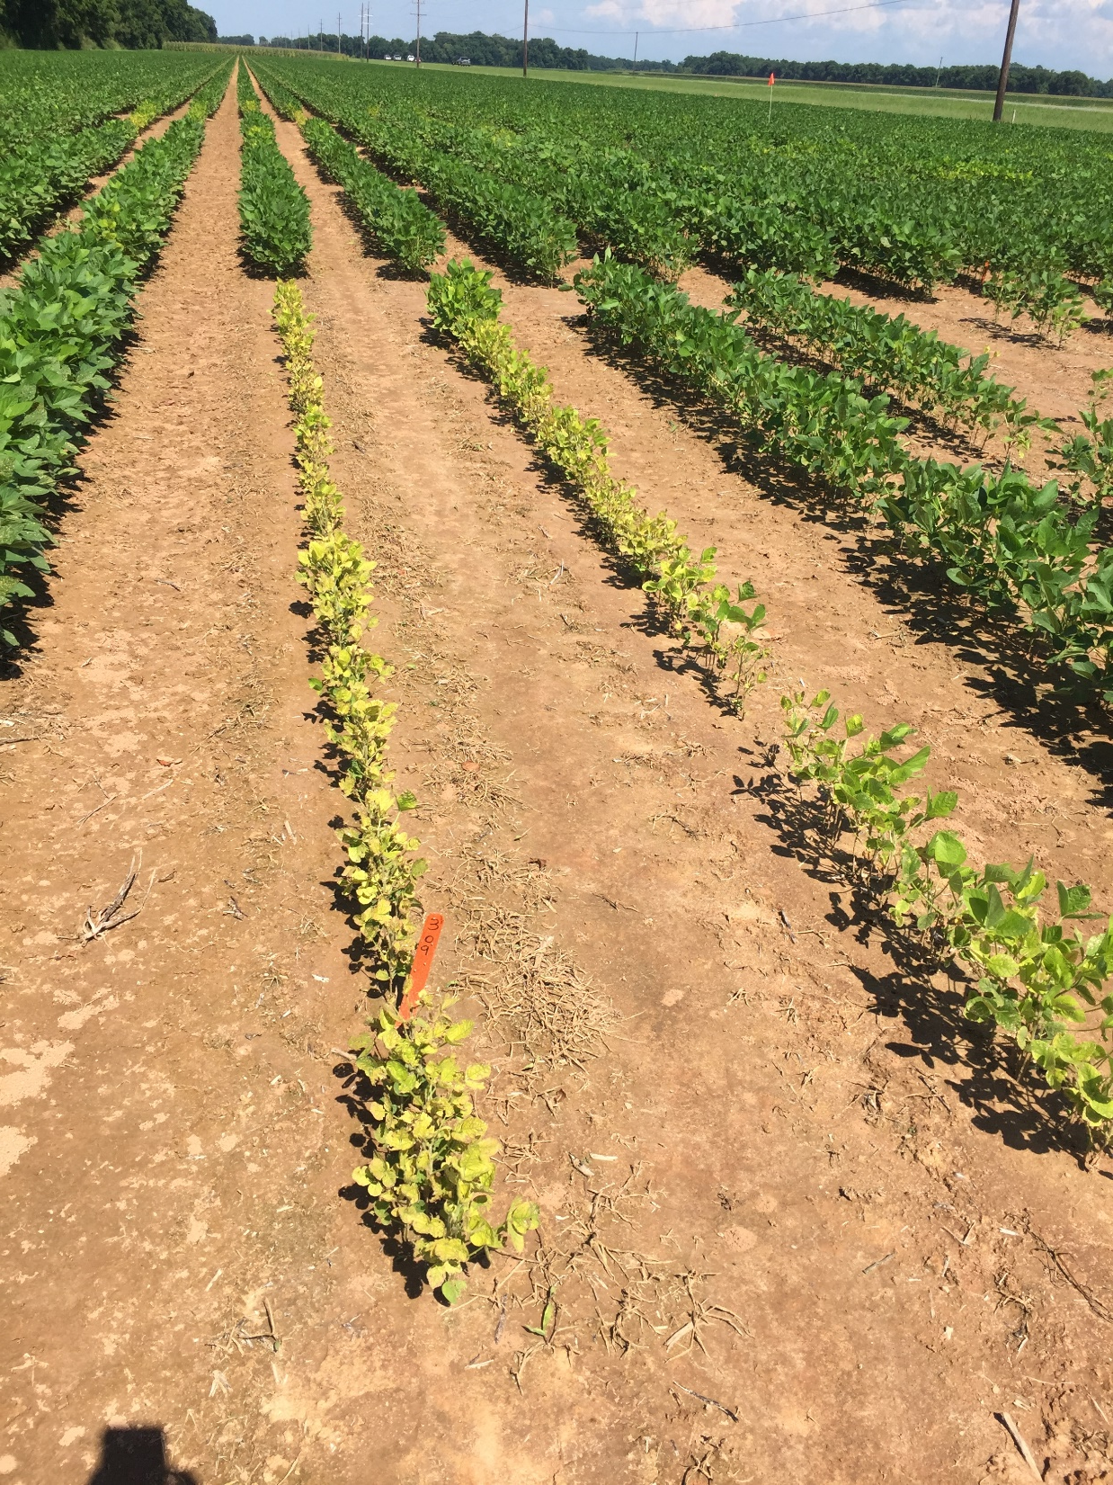

Slide 15
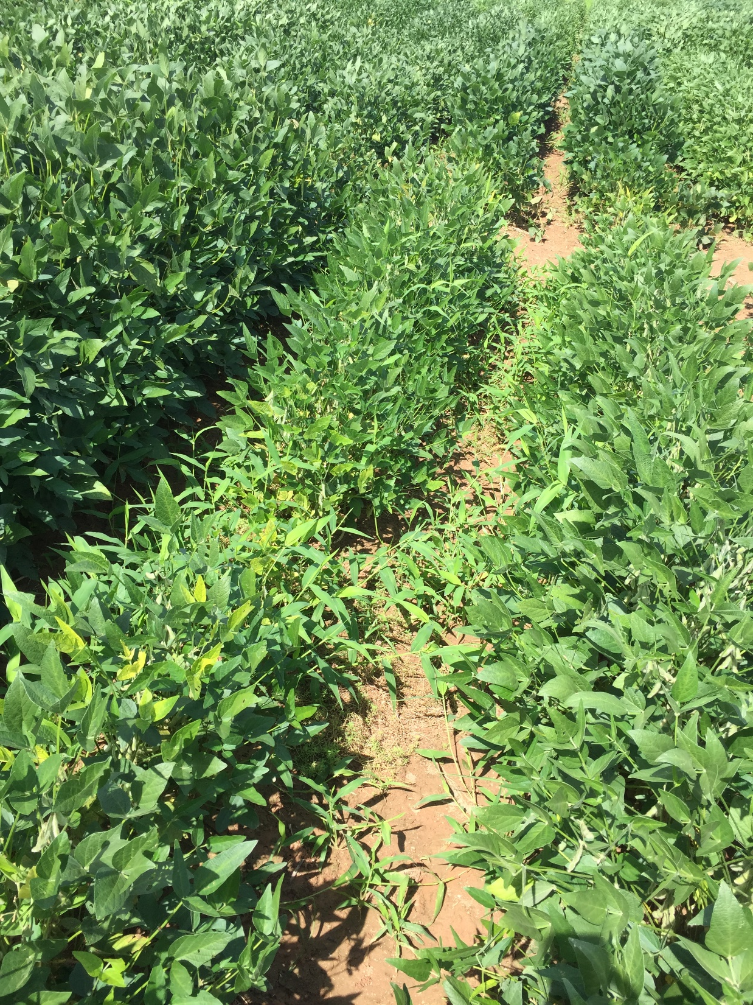

Slide 16
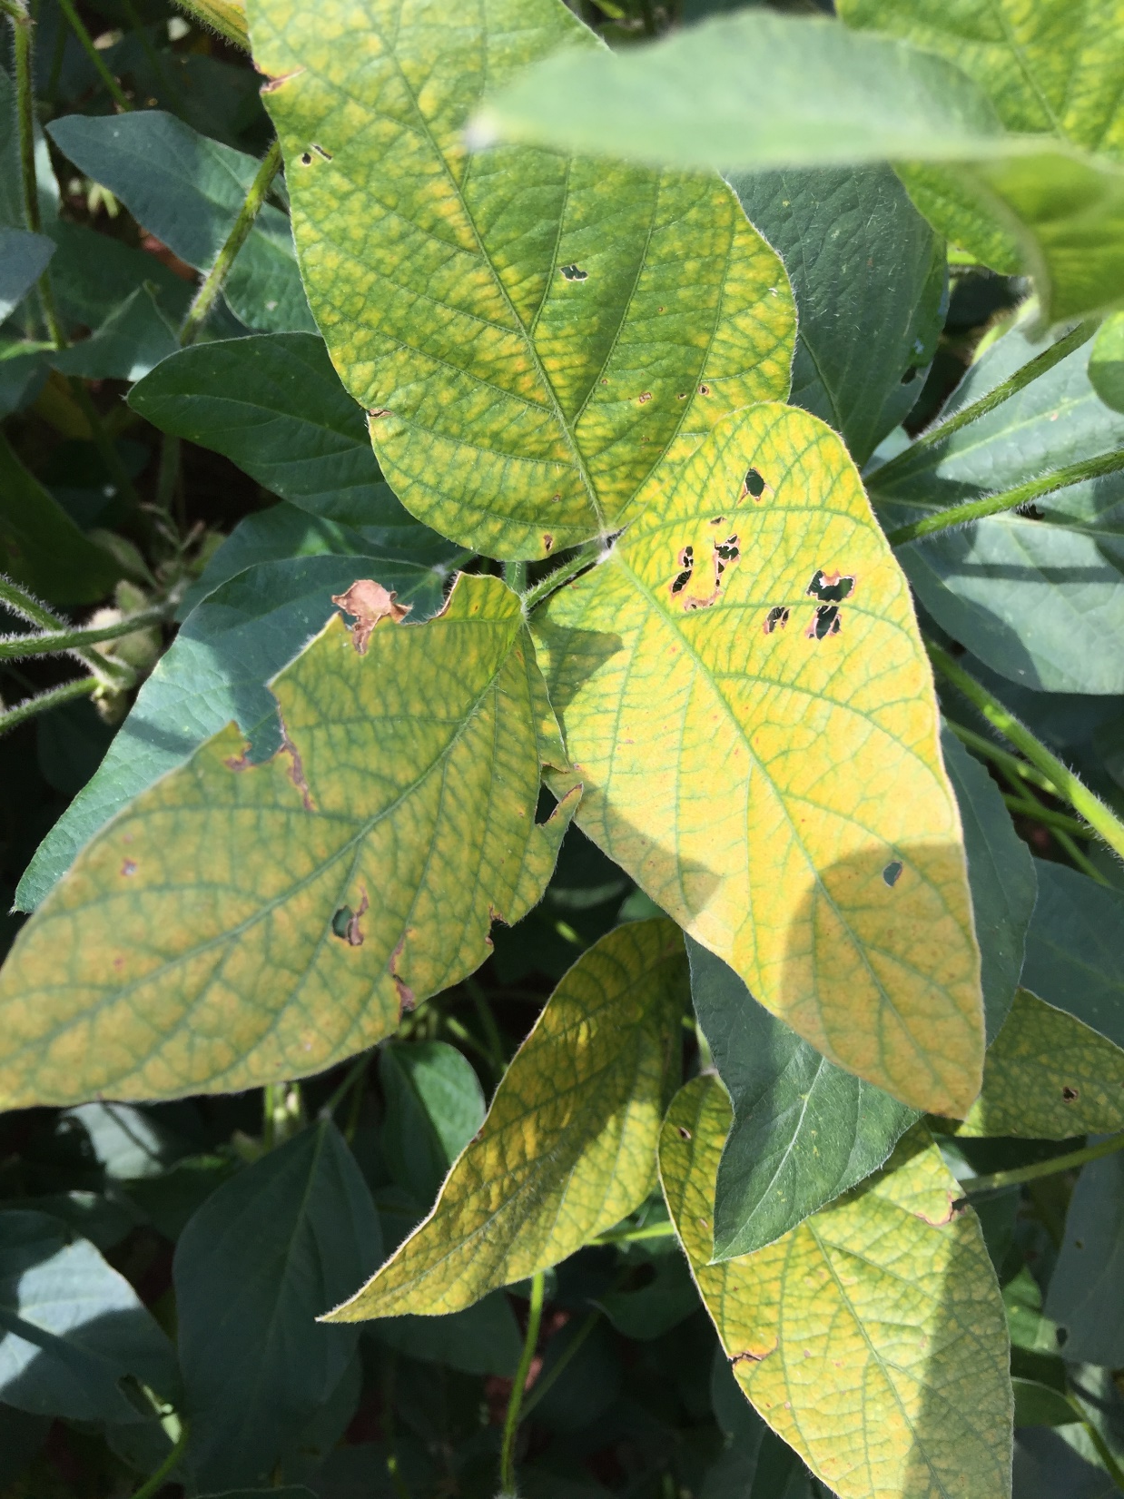

Slide 17
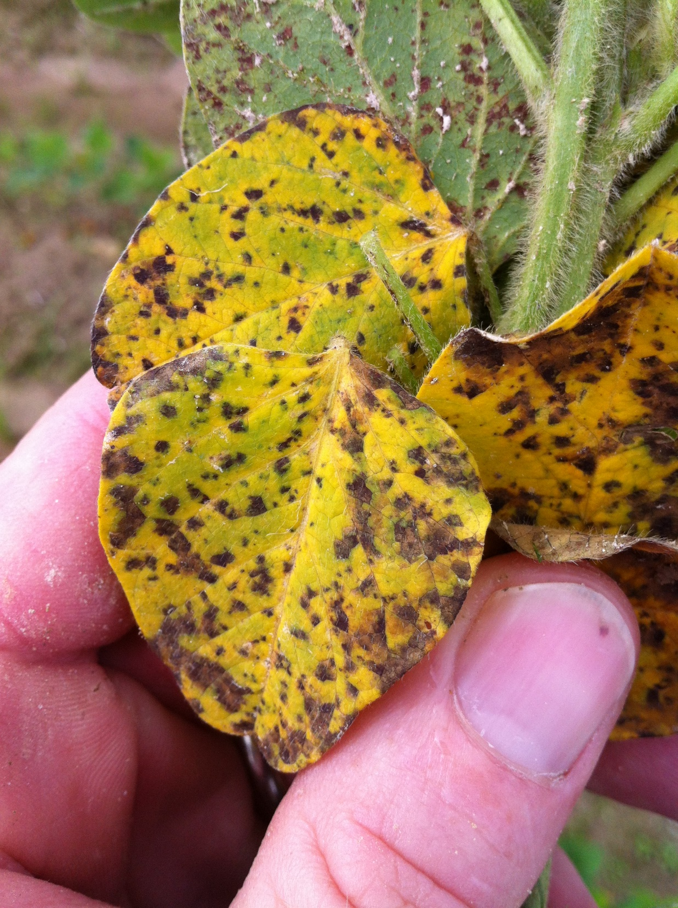

Slide 18
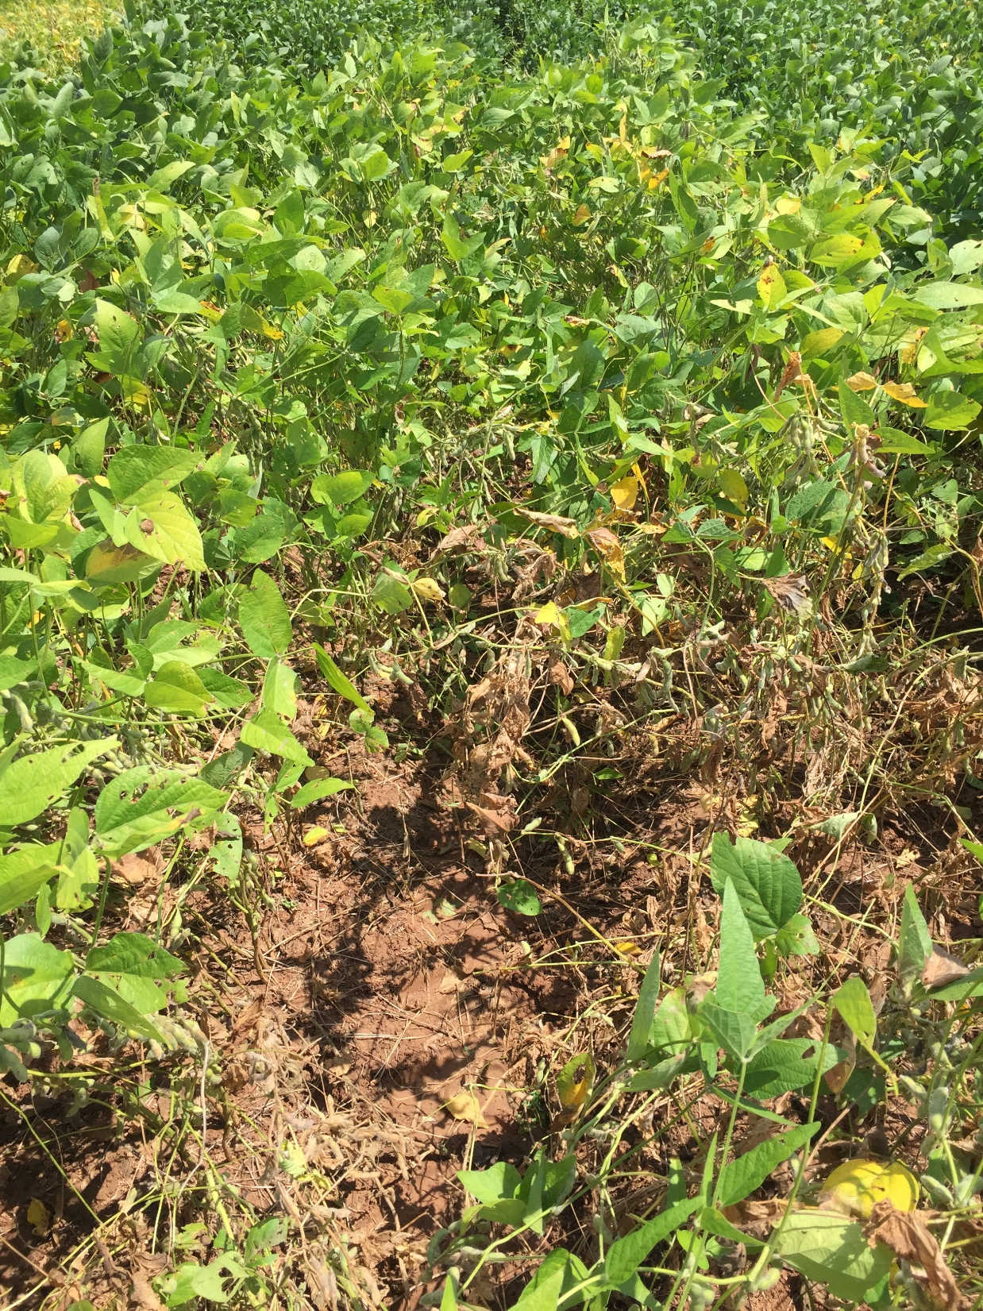

Slide 19
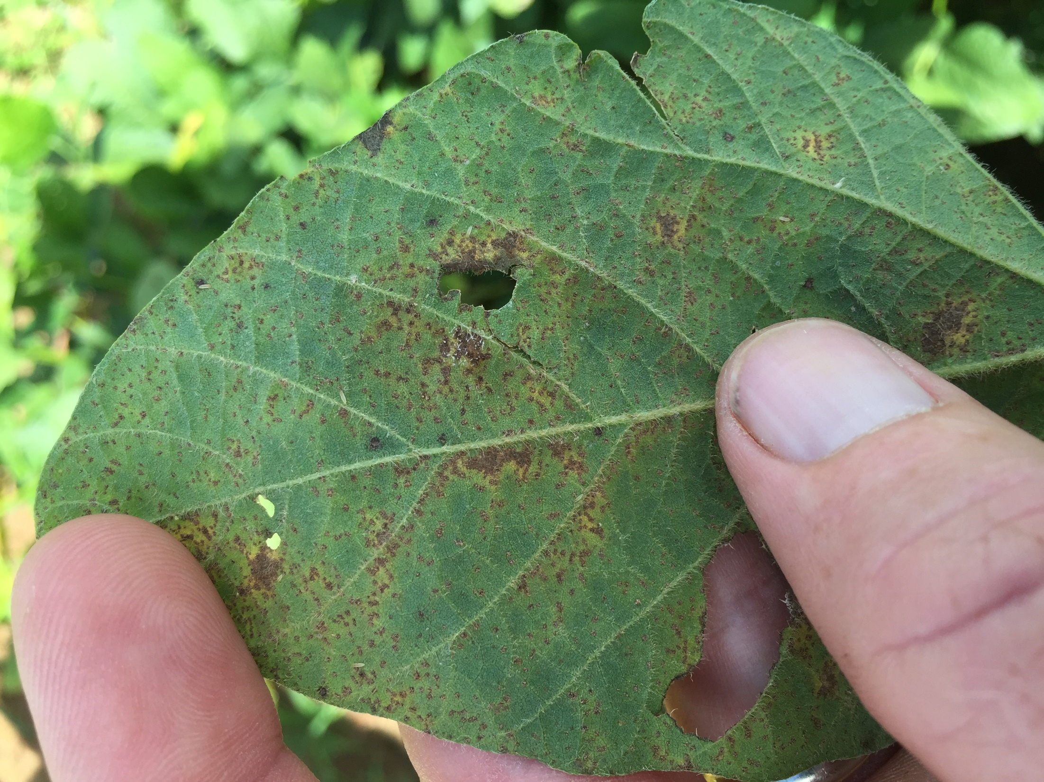

Slide 20
St. Joe
Alex

Slide 21







Thanks for your support!
Trey Price
pprice@agcenter.lsu.edu
318-235-9805
@ppp_trey

