Slide 1
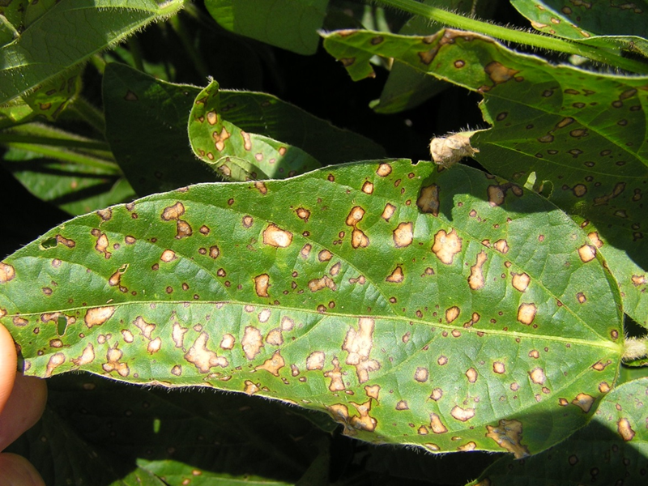
Enhanced Pest Control Systems for Mid-South Soybean Production
Tom Allen, Mississippi State
Blair Buckley, LSU AgCenter
Pengyin Chen, University of Arkansas
Jeff Davis, LSU AgCenter
Travis Faske, University of Arkansas
Clayton Hollier, LSU AgCenter
Heather Kelly, University of Tennessee
Trey Price, LSU AgCenter
John Rupe, University of Arkansas
Grover Shannon, University of Missouri
Terry Spurlock, University of Arkansas
Shane Zhou, Texas A&M
Tri-State Producer Meeting
January 8, 2016

Slide 2
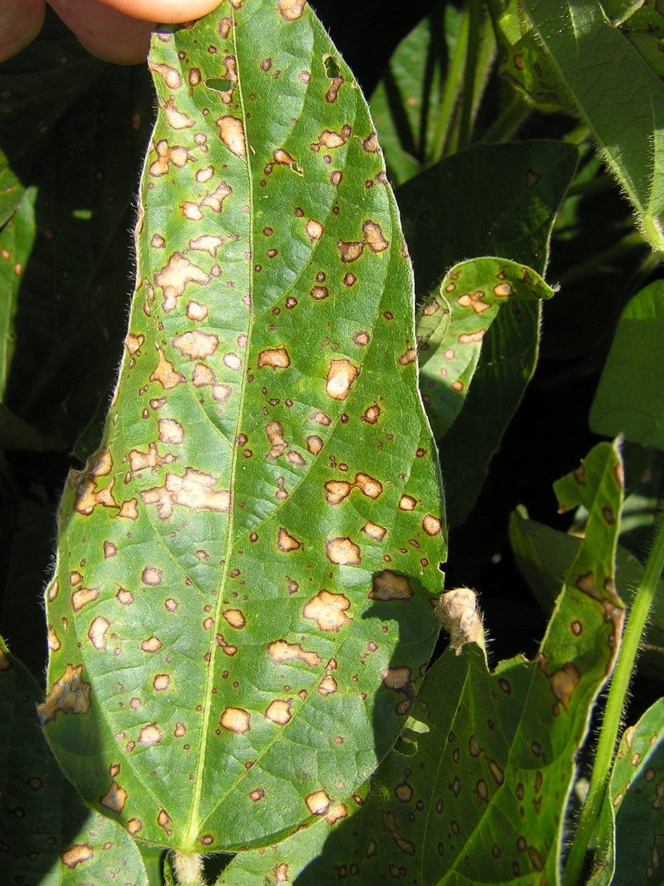
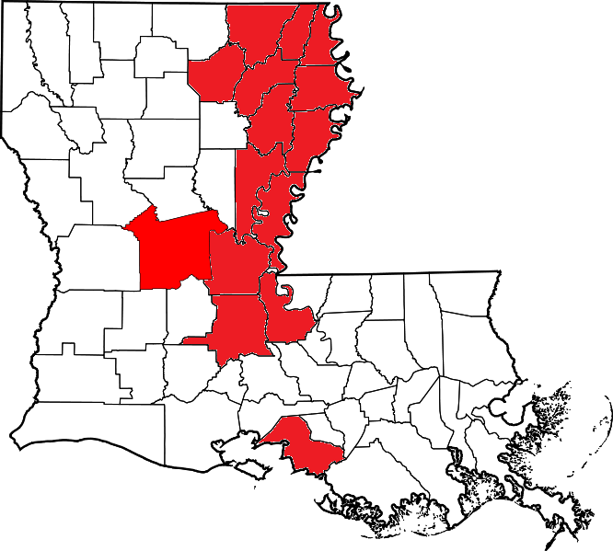
Foliar Diseases – Frogeye leaf spot
$96 million in losses in 2014
Strobilurin Resistance

Slide 3
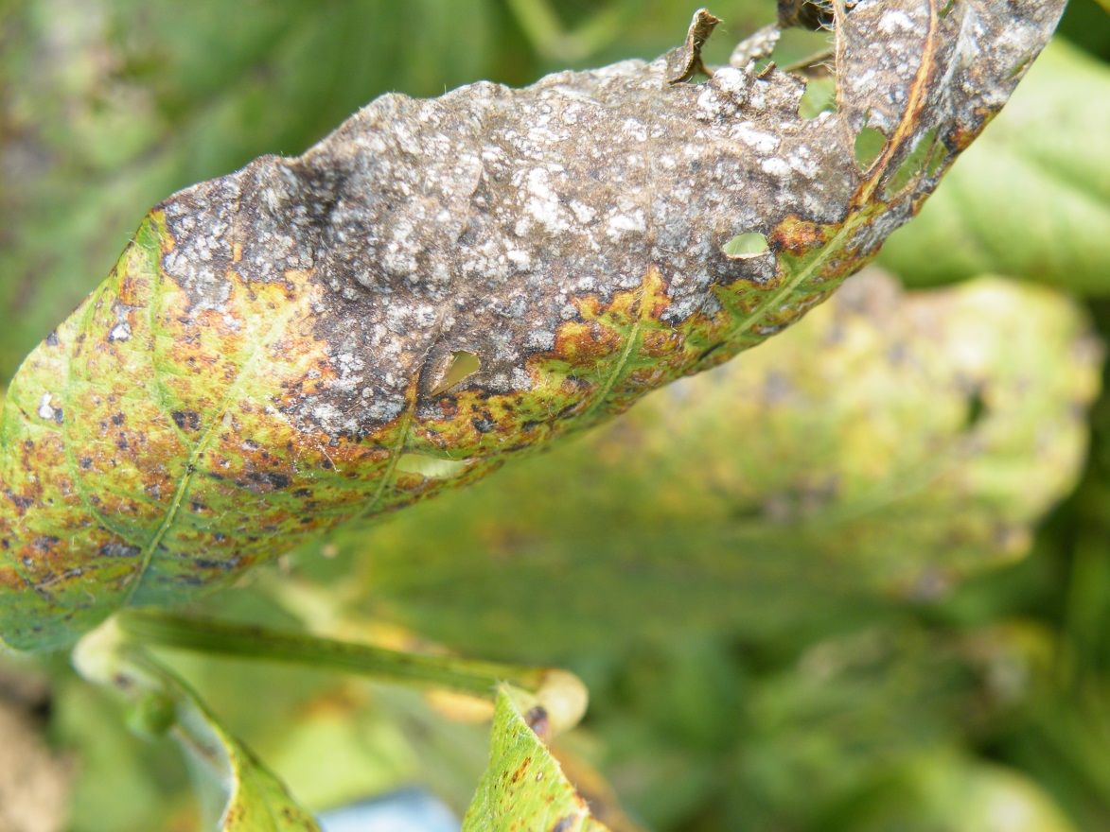
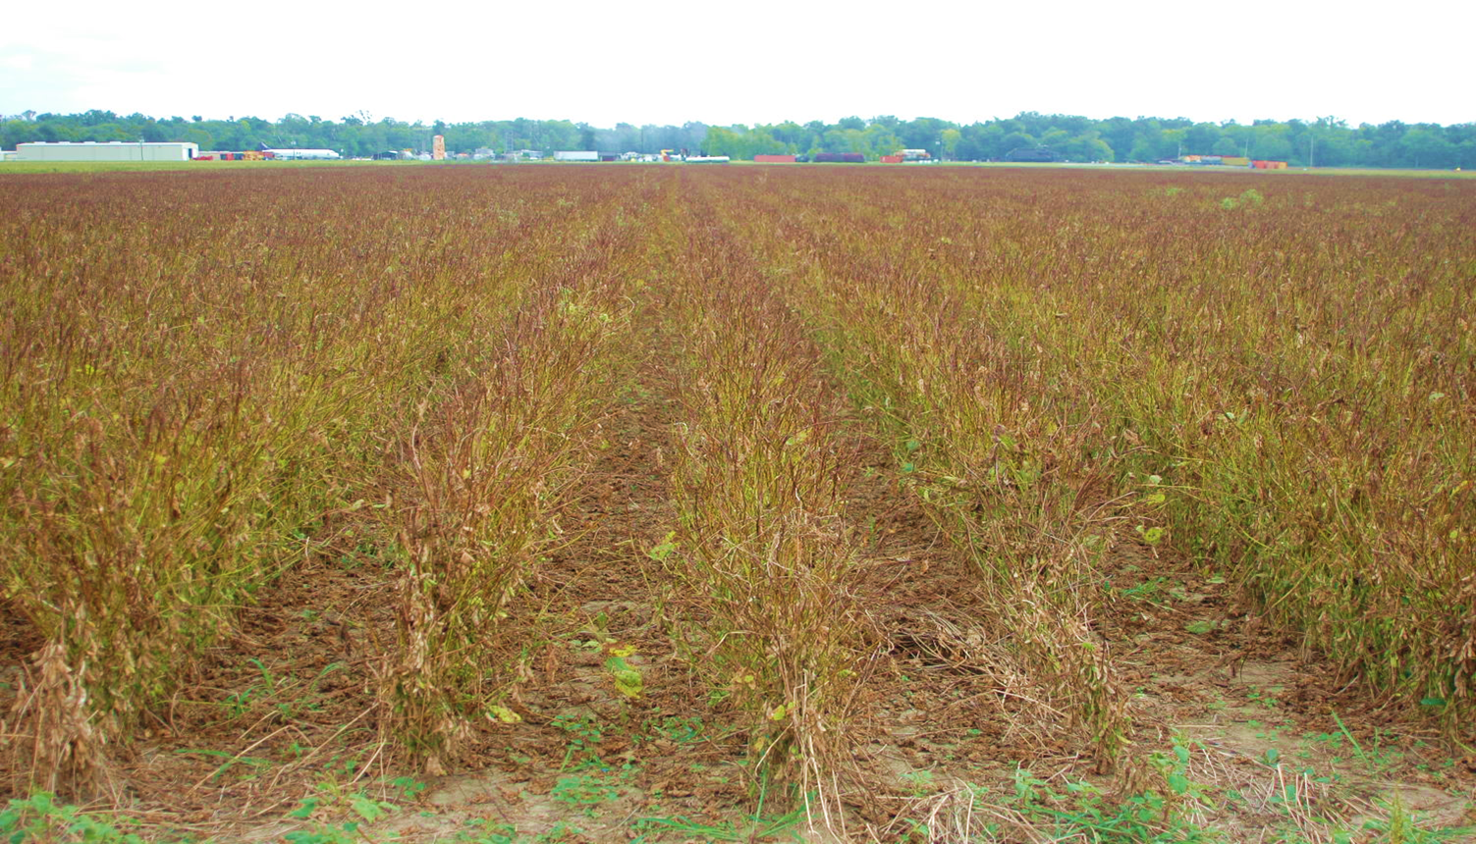
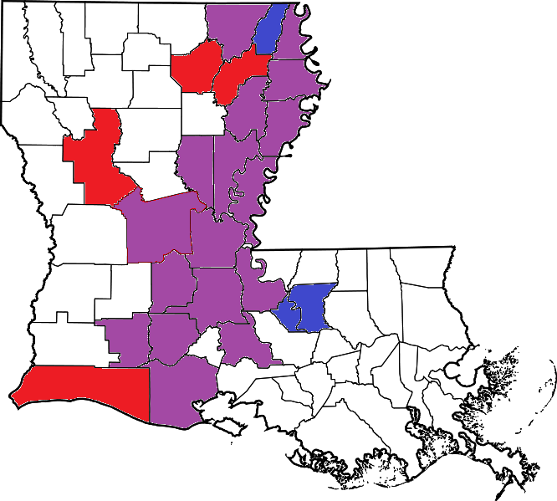
Foliar Diseases – Cercospora leaf blight
Strobilurin &
Thiophanate-methyl
Resistance
$29 million in losses in 2014

Slide 4
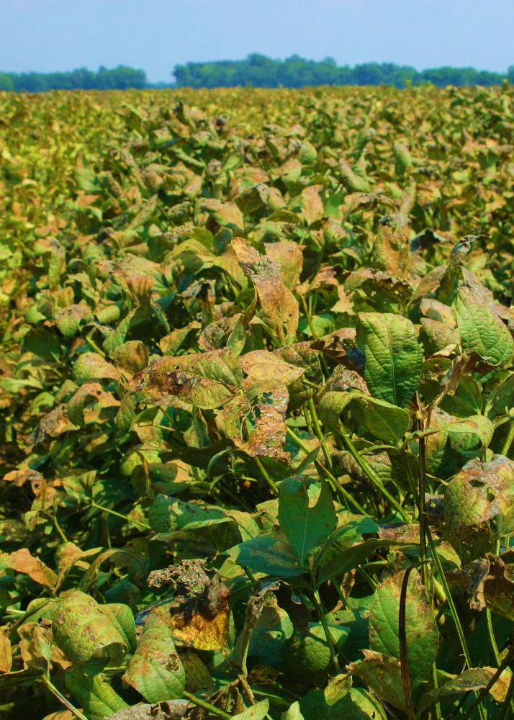
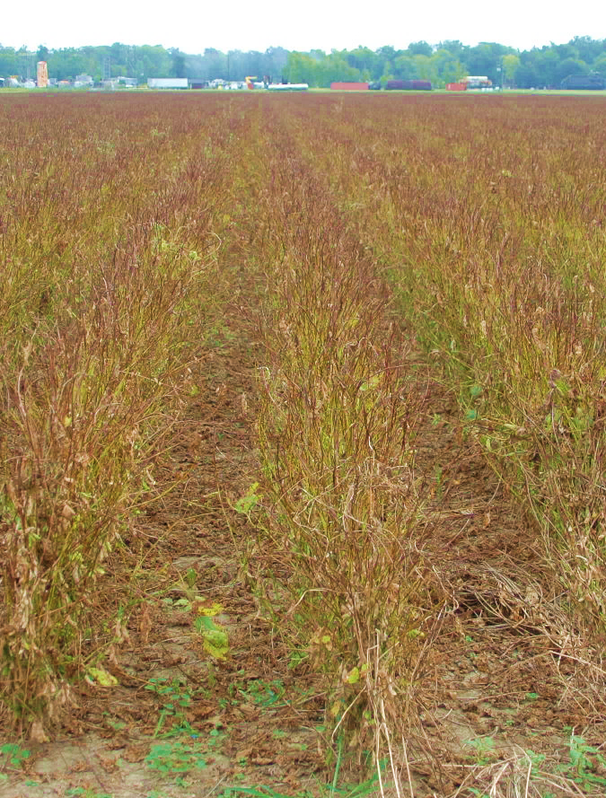
YIeld loss
~20%
Losses
100%
LSU AgCenter Dean Lee Research Station
Alexandria, Louisiana, 2013
LSU AgCenter Ben Hur Reasearch Station
Baton Rouge, Louisiana, 2012
Dr. Ray Schneider
E. Chagas

Slide 5
Soybean Varieties Resistant to CLB
Louisiana
1999 2002 2005 2012
4%
40%
Moore, 2000
Schneider, 2003
Unpublished Data
Levy, 2013
E. Chagas
Notes:
To avoid yield losses, we could use resistant varieties
But there is no resistant varieties
Every year the LSU Agcenter tests 250 soybean varieties in different locations of LA
In 1999 40%............
Moore agronomist breader
Hysteric disease

Slide 6
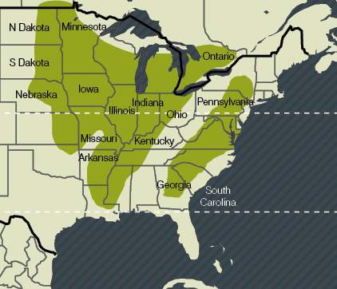
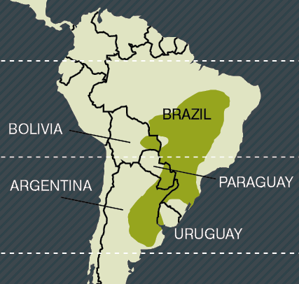
Major Soybean Production Areas
COLOMBIA
Gulf South
Major soybean areas
Yield losses confirmed due to CLB
CLB recently confirmed
Source: Australian Centre for International Agricultural Research
E. Chagas
Notes:
- Major soybean areas regions of North America. Source: Map constructed using data from the IFPRI/SPAM world map
CLB is most severe in the gulf south states
Has been found and it is increasing in OH, IO and MN
We are going to Brazil next year to visit some farms, Universities and companies
Argentina as well Leonardo Daniel Ploper

Slide 7
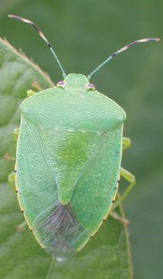
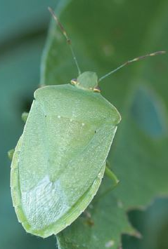
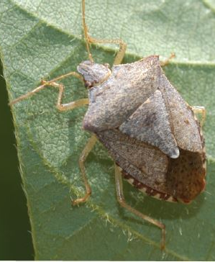
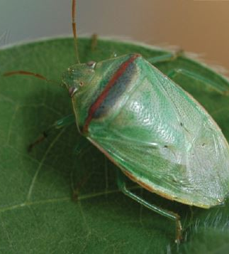
Stinkbug Complex
↓Yield
↓Quality
Up to $78 million lost annually
*Insecticide
Resistance

Slide 8
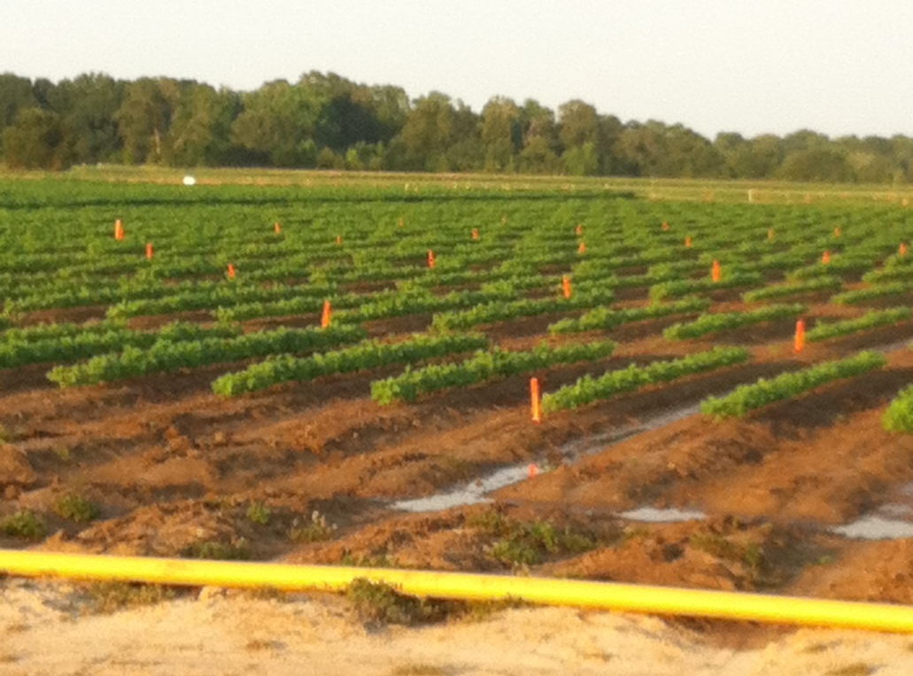
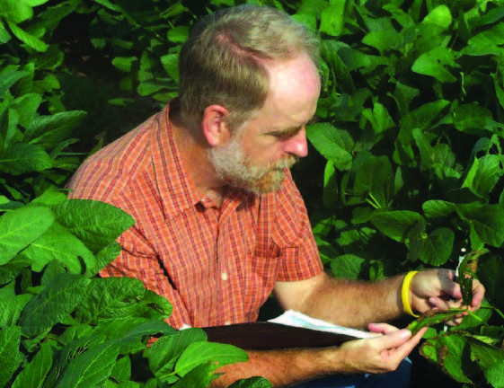
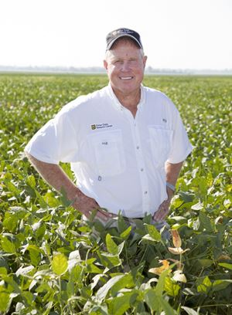
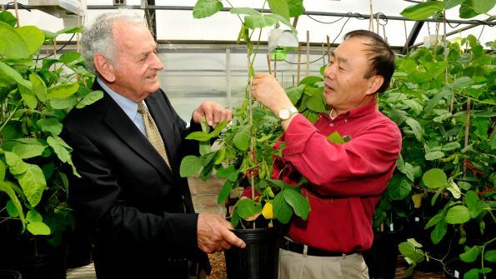
Variety Development – Regionwide

Slide 9
Objectives
To evaluate potential varieties in MANY LOCATIONS throughout the Mid-South for disease (foliar and soilborne) and insect resistance.
To further define the scope of current disease and insect pest problems.
ID resistance to CLB, identify molecular markers for resistance, and develop competitive cultivars with resistance.
Screening soybean crosses for resistance to stink bugs under laboratory and field conditions.
ID specific mechanisms of resistance to stink bugs in soybean.

Slide 10
Expected Outcomes
Short term: Annual publication detailing disease reactions of commercial varieties to specific diseases.
Short term: Identify breeding stock with resistance serving as a guide for breeder selections.
Long term: High-yielding, locally adapted varieties resistant to diseases (CLB) and insects (stinkbugs).
Long term: ID of resistance mechanisms to diseases and insects.

Slide 11
Collaborative Efforts
The USB-MSSB projects will be leveraged and coordinated with three other related projects:
USB ‘s project “Developing a Comprehensive Management Program for Foliar Diseases of Soybean”
USB’s project “Biology and Management Strategies for Redbanded Stink Bug, an Emerging Threat to U.S. Soybean Production”
Dr. Burt Bluhm’s (University of Arkansas) grants with the U.S. Department of Energy and the National Science Foundation to study the genome of the pathogens causing Frogeye Leaf Spot and Cercospora Leaf Blight.

Slide 12
Varietal Susceptibility to Cercospora Leaf Blight – USB Uniform Variety Trial - 2015
*Commercially available.
†New varieties developed in Louisiana by Blair Buckley.
†
*
*
†
†
Data ranked by Cercospora Leaf Blight severity (least to most).
Petiole symptoms were rated separately and somewhat correlated with foliar ratings (R²=0.58).
Yield was not obtainable because of inclement weather.
DLSB1501

Slide 13
Summary
“Enhanced Pest Control Systems for Mid-South Soybean Production” was funded by the USB at a level of $102,233.
The bulk of this funding will soon be allocated to the core of the program (Buckley, Chen, Davis, & Shannon)
As submitted, this project requests that the MSSB fund the remaining component of this project $160,000 annually.
Proposing AR, LA, MO, and MS contribute $35,000 and TX QSSB allocate $5,000.
The TN QSSB will be contacted to cover the expenses of a TN location with an associated cost of $15,000.
The funding of each QSSB/state essentially goes toward more field sites in their state and funds the work of their state’s extension pathologist and/or entomologist.

Slide 14
Summary
Combined efforts + collaboration among all these projects = solving the annual yield reduction and increasing input costs of Frogeye Leaf Spot, Cercospora Leaf Blight, and stinkbugs.
Important varietal reactions to other important foliar/soilborne diseases also are a possibility.
Multiple locations are key to the success of this project.

Slide 15
Thanks for your consideration!
Trey Price
pprice@agcenter.lsu.edu
318-235-9805
@ppp_trey

