Slide 1
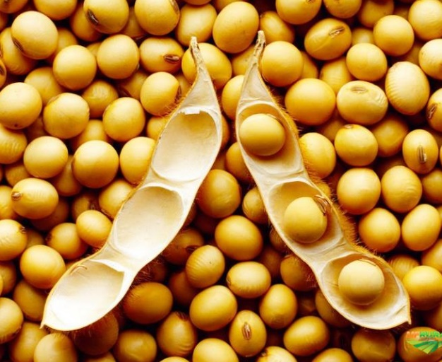
Soybean yield components and seed nutrient concentration responses among nodes to phosphorus fertility
Nathan A. Slaton¹, Gerson L. Drescher¹, Trenton L. Roberts¹, Md Rasel Parvej²
¹ University of Arkansas Division of Agriculture, ² LSU AgCenter
Nathan A. Slaton
Assistant Director, Agricultural Experiment Station
University of Arkansas System Division of Agriculture
nslaton@uark.edu
Mid-South Soybean Board Summer Meeting, Newport AR, August 25 & 26th, 2022

Slide 2
Project Objectives
Identify how soybean seed yield, individual yield components, leaflet-P concentration, and the seed nutrient concentrations are affected by P deficiency and node location on the plant

Slide 3
Rice Research and Extension Center - RREC
Long-term trial established in 2007 on a Dewitt silt loam
Randomized complete block design with 6 blocks
0, 40, 80, 120, and 160 lb P₂O₅/acre/year applied preplant
Soil-test P ranges from 8 to 89 ppm
Pioneer 52A14SE planted on June 6th
Currently at R4 stage
Vegetative leaf sampling at V6/7 (July 8th) and weekly samples collected

Slide 4
LSU AgCenter – Macon Ridge Research Station
Single year trial on a Gigger-Gilbert silt loam
Randomized complete block design with 4 blocks
0, 40, 80, 120, and 160 lb P₂O₅/acre broadcast on the top of the seedbed
Mean soil-test P of 13 ppm
Progeny 4806 XFS planted May 10
Currently at R5.5 growth stage
Weekly leaf samples collected from R1 to R6
Chloride toxicity has affected the 2022 trial

Slide 5
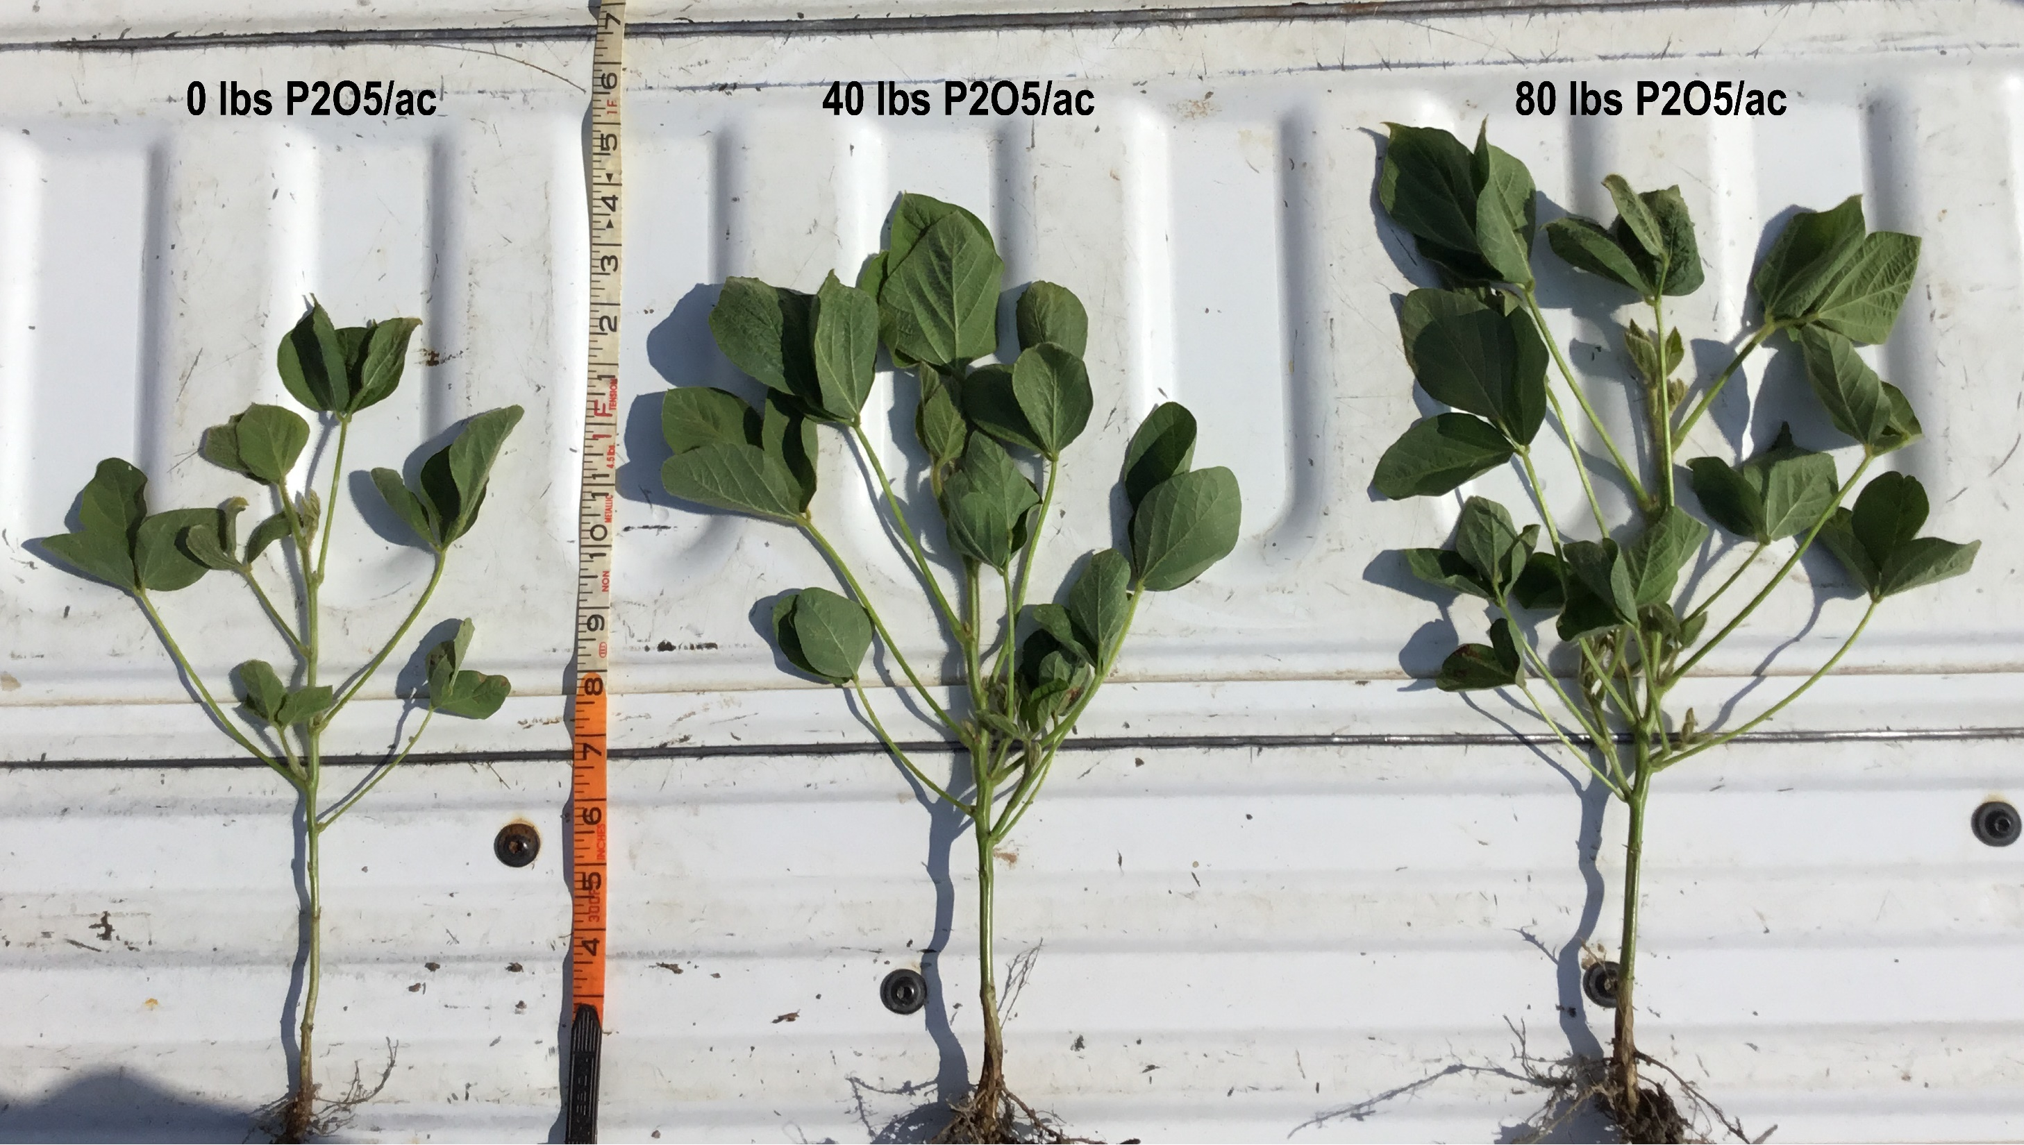
Progress made & preliminary results
P-deficiency at early soybean vegetative growth stages: smaller trifoliolate leaves, shorter plants, and less lateral branches!
RREC, Stuttgart AR, 2021

Slide 6
Consistent Early Season Growth Benefits
2021
2022

Slide 7
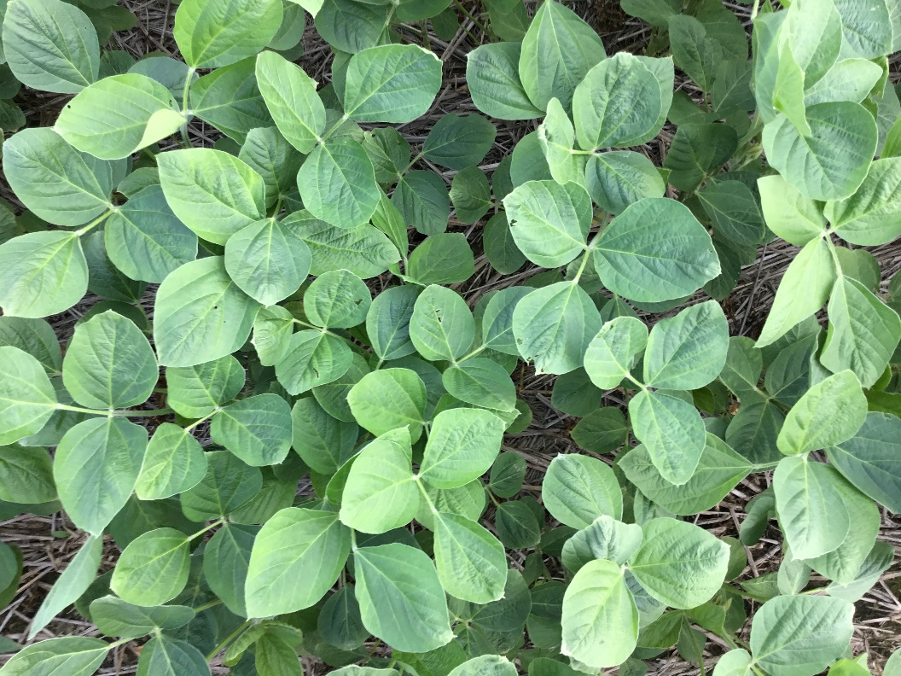
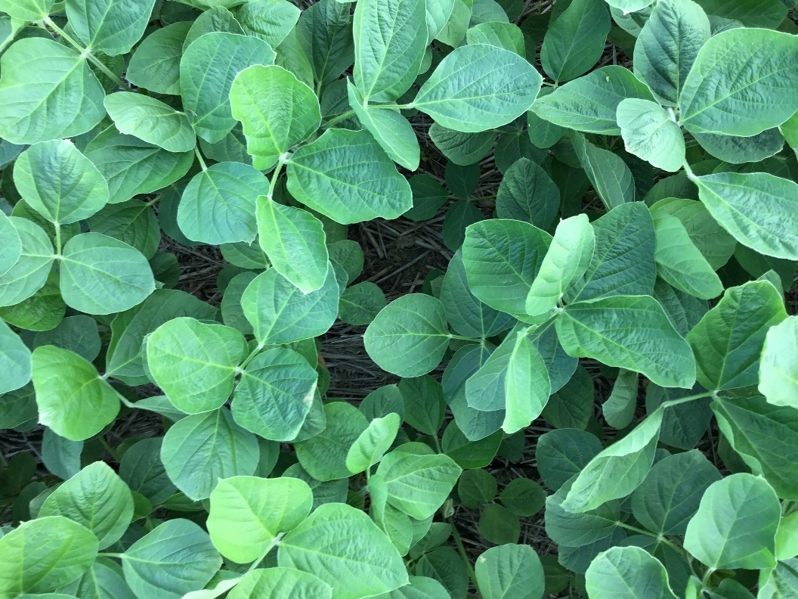
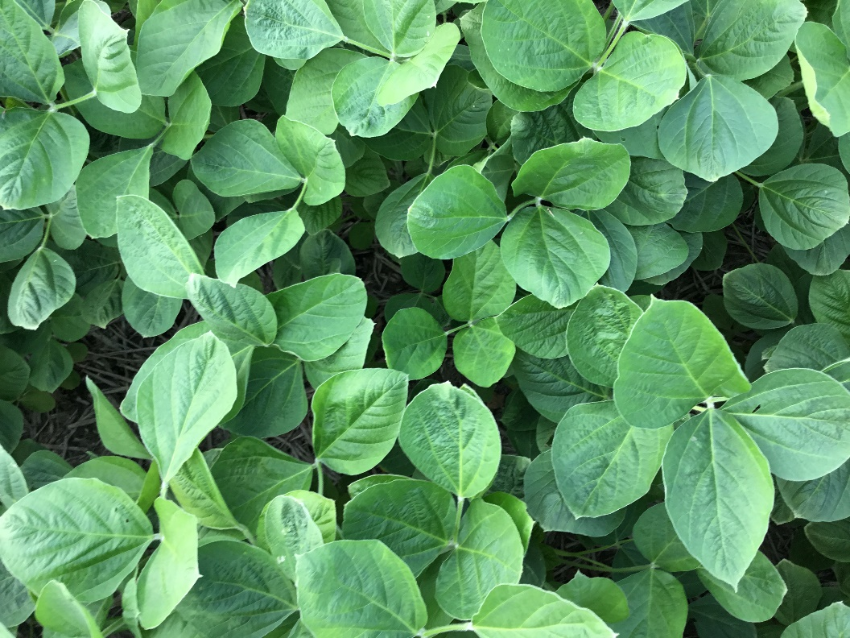
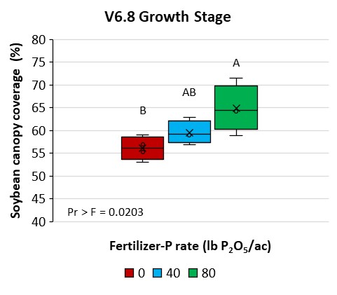
Progress made & preliminary results
0 lbs P₂O₅/ac, 13 ppm P
40 lbs P₂O₅/ac, 23 ppm P
80 lbs P₂O₅/ac, 47 ppm P
Overhead view of soybean canopy and percentage of canopy coverage at the V6.8 growth stage as affected by fertilizer-P rate and soil-test P. Pictures were taken at a 42-inch height from the soil level.
RREC, Stuttgart AR, 2022

Slide 8
Pod number (2021 Results)
2 nodes per node segment

Slide 9
Seed number (2021 Results)
2 nodes per node segment

Slide 10
Seed weight (2021 Results)
2 nodes per node segment

Slide 11
Seed Yield (2021 Results)
Total seed weight/plant was significantly affected by P rate
Arkansas (P < 0.05)
Louisiana (P = 0.0808)
2 nodes per node segment

Slide 12
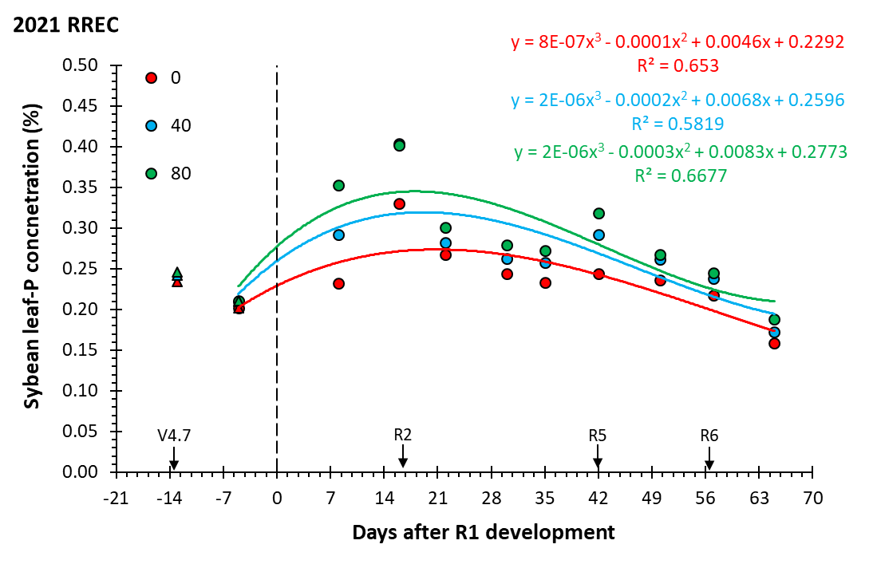
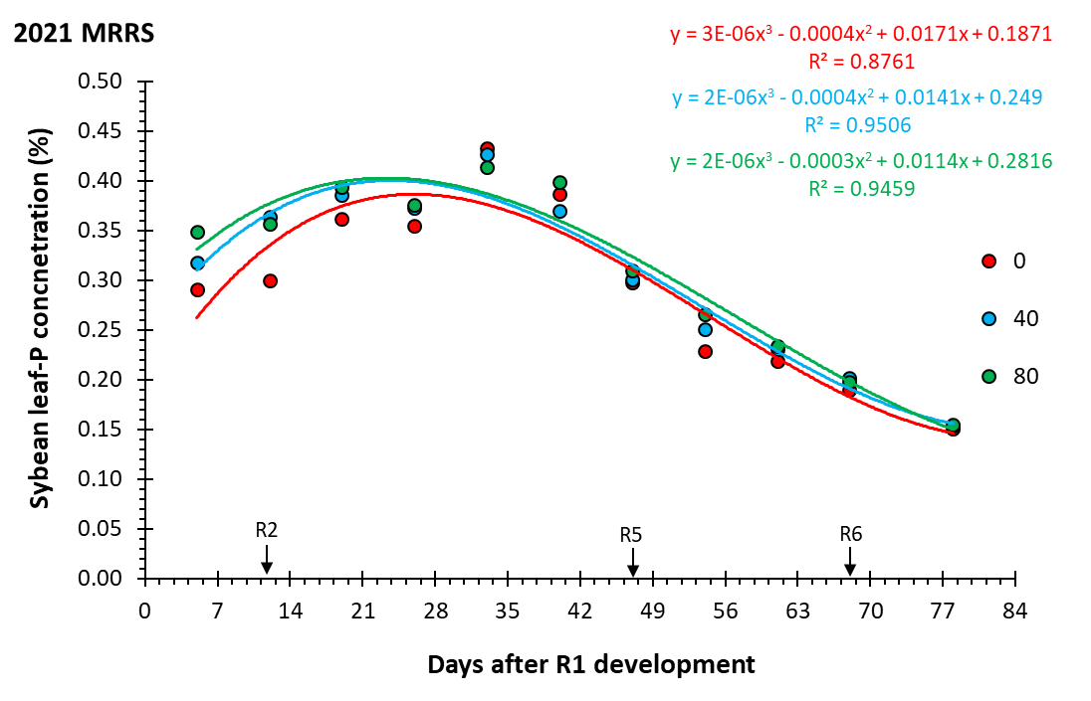
2021 Preliminary results, Arkansas (RREC) & Louisiana (MRRS)
Soybean leaf-P concentration as affected by fertilizer-P rates and leaf sampling time
MG V, determinate
MG IV, indeterminate
Days after R1 development stage (DAR1) as predicted by SoyMap (Popp et al., 2016).
Soybean leaf-P concentration:
is dynamic across time and declines as reproductive growth progresses;
consistently different among fertilizer-P treatments (80 > 40 > 0 lb P₂O₅/ac);
the peak of leaf-P concentration among locations occurred at different time.
X

Slide 13
2021 Conclusions
Specifically, we identified that sub-optimal P supply reduces
plant height
number of pods
number of seeds,
seed weight per plant
Seed abortion rate was mostly a function of node section (not P rate)
Seed P concentrations differed
among node sections
among P rates
Greater fluctuation among plant nodes for )-P control
Seed P concentrations differed
among node sections: 0.42-0.52% P at ARK and 0.39-0.51% P at LSU
among P rates
Greater fluctuation among plant nodes for )-P control
Outreach
Arkansas Soybean Research Studies Publication
Conservation Tillage Conference

Slide 14
2021 Conclusions
Take Home
Interpretation of leaf P concentrations must be made with plant development in mind
Will in-season P application be theoretically effective for correcting P deficiency?
To early to tell
Specifically, we identified that sub-optimal P supply reduces
plant height
number of pods
number of seeds,
seed weight per plant
Seed abortion rate was mostly a function of node section (not P rate)
Arkansas Soybean Research Studies Publication
Conservation Tillage Conference

Slide 15
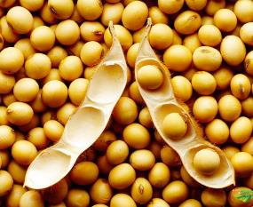
Thank you!
Nathan A. Slaton
Assistant Director, Agricultural Experiment Station
University of Arkansas System Division of Agriculture
nslaton@uark.edu

Slide 17
2021 Preliminary results, Arkansas (RREC) & Louisiana (MRRS)
Soybean seed weight distribution in the main stem and branches as affected by 0 (A & D), 40 (B & E), and 80 lb P₂O₅/ac (C & F) in Arkansas and Louisiana, respectively.

