Slide 1
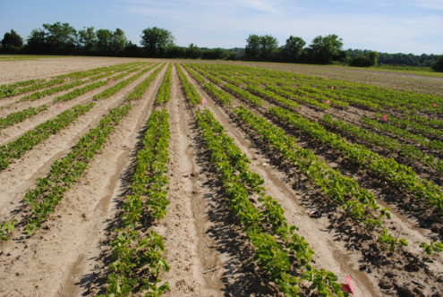
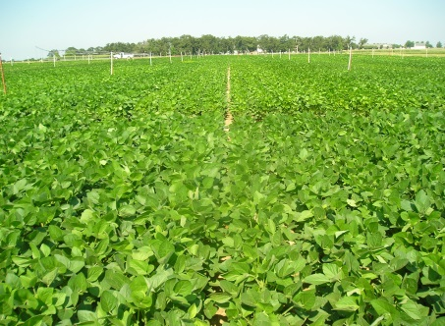
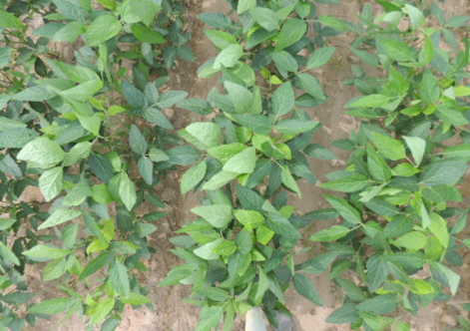
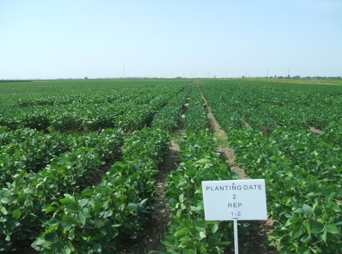
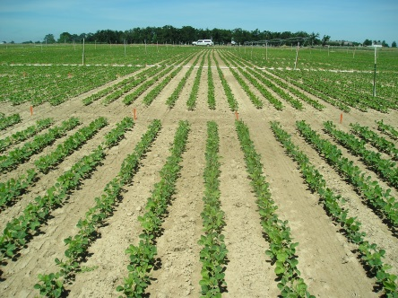



Soybean seed quality response among maturity groups to planting dates in the Midsouth
Larry C. Purcell & Montserrat Salmeron
MidSouth Soybean Board Meeting,
9 February 2015, Savannah

Slide 2

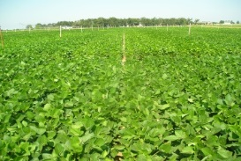
Outline
Results
  Yield
  Seed no. & seed wt.
  Light interception
Decision support tool
  Calibrating model
  Simulating long-term responses
  Demonstration

Slide 3
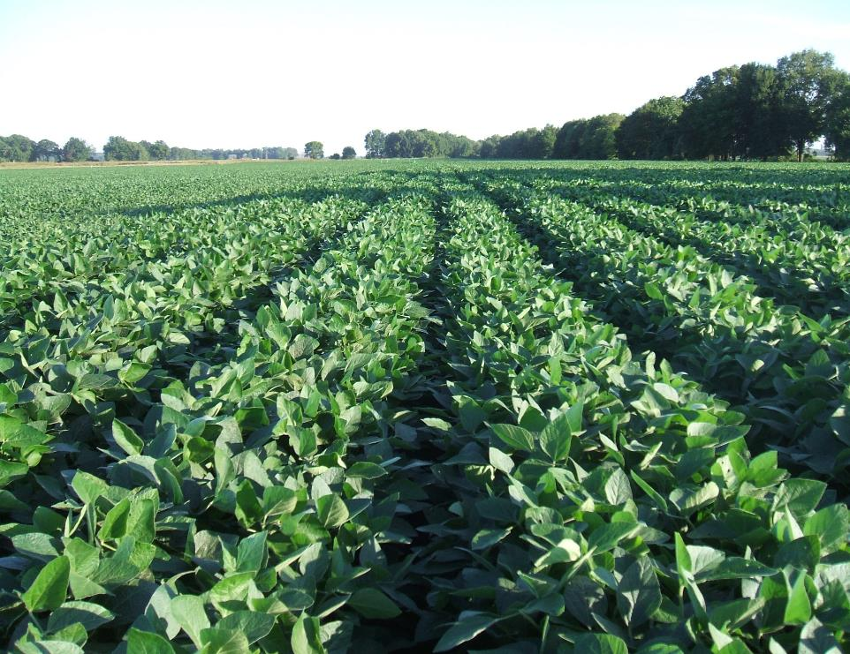
Soybean regional PD x MG study
Soybean Midsouth PD x MG study (MSSB-USB project)
What is the best soybean MG choice for a given location and PD?
Need to redefine recommendations for irrigated soybean

Slide 4
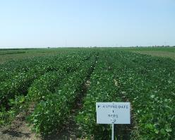
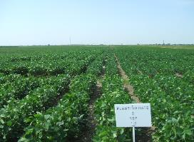
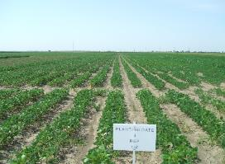
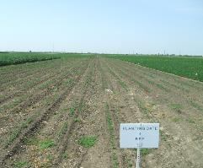
Soybean regional PD x MG study
3-year study (2012-14)
10 locations
Irrigated
4 planting dates
MG 3 to 6 (16 cultivars)
( > 6000 plots)
❶ Columbia, MO
❷ Portageville, MO
❸ Fayetteville, AR
❹ Keiser, AR
❺ Milan, TN
❻ Verona, MS
❼ Rohwer, AR
❽ Stoneville, MS
❾ St. Joseph, LA
❿ College Station, TX
Participants: ❶ Felix Fritschi, Bill Wiebold; ❷ Earl Vories, Grover Shannon; ❸ Larry Purcell, Montse Salmeron, Ed Gbur; ❹ Fred Bourland; ❺ David Verbree; ❻ Normie Buhering; ❼ Larry Earnest; ❽ Bobby Golden; ❾ Josh Lofton; ❿ Travis Miller, Clark Nelly, Daniel Hathcoat

Slide 5
Soybean regional PD x MG study
Variables measured:
Yield and yield components
Phenology
Seed quality
  Soil and protein concentration in seed
  Germination and accelerated aging
  Seed grade (test grade, seed damage)

Slide 6
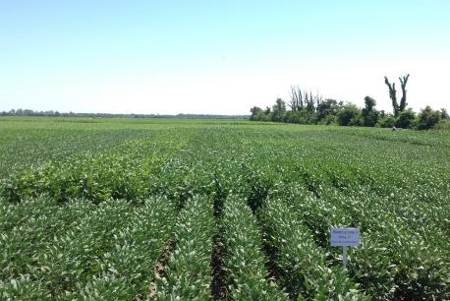
Soybean regional PD x MG study
What would be the best choice of soybean MG for the Midsouth?
High yield
Most stable across environments
?
Analysis of yield stability (Agronomy Journal 106, 2014)
Factors studied:
Planting system: Early vs. Late
Maturity Group
n=34 env: 2 years x (7 to 10 locations) x 2 PDs within planting system

Slide 7
Yield results
Yield results: MG choices for early vs. late planting dates (Agronomy Journal 106, 2014)
MG 4 and MG 5 soybeans were the best choices for early plantings.
MG 4 best choices for late plantings, followed by MG 3 soybeans.

Slide 8
Soybean regional PD x MG study
Yield physiology approach to understand factors affecting yield
Study of yield components
Quantify environmental variables related to yield component determination during main developmental stages
  Solar radiation and total cumulative intercepted PAR (CIPAR)
  Temperature
  No water limitations (irrigated)
YIELD = SEED NUMBER x SEED SIZE
(g m⁻²) (seeds m⁻²) (g seed⁻¹)

Slide 9



Soybean regional PD x MG study
Length of soybean developmental stages
Vegetative phase
(E to R1)
Flowering phase
(R1 to R5)
Seed-fill phase
(R5 to R7)
Effect on length | Vegetative Phase | Flowering phase | Seed filling phase
Delay in PD | - 5 days | - 5 days | - 7 days
MG 3 to 6 | + 20 days | + 8 days | + 3 days

Slide 10
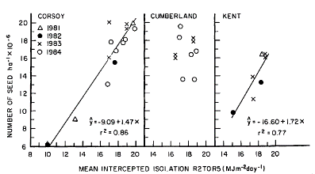
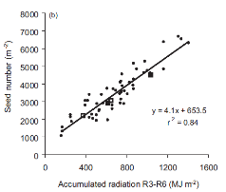
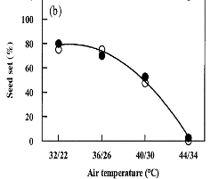
Seed number determination
Egli et al (1987)
SEED NUMBER (seeds m⁻²)
Kantolic et al (2013)
What do we know about seed number determination?
Flowering and seed set (R1 – R6) period is critical
Radiation interception
Temperature
Effect of temperature on seed number in PEANUT (Prasad et al, 2003)
27 31 35 39

Slide 11
Seed number determination
SEED NUMBER (seeds m⁻²)
CIPAR from R1 to R6
Relationship between CIPAR (R1 to R6) and seed number

Slide 12
Seed number determination
SEED NUMBER (seeds m⁻²)
Av. Temperature from R1 to R5
More optimum T for seed set than later MG and late PD

Slide 13
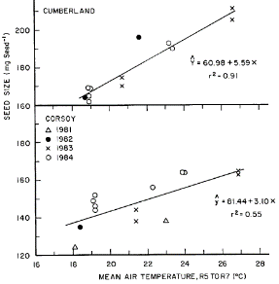
Seed weight determination
SEED WEIGHT (g 100 seeds⁻¹)
(Egli et al, 1987)
What factors influence seed weight?
Temperature during seed-fill (R5 – R7)

Slide 14
Seed size determination
Soybean regional PD x MG study
Relationship between T (R1- R5) and seed size at our most southern location
SEED WEIGHT (g 100 seeds⁻¹)
(Egli et al, 1987)
More optimum T for seed growth in earlier PD and MG
Av. Temperature from R5 to R7
What factors influence seed weight?
Temperature during seed-fill (R5 – R7)
Temperatures during flowering (Egli et al, 1978)

Slide 15
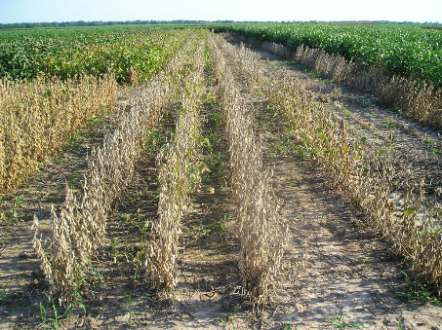
Soybean regional PD x MG study
Conclusions – why MG 4 yield more across all environments?
Longer growing season in late MG, but similar length of reproductive periods
Higher CIPAR increased seed number in early PD and MG 3 to 4 …but not in later MG
High temperatures during seed set decreased seed number (and seed size) in late PD and in late MG 5 and MG 6 in early PD
Low temperatures during seed filling decreased seed weight in late plantings and late MGs

Slide 16
Developing a decision-support tool
How does CropGro predict phenology and yield?
Equations describe how a crop develops in response to temperature, light intensity, photoperiod, soil type, and soil moisture.
Cultivars (or MG) have different coefficients that change the rate of development and duration of growth stages.
When the model has not been used in particular locations or conditions, the coefficients may need to be ‘calibrated’.
We are using the first two years of data to calibrate the model and the last year to validate, or confirm, that the model is working well.

Slide 17
Currently, CropGro is predicting crop phenology fairly well with the default coefficients for different MGs.

Slide 19
Once we have the model calibrated, we predict phenology, yield, irrigation amounts at 12 locations in the MidSouth using 30 years of weather data from each location:
12 locations, from 29 to 39 ºN
14 planting dates, at weekly intervals, from March 15 to June 30
8 MGs from 3.2 to 6.7
2 soils (silt loam and clay)
12 x 14 x 8 x 2= 2688 different scenarios
with 30 observations for each scenario to give 80,640 simulations
By having 30 observations for each scenario, we can look at probability

Slide 20
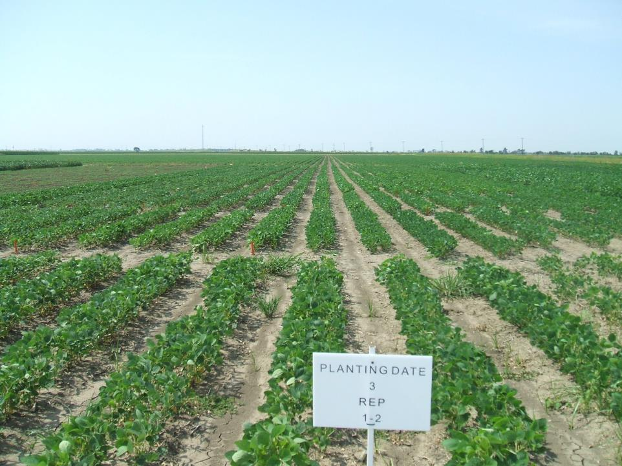
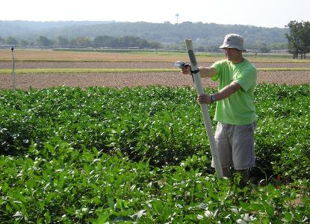
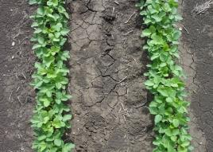
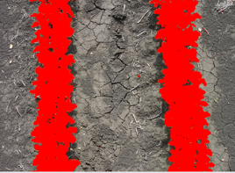
Light interception study by PD x MG x Row spacing
3 locations in AR, 2 years, 4 planting dates, MG 3 to 6
Narrow rows (18 inch)
Twin rows (7 inch on 38 inch beds)
Light
Light
Estimation of light interception from digital images of the crop canopy (Purcell, 2000)

Slide 21
Light interception study
Fraction of light interception described as a function of cumulative thermal time (T_{base} = 50°F)
Narrow row spacing
Full canopy in 1215 ºF days (~51 calendar days)
Twin row spacing
Full canopy in 1634 ºF days (~68 calendar days)

Slide 22
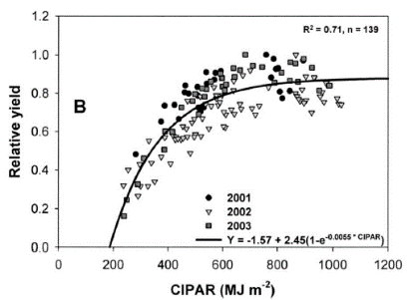
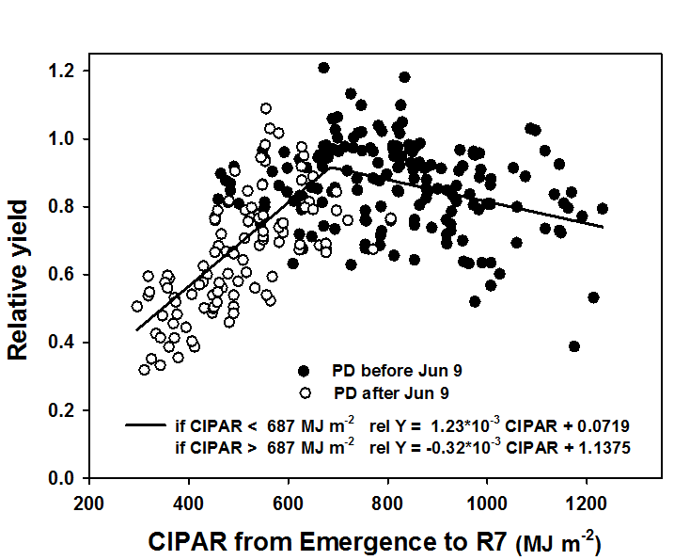
Light interception study
Can intercepted solar radiation explain yield differences?
Previous studies in Arkansas
(Edwards et al, 2005)
PD x MG study, 2 years, 3 locations AR
“Late” PD
light is limiting
“Early” PD
light non-limiting
yield decrease
650 MJ m⁻²
for 90% of max. yield
CIPAR: Cumulative intercepted photosynthetically active radiation, MJ m⁻²

Slide 23

Light interception study
  Simulation study: Location x PD x MG x Row spacing
  2 locations in AR, 30-yr weather data
  PD from March to July
  MG 3 to 6
  Narrow (47 cm) and Twin rows (19 cm on 97 cm beds)
  Total of n = xx scenarios
  Estimation of phenology with DSSAT – CROPGRO – Soybean
  Estimation of light interception from thermal time (experimental equations)
  Analysis of fraction of light interception (FLI) and total CIPAR

Slide 24
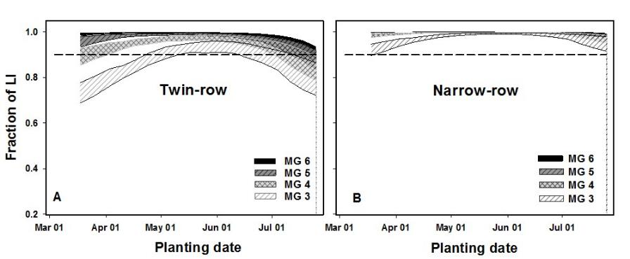
Light interception study
Fraction of light interception (LI) at R5 (Fayetteville, AR)
Identify managements with high risk of incomplete full canopy by R5
Can be site-specific

Slide 25
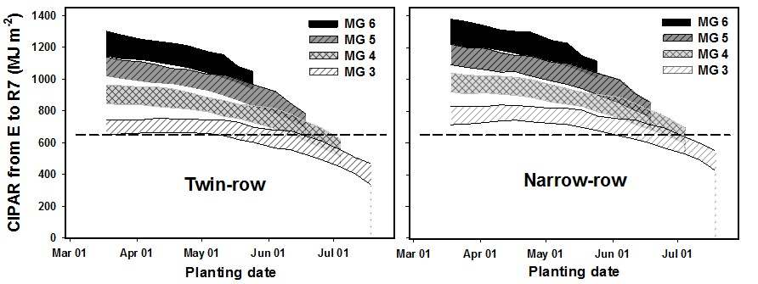
Light interception study
Total intercepted PAR (CIPAR) from emergence to R7
CIPAR for 90%
of max yield
CIPAR >> 650 MJ m⁻² might not be beneficial
Possible yield decrease
Irrigation needs and costs will increase
Unnecessary long growing season
Potential yield increase in late PD with late MG

Slide 26
Light interception study
Other factors influencing yield – Temperature during critical periods
T. during flowering
(R1 to R5)
Lower T favor seed set and seed size
T. during seed fill
(R5 to R7)
Low T during seed fill
reduces yield in late MG
Higher T favor seed growth rate

