Slide 1



What Maturity Group to Plant - When and Where
Larry Purcell, Michael Popp, and Montserrat Salmeron
(lpurcell@uark.edu)
MSSB Meeting
January 12, 2016
Memphis, TN

Slide 2
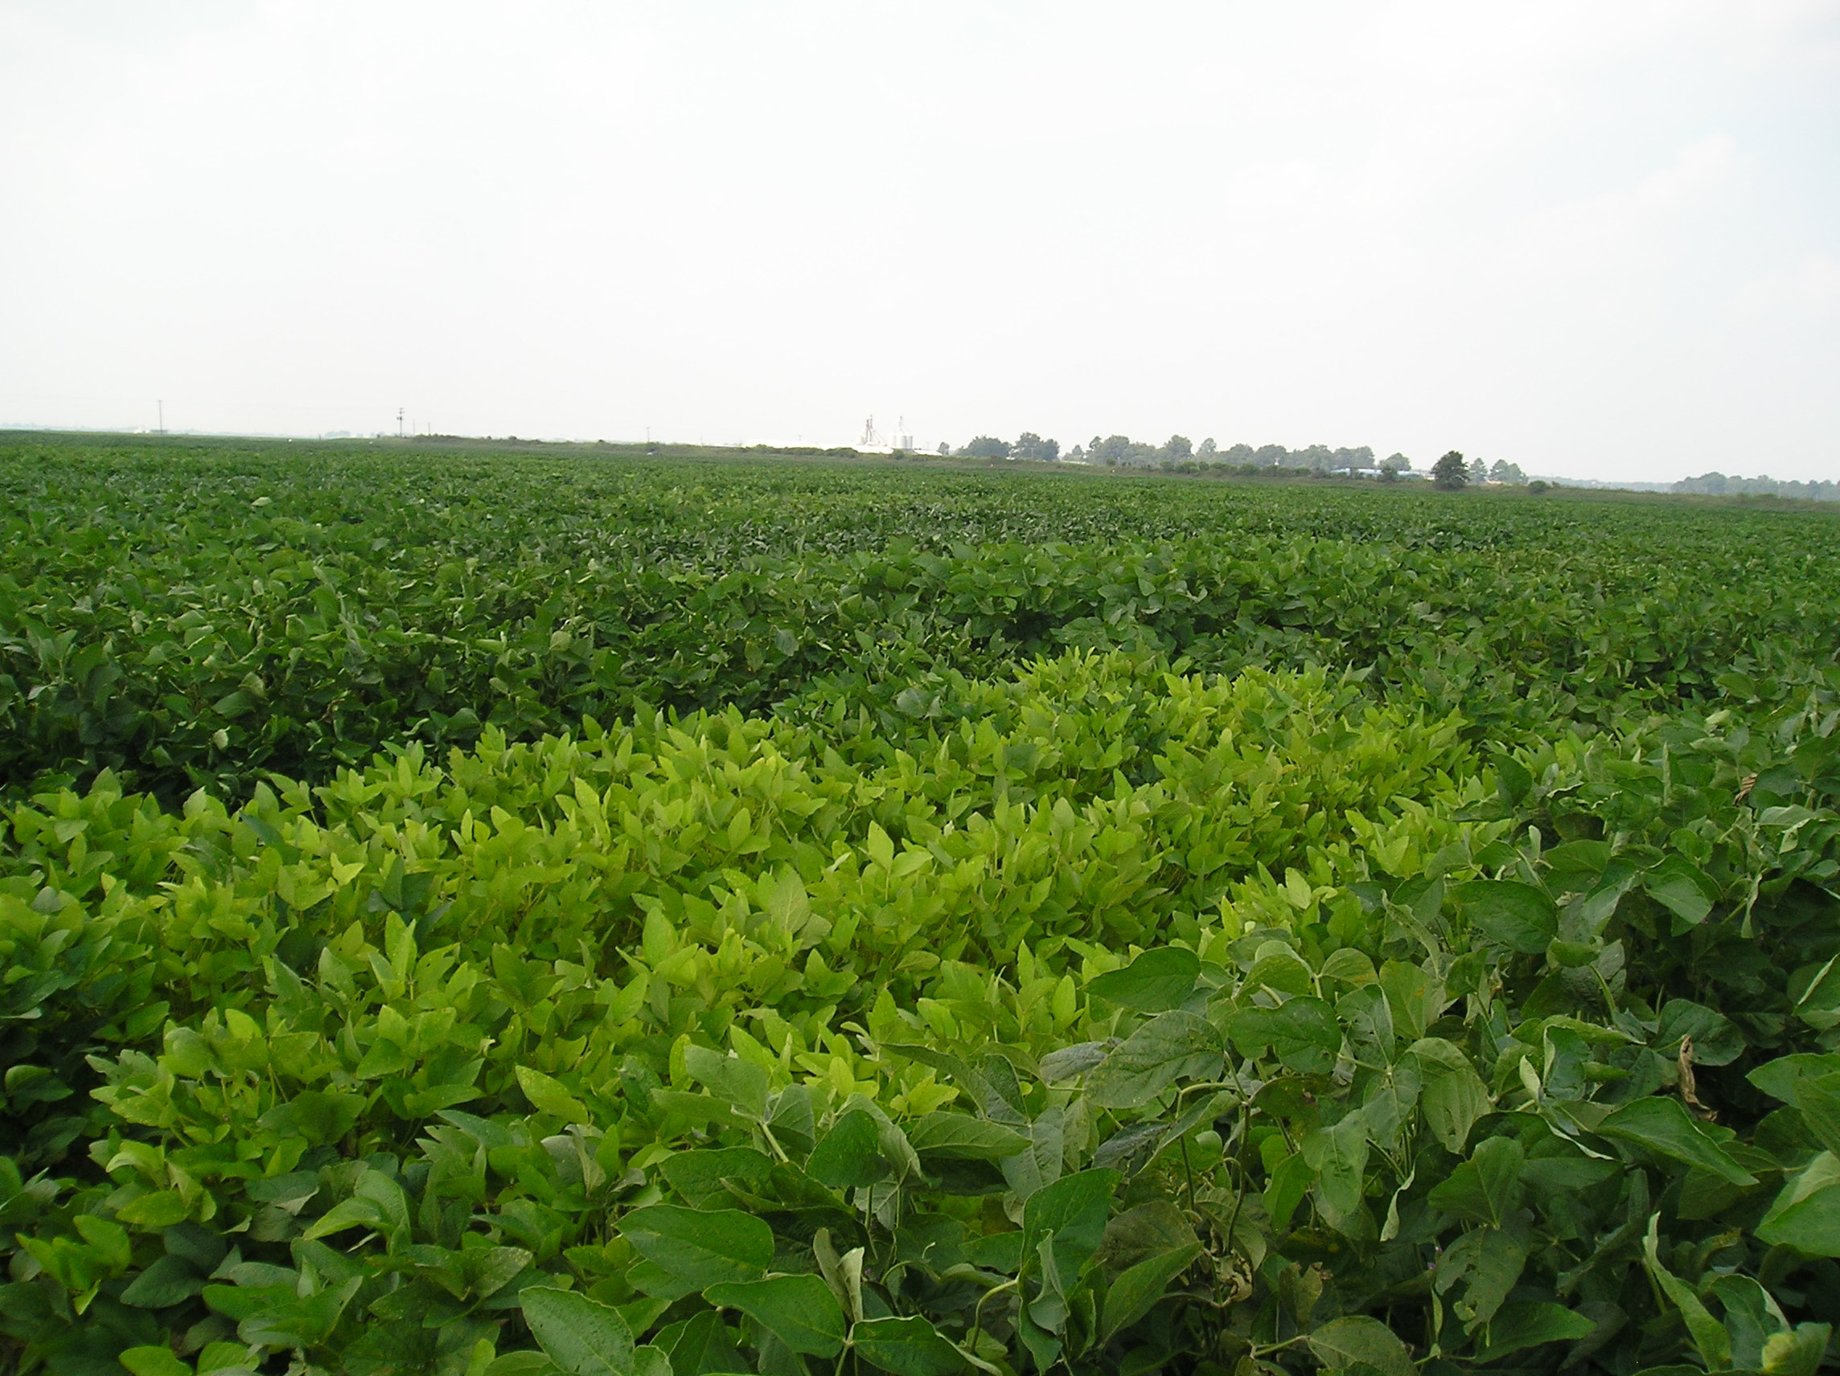

Outline
Project description
Yield results 2012 – 2014
Economics
Modeling
Decision-support tool

Slide 3
Project Description
3-year study (2012-14)
10 locations
Irrigated
4 planting dates (PD)
MG 3 to 6 soybeans (16 cultivars)
( > 6000 plots)
❶ Columbia, MO
❷ Portageville, MO
❸ Fayetteville, AR
❹ Keiser, AR
❺ Milan, TN
❻ Verona, MS
❼ Rohwer, AR
❽ Stoneville, MS
❾ St. Joseph, LA
❿ College Station, TX
Participants: ❶ Felix Fritschi, Bill Wiebold; ❷ Earl Vories, Grover Shannon; ❸ Larry Purcell, Montse Salmeron, Ed Gbur; ❹ Fred Bourland; ❺ David Verbree, Angela McClure; ❻ Normie Buehring; ❼ Larry Earnest; ❽ Bobby Golden; ❾ Josh Lofton; ❿ Travis Miller, Clark Neely, Daniel Hathcoat

Slide 4
At all locations, we measured:
Yield
Seed quality (AA, germ, grade, oil/protein)
Developmental stages
Stand counts, plant height, node number
Lodging, shattering, green stem

Slide 5
Outline
Project description
Yield results 2012 – 2014
Economics
Modeling
Decision-support tool

Slide 6
Average Yield Response Over Locations
MG 4 and MG 5 soybeans were the best choices for early plantings.
MG 4 best choices for late plantings, followed by MG 3 soybeans.
Salmeron et al. 2014. Agron. J. 106:1893

Slide 7
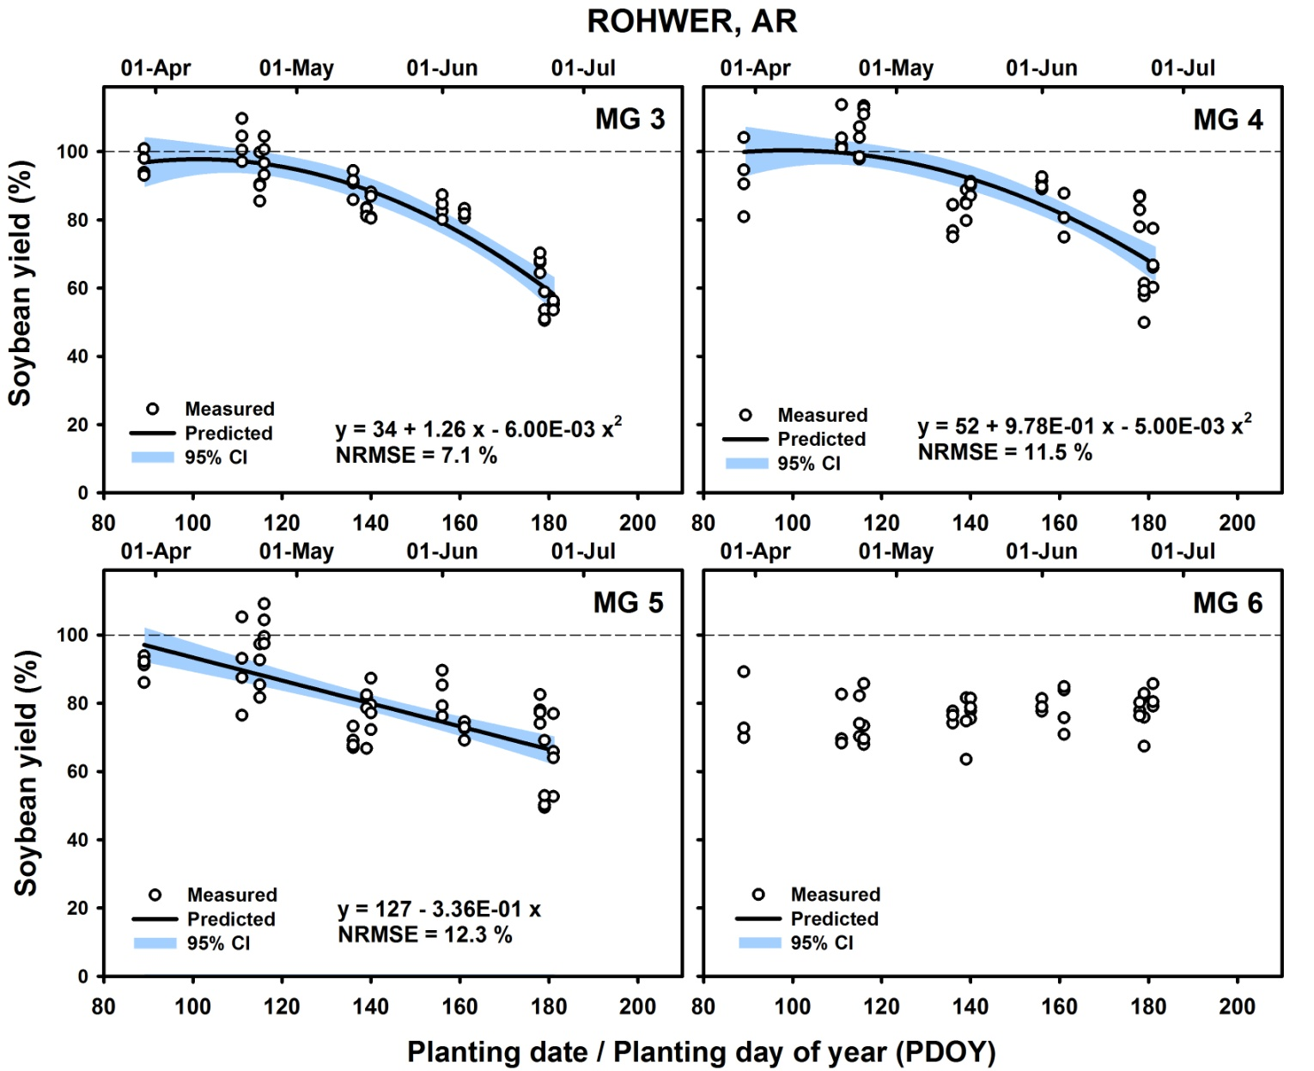
Yield Response by Location
Salmeron et al. 2016. Crop Sci. (in press)

Slide 8
Yield Response by Location
Day of
Location MG RelY_{max} RelY_{max} Apr 1 Apr 15 May 1 May 15 Jun 1 Jun 15
Rohwer 3 0.98 11-Apr 0.97 a 0.98 a 0.95 a 0.91 a 0.82 a 0.72 b
4 1.00 9-Apr 1.00 a 1.00 a 0.98 a 0.94 a 0.87 a 0.78 a
5 0.97 30-Mar 0.96 a 0.92 b 0.86 b 0.82 b 0.76 b 0.71 b
6 0.79 - 0.74 b 0.75 c 0.76 c 0.77 c 0.77 b 0.78 a
Salmeron et al. 2016. Crop Sci. (in press)

Slide 9
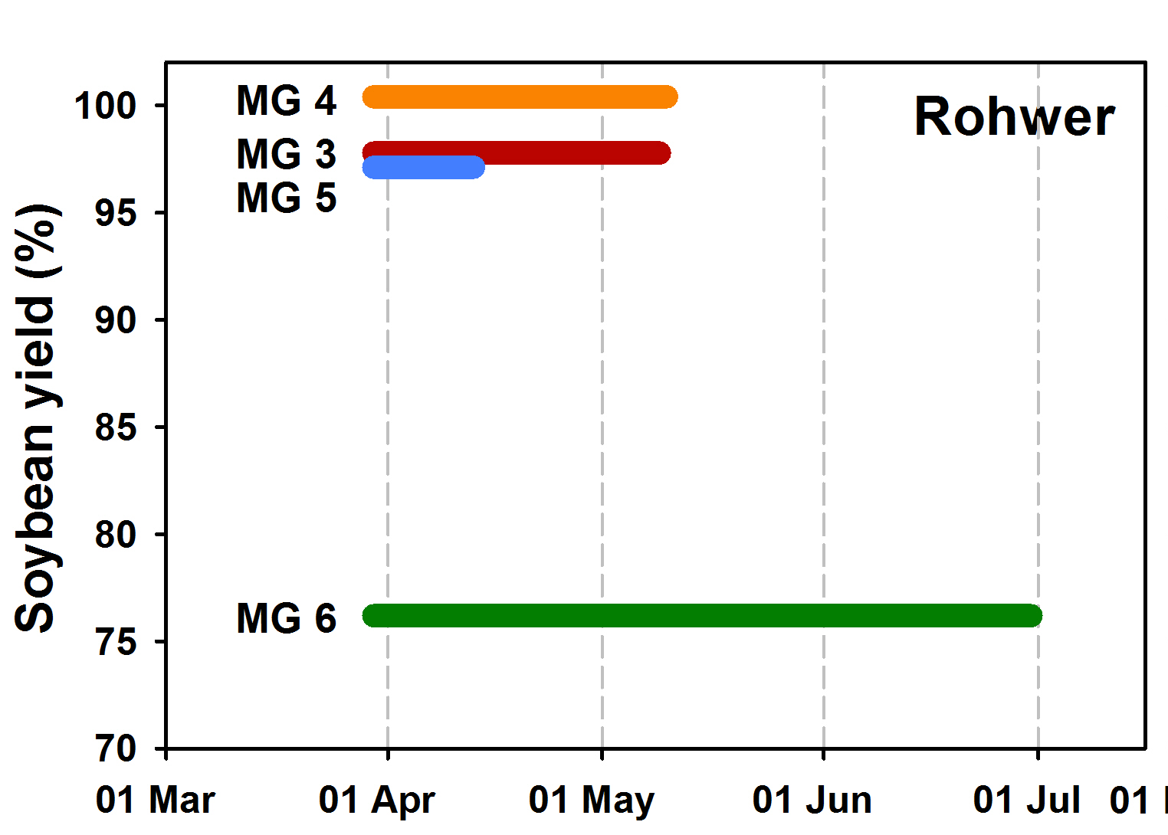
Optimum Planting Window

Slide 10
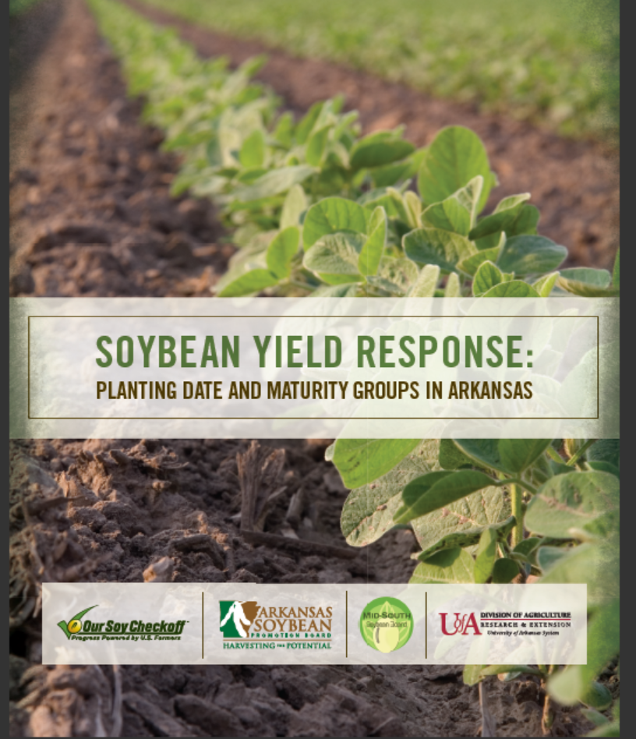
Planting date x MG management guide by state.
Guide for Arkansas available at MidSouth Soybean Board’s and Arkansas Soybean Board’s websites.
Other states available soon.
Limited number of hardcopies available in back.

Slide 11
Outline
Project description
Yield results 2012 – 2014
Economics
Modeling
Decision-support tool

Slide 12
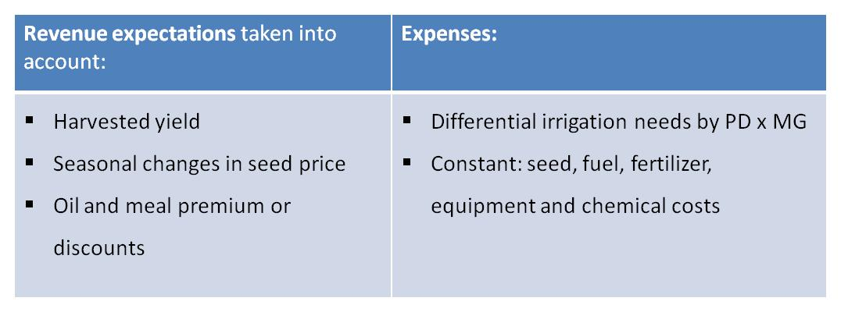
Identify PD x MG combinations that reduce production risks as opposed to planting only the profit-maximizing PD x MG selection.

Slide 13
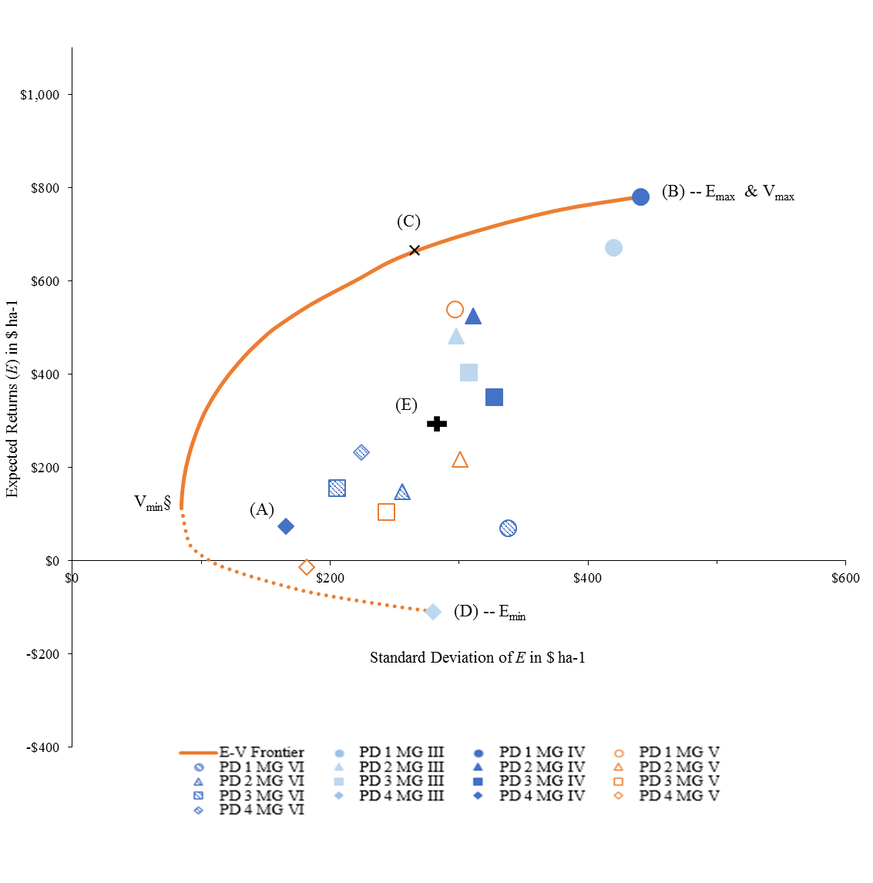
Expected returns vs. return risk at Rohwer, AR.
Highest expected returns for MG 4 at first planting date
Greatest risk also for MG 4 at first planting date
By combining different MGs and planting dates, risk can be greatly decreased while returns are only slightly decreased
Weeks, Popp, Purcell et al. 2016. Field Crops Res. (in review)

Slide 14
Expected returns vs. return risk at Rohwer, AR.
MG 3, PD1, 21%
MG 4, PD1, 39%
MG 5, PD1, 12%
MG 3, PD2, 7%
MG 4, PD2, 21%
MG 4, PD1, 100%
Returns: 16% decrease
Risk: 41% decrease

Slide 15
Outline
Project description
Yield results 2012 – 2014
Economics
Modeling
Decision-support tool

Slide 16

Decision Support System for Agrotechnology Transfer
What is a crop model?
Predicts crop growth for each day throughout season
Uses daily weather data
Uses soil characteristics
Predicts yield, development stages based upon crop characteristics
Once calibrated, models can predict responses to different ‘what ifs’…
Our approach:
Calibrate CropGro model using data from all locations for 2012 and 2013 (4480 observations)
Compare predicted vs observed results using independent data from 2014 (2368 observations)

Slide 17
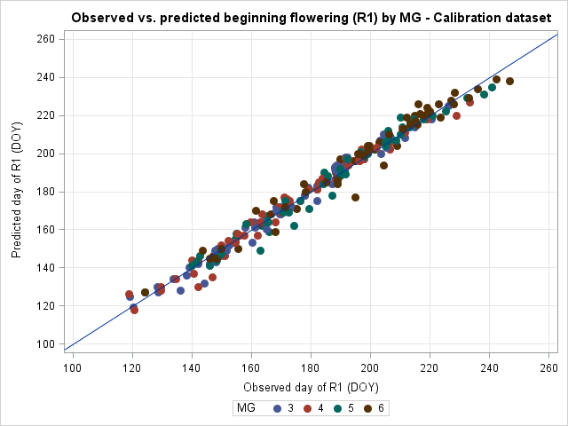
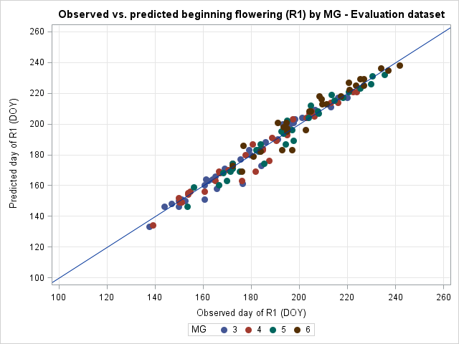
Model Prediction for R1
Calibration
Evaluation

Slide 18
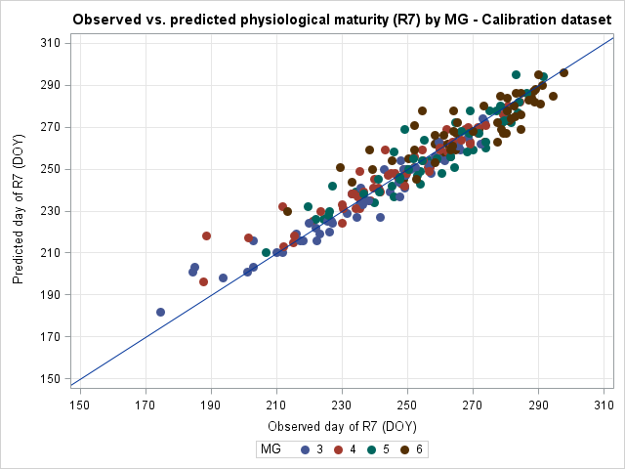
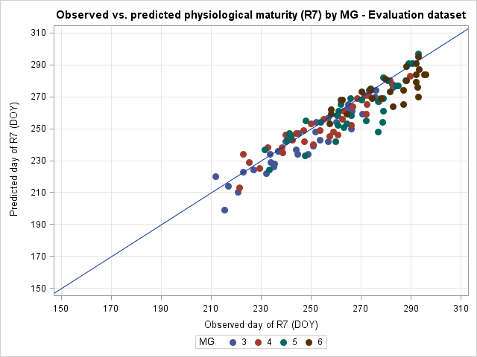
Model Prediction for R7
Calibration
Evaluation

Slide 19
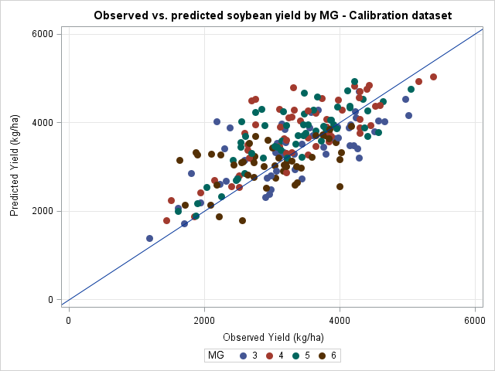
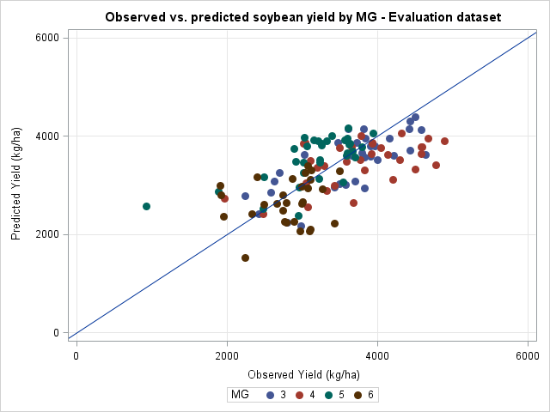
Model Prediction for Yield
Calibration
Evaluation

Slide 20
Outline
Project description
Yield results 2012 – 2014
Economics
Modeling
Decision-support tool

Slide 21

Decision Support Tool Development
Collect daily weather data from 30 years from 11 locations in the MidSouth
Run model simulations for:
  MGs 3 through 6 in half-MG intervals
  weekly planting dates from Mar 15 to June 30 (16 weeks)
  30 years
  11 sites between 29 and 39ºN
  total of 73,920 simulations
Create interface in Excel that allows user to make comparisons among these 73,920 predictions

Slide 22
SOYMAP is available online for downloading
http://agribusiness.uark.edu/decision-support-software.php
Link available to this site from MSSB’s and ASPB’s websites

