Slide 1


Feed Grains Impact on Soybean Yields - Update
Bobby R. Golden
Delta Research and Extension Center
662-769-0274
bgolden@drec.msstate.edu
www.mississippi-crops.com
Twitter: @BobbyRGolden or @DeltaSoil

Slide 2
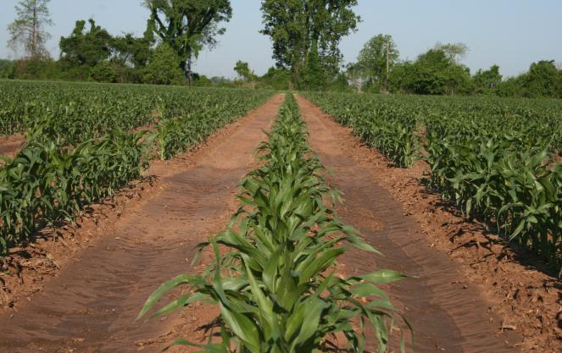
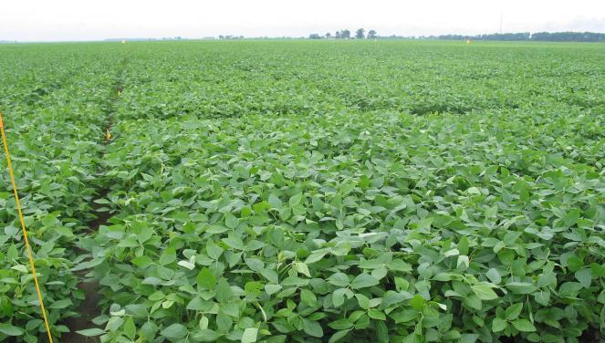
Rational and Justification
The dramatic increase in corn acreage in the Mid-South and the resulting agronomic and economic impact of incorporating corn into Mid-South soybean production systems.
The unique problems and management issues that may result from a rotational system of soybean and grain crops, and the incorporation of wheat in a double-cropping production scheme.

Slide 3
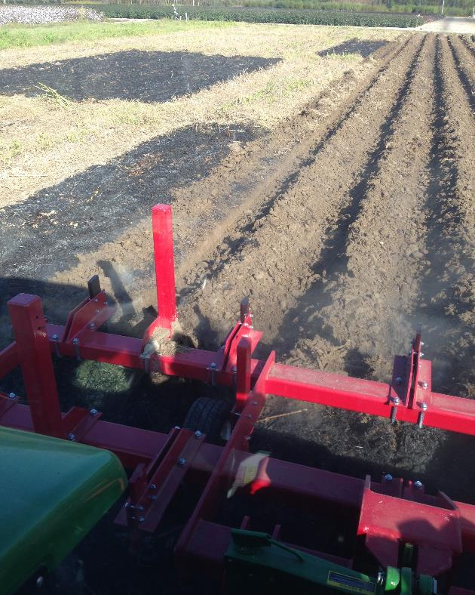
Rational and Justification
Numerous research out of the Midwest suggests that both corn and soybean benefit as a rotation partner.
Does this hold true in Southern U.S. Climates when cultivation occurs on low organic matter soils
Overall lack of long term rotational research with Corn in the Mid South.

Slide 4
Treatments

Slide 5
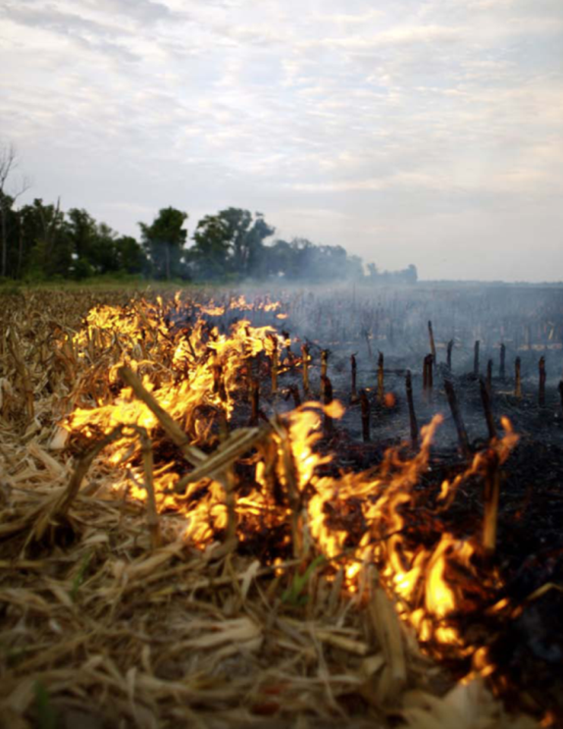
Why are we interested in Residue Management?
How we handle corn stubble may influence our overall soil quality.
Residue management may have a distinct effect on soil test sulfur.
Corn residue management may impact soybean yield

Slide 6
Soybean Baseline Yield
Location | Latitude | Mean Soybean grain yield
 |  | Irrigated | Rainfed
 |  | - - - - - - - - -Bushels/acre- - - - - - - - -
Stoneville | 33.4 | 67 | 58
Portageville | 36.4 | 68 | 64
St. Joseph | 32.0 | 63 | 66
Pine Tree | 35.0 | 72 | 54
Newport | 35.3 | 28 | 18
Brooksville | 33.1 | 51 | 50
LSD_{0.5} |  | 4.0
P-value |  | <0.0001
Soybean yields were greatly influenced by irrigation in 2014, even with all the rainfall. Low yields at Newport location were directly attributed to vast amounts of rainfall and drainage. Texas results were not included due to Dicamba drift contamination

Slide 7
Corn Yield Baseline Yield
Location | Latitude | Mean corn grain yield
 |  | Bushels/acre
Stoneville | 33.4 | 248
Portageville | 36.4 | 239
College Station | 30.3 | 212
St. Joseph | 32.0 | 194
Pine Tree | 35.0 | 167
Newport | 35.3 | 110
Brooksville | 33.1 | 103
LSD_{0.5} |  | 9.0
P-value |  | <0.0001
No Statistical response was observed to irrigation for corn in 2014. Low corn yields at Newport and Brooksville were due to vast amounts of rainfall and drainage issues.

Slide 8
Grain Sorghum Baseline Yields
Location | Latitude | Mean corn grain yield
 |  | Bushels/acre
College Station | 30.3 | 137
Portageville | 36.4 | 118
Pine Tree | 35.0 | 91
Brooksville | 33.1 | 65
St. Joseph | 32.0 | 57
Newport | 35.3 | 18
LSD_{0.5} |  | 13.0
P-value |  | <0.0001
No Milo was harvested in 2014 at Stoneville due to severe damage from sugarcane aphid. Low corn yields at Newport were do to abundant rainfall

Slide 9
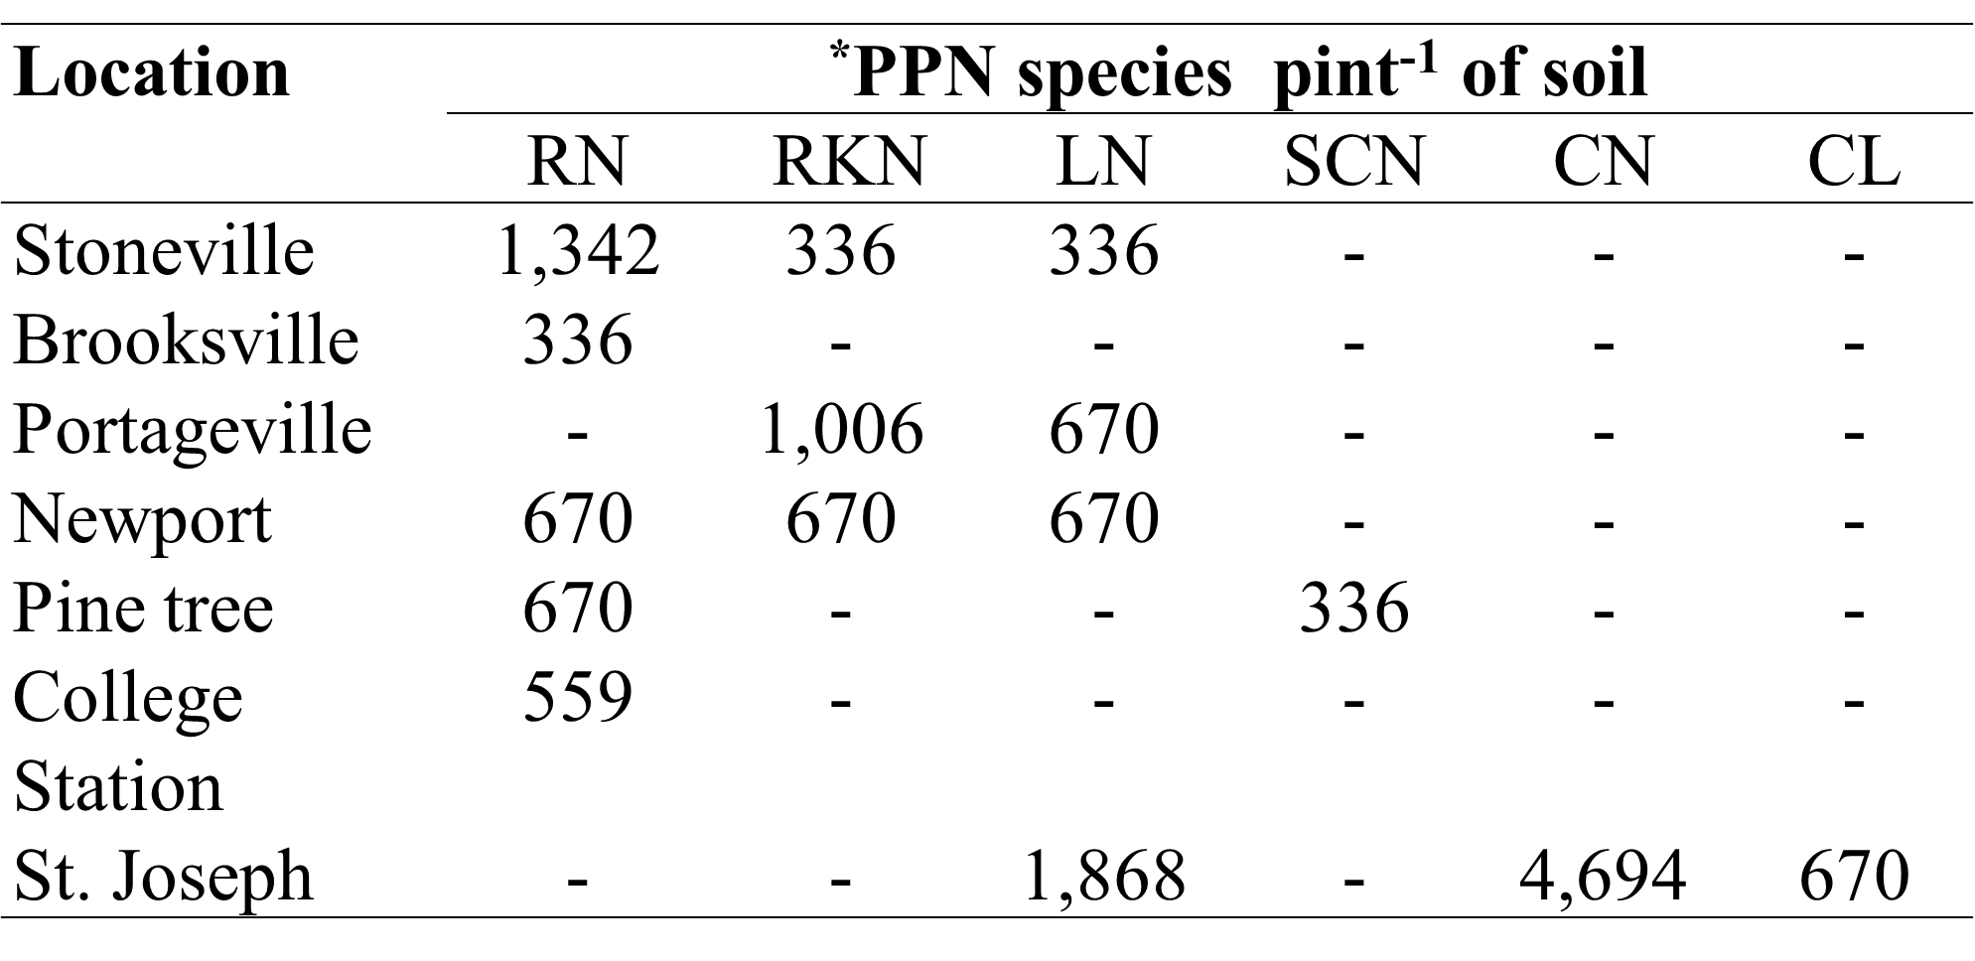
Baseline Nematode Values

Slide 10
2015 Corn Yields – Irrigation and Residue Management
Location | Latitude | Level of irrigation
 |  | Irrigated |  | Rain fed
 |  | Burn | No Burn | Burn | No Burn
Stoneville | 33.4 | 187 | 185 | 149 | 131
Portageville | 36.4 | 153 | 117 | 129 | 119
St. Joseph | 32.0 | 183 | 162 | 135 | 111
Pine Tree | 35.0 | 140 | 151 | 111 | 105
Newport | 35.3 | 149 | 152 | 131 | 118
Brooksville | 33.1 | 89 | 83 | 89 | 93
College Station | 30.3 | 111

Slide 11
2015 Soybean Yields – Irrigation and Residue Management
Location | Latitude | Level of irrigation
 |  | Irrigated |  | Rain fed
 |  | Burn | No Burn | Burn | No Burn
Stoneville | 33.4 | 68 | 70 | 36 | 37
Portageville | 36.4 | 64 | 71 | 50 | 50
St. Joseph | 32.0 | * | * | 26 | 23
Pine Tree | 35.0 | 45 | 44 | 19 | 22
Newport | 35.3 | 54 | 54 | 45 | 46
Brooksville | 33.1 | 43 | 42 | 40 | 38
College Station | 30.3 | * | 20.2 | * | 26.2

Slide 12
2015 Milo Yields – Irrigation and Residue Management
Location | Latitude | Rain fed
 |  | Burn | No Burn
Stoneville | 33.4 | 63 | 38
Portageville | 36.4 | 87 | 87
St. Joseph | 32.0 | 75 | 95
Pine Tree | 35.0 | 82 | 72
Newport | 35.3 | 70 | 68
Brooksville | 33.1 | 77 | 71
College Station | 30.3 | 114 | 117

Slide 13
2015 Soil Test Baseline – Post 2014 Crop Cycle
Location | Lat. | Soil Test Value (ppm)
 |  | pH | Ca | Mg | P | K | S | Zn
Stoneville | 33.4 | 6.4 | 2073 | 358 | 29 | 241 | 4.4 | 2.8
Portageville | 36.4 | 6.1 | 962 | 109 | 47 | 119 | 3.2 | 2.8
St. Joseph | 32.0 | 5.2 | 1465 | 224 | 31 | 126 | 10.9 | 1.7
Pine Tree | 35.0 | 6.4 | 1679 | 351 | 17 | 92 | 12.4 | 4.0
Newport | 35.3 | 5.8 | 1302 | 121 | 112 | 148 | 13.0 | 4.4
Brooksville | 33.1 | 6.7 | 5810 | 84 | 4 | 113 | 9.7 | 1.09
College St. | 30.3 | 8.1 | 6135 | 455 | 42 | 311 | 12.7 | 1.05

Slide 14
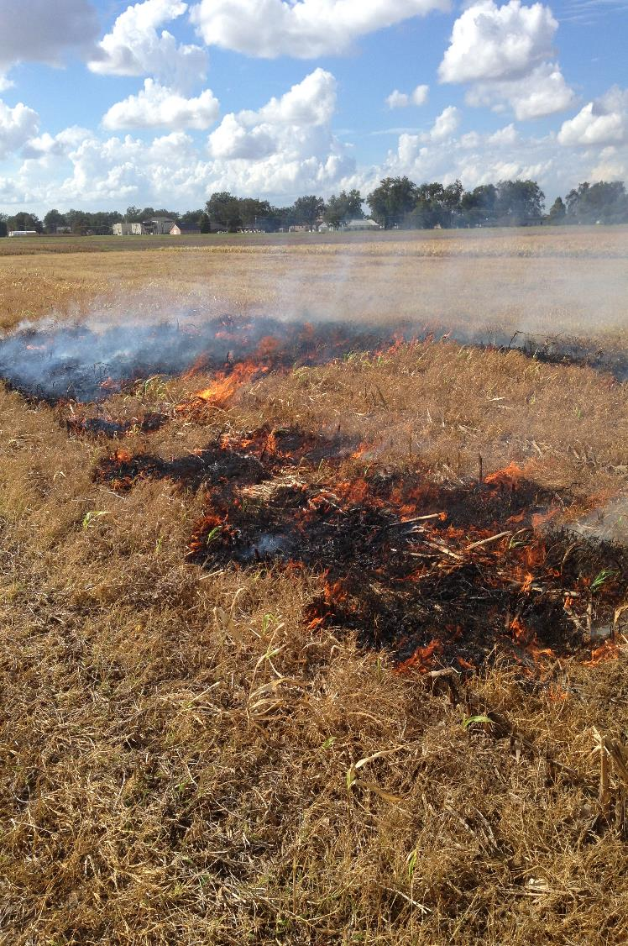
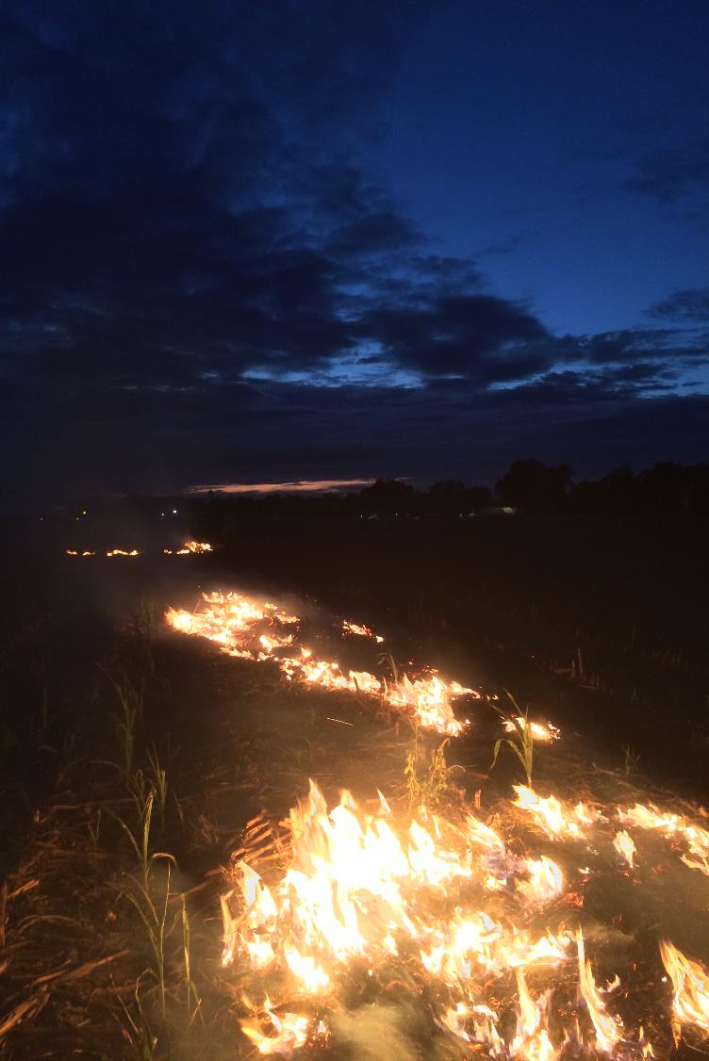

Slide 15
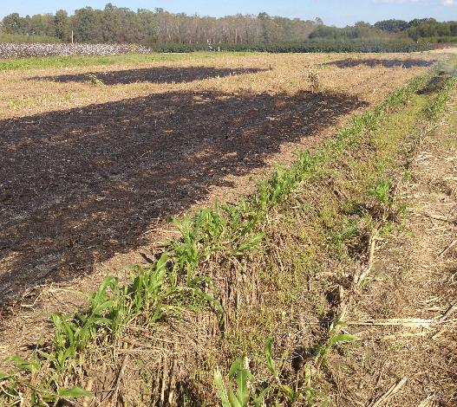
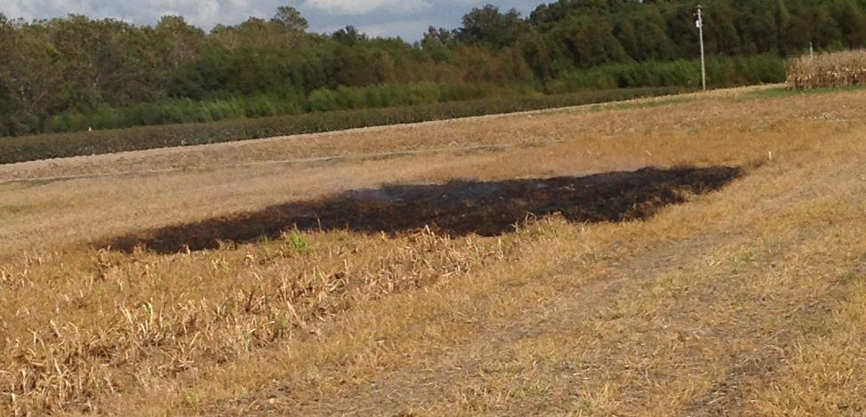
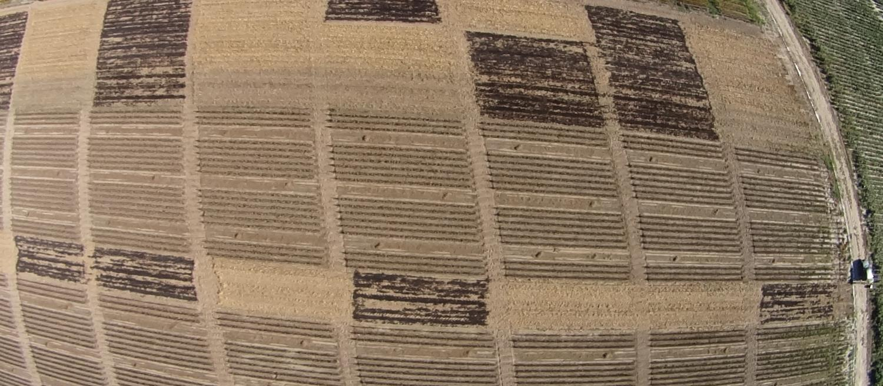

Slide 16
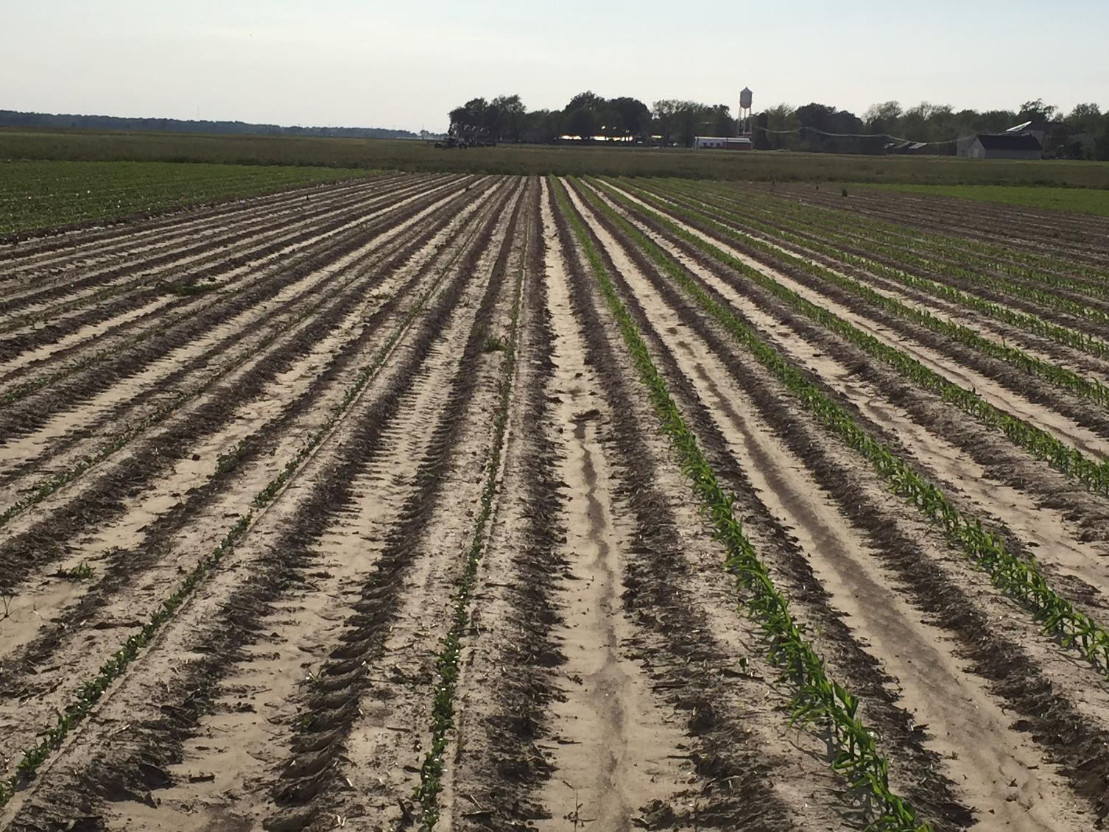

Slide 17
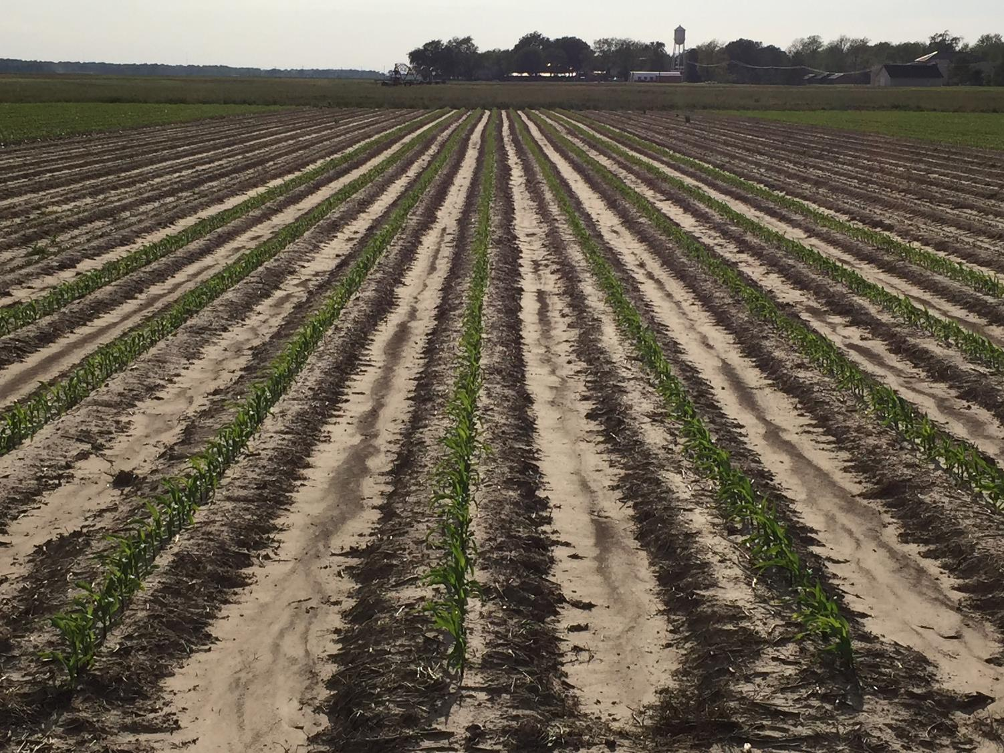

Slide 18
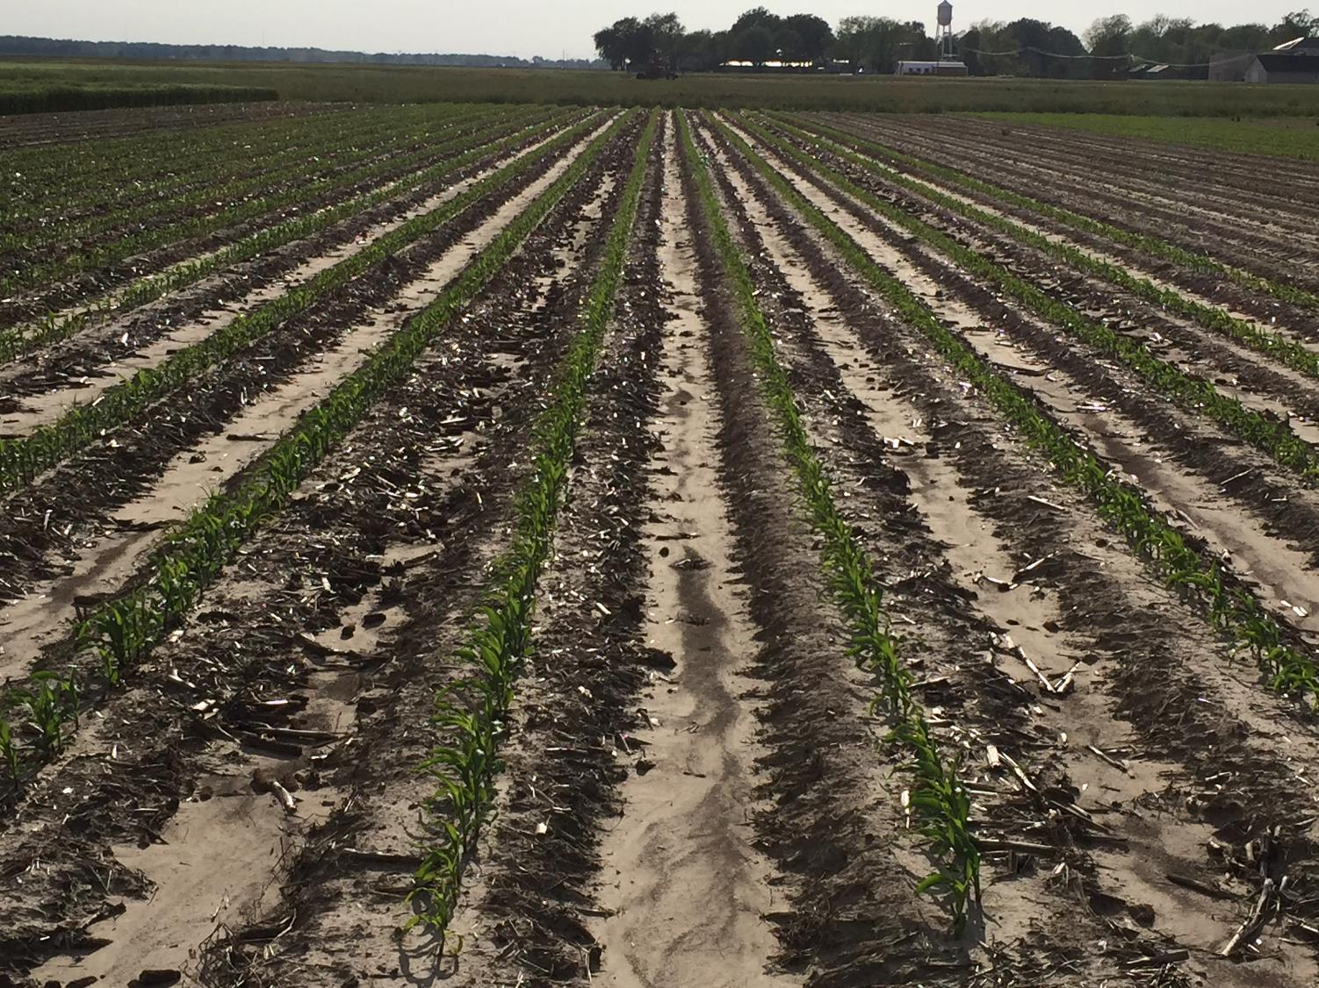

Slide 19
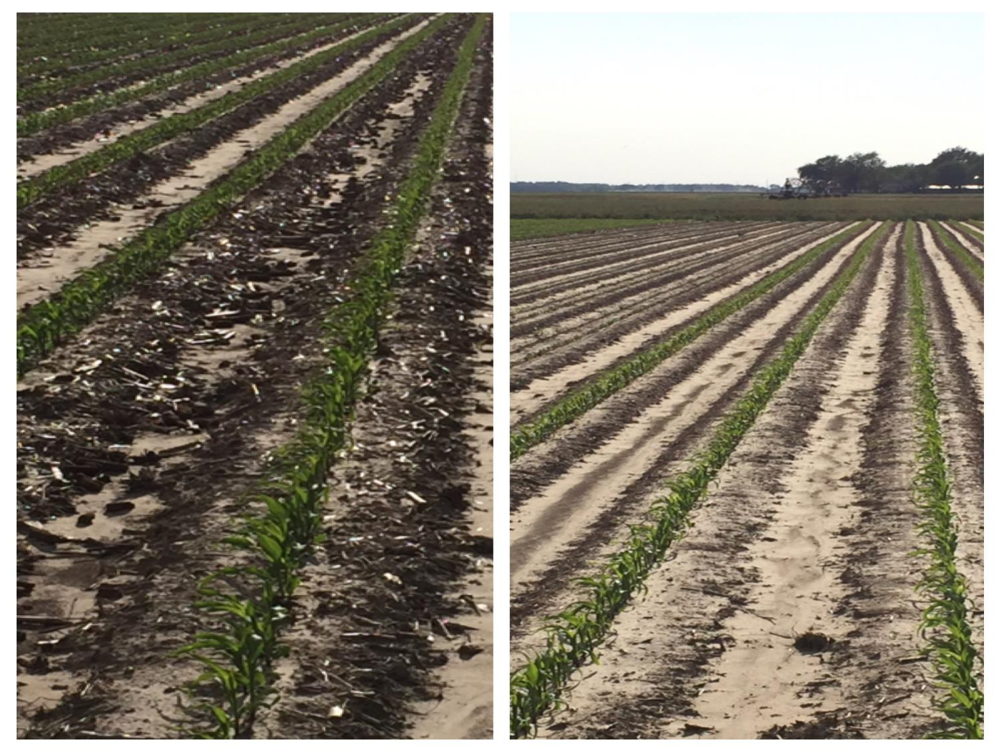

Slide 20
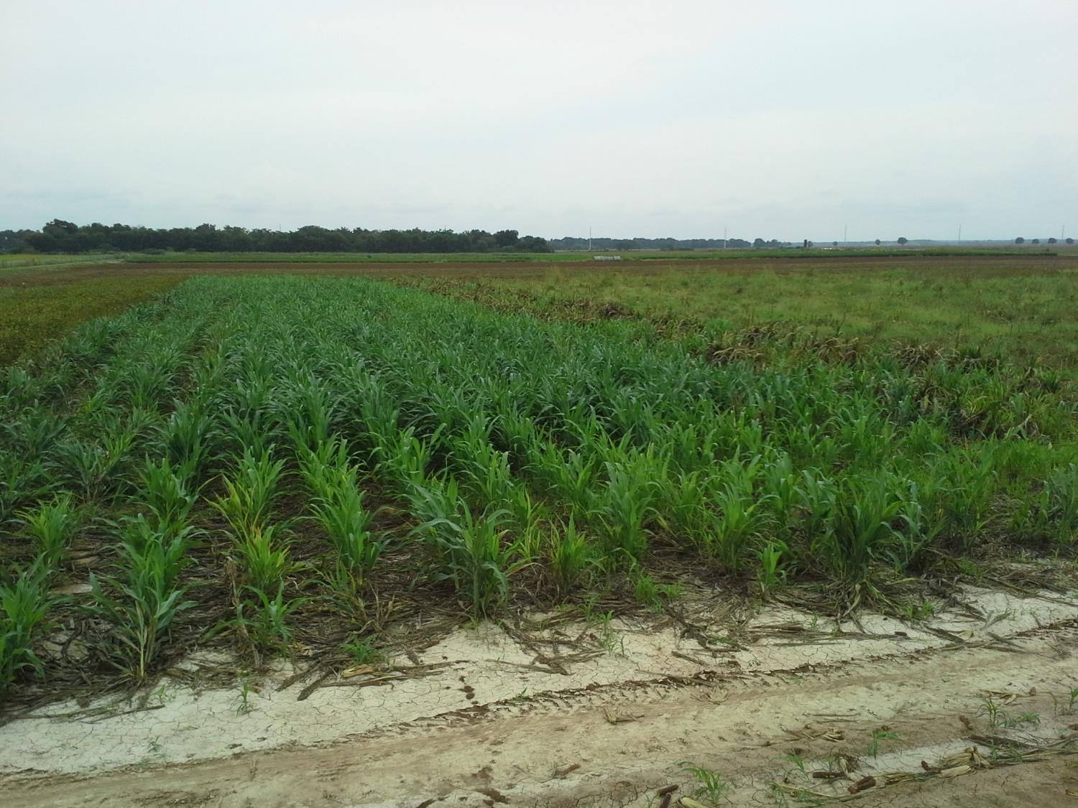

Slide 21




A group Effort

Slide 22
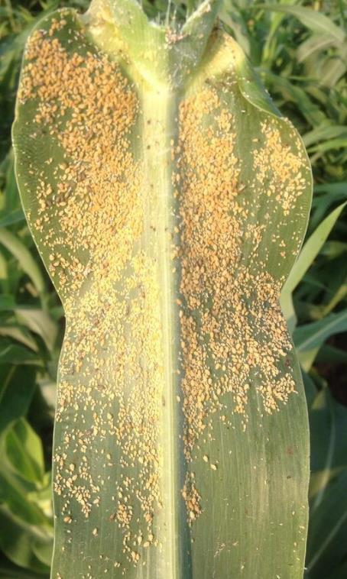
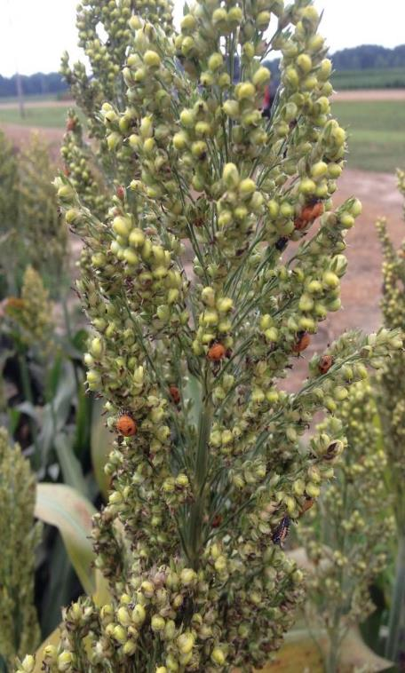
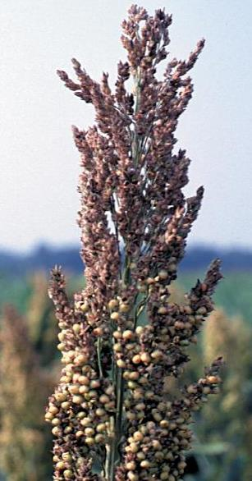
Year 1 Production Issues – Greater Mid-South

Slide 23
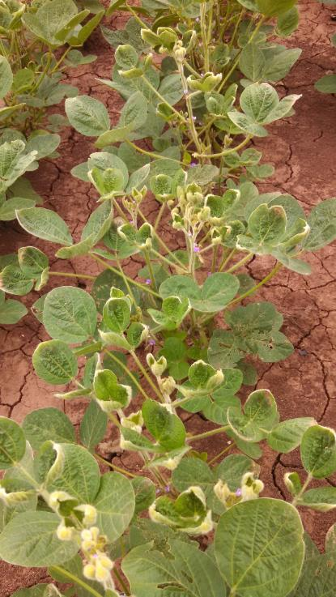
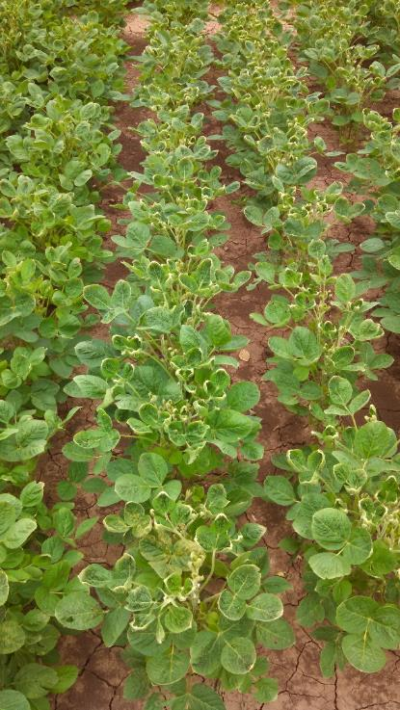
Year 1 Production Issues - Texas

